Slide 1

The Female & Male
Reproductive Systems
Lesson 20

Slide 2
Puberty – the stage of growth and development when both the male and female become capable of producing offspring.
In females this can be between 8-15 years old.
Pituitary gland increases its production of FSH. Follicle stimulating hormone causes ovaries to secrete estrogen, a hormone that stimulates the development of secondary sex characteristics and affects the menstrual cycle. Secondary sex characteristics are physical and emotional changes that occur puberty.
In males this usually happens between 12 -15 years old.
Pituitary gland increases its production of LH. Luteinizing hormone travels through the bloodstream to the testes and causes them to secrete testosterone, a hormone that produces the male secondary sex characteristics.

Slide 3
Secondary Sex Characteristics
Female
Increase in height
Widening of the hips
Softer & smoother skin
Growth of pubic & underarm hair
Increase in breast size
Enlargement of external genitalia
Formation of mature ova
Beginning of menstruation
Male
Increase in height
Longer and heavier bones
Broader shoulders
Thicker and tougher skin
Deepening voice
Growth of facial, pubic, and body hair
Enlargement of penis, scrotum, and testes
Formation of sperm

Slide 4

What to Know About the Menstrual Cycle
28
The menstrual cycle or “period” usually occurs over 28 days.
Days 1-5
Menstruation occurs. At the same time, a new ovum is maturing in the ovary.
Days 6-12
The uterine lining begins to thicken. The uterus prepares for ovulation and the possibility that an ovum will be fertilized.
Days 13-14
Ovulation occurs. A follicle in an ovary bursts and an ovum is released into one of the Fallopian tubes.
Days 15-20
The corpus luteum secretes hormones to support a pregnancy. The corpus luteum is a temporary gland that secretes progesterone. It is formed when the remains of the burst follicle close. Progesterone is a hormone that changes the lining of the uterus in preparation to support a fertilized ovum.
Days 21-28
The corpus luteum disintegrates if an ovum is not fertilized. Progesterone is no longer secreted. The cells in the lining of the uterus die without progesterone. The unfertilized ovum disintegrates. The menstrual cycle begins again with menstruation.

Slide 5
Female Reproductive System
External Reproductive Organs
Called the vulva
Vulva consists of the mons veneris, labia majora, labia minora, clitoris, and hymen
Mons veneris is the fatty tissue that covers the front of the pubic bone and serves as a protective cushion for the internal reproductive organs
Labia majora are the heavy folds of skin that surround the opening of the vagina
Labia minora are two smaller folds of skin located within the labia majora. The clitoris and the openings of the urethra and the vagina are located within the labia minora.
Clitoris is a small structure located above the opening of the urethra.
Hymen is a thin membrane that has small openings in it and stretches across the opening of the vagina
Internal Reproductive Organs
Consists of the ovaries, Fallopian tubes, uterus, and vagina
Ovaries are female reproductive glands that produce ova and estrogen. They are situated in the lower abdomen. Females are born with between 200,000 to 400,000 immature ova. About 375 of these will mature and be released in a female’s lifetime.
Ovulation is the release of a mature ovum from one of the two ovaries.
Fallopian tube is a tube through which an ovum moves from an ovary to the uterus. A female has two Fallopian tubes that are about 4 inches long. Each tube is close to the ovary and the end is shaped like a funnel.
Uterus is a muscular organ that receives and supports the fertilized ovum during pregnancy and contracts during childbirth to help with delivery.
Cervix is the lowest part of the uterus that connects to the vagina.
Vagina is a muscular tube that connects the uterus to the outside of the body. The vagina is the female organ for sexual intercourse, the birth canal, and the passageway for the menstrual flow.

Slide 6
Other Important Things to Know
TSS or toxic shock syndrome is a severe illness that results when vaginal bacteria secrete a toxin, Staphylococcus, that gets into the bloodstream. Most cases occur in women who are using tampons. Early flu-like symptoms such as high fever, vomiting, diarrhea, dizziness, fainting, and a rash can be signs of TSS. Blood pressure may drop suddenly and complications may include kidney and heart failure and difficulty breathing. Tampons should be changed often and pads used at night.
Amenorrhea is the absence of menstruation. Some females do not begin menstruation at puberty. This type of amenorrhea may be caused by underdeveloped reproductive organs, poor general health, and/or emotional stress. Some females miss additional menstrual cycles after their first menstrual cycle. This type of amenorrhea is often caused by pregnancy, a reduction in red blood cell levels resulting from stress, overtraining, eating disorders, drastic weight loss, or anemia.
PMS or premenstrual syndrome is a combination of physical and emotional symptoms that affect a female one week to ten days prior to menstruation. Symptoms may include weight gain, mild to severe cramps, bloating, swollen breasts, headache, backache, constipation, mood swings, cravings, anxiety, and depression. To help alleviate these symptoms a female should avoid caffeine and salt and exercise. Medications can be prescribed to lessen the symptoms of PMS.
Pelvic examination is an examination of the internal female reproductive organs.
Pap smear is a screening test in which cells are scraped from the cervix and examined to detect cervical cancer. This is usually done during a pelvic exam.

Slide 7
Male Reproductive System
External Reproductive Organs
Internal Reproductive Organs
Consist of the penis and the scrotum
Penis is the male sex organ used for reproduction and urination.
Scrotum is a saclike pouch that hangs under the penis and holds the testes. The scrotum helps regulate the temperature of the testes. If it becomes too cool, the scrotum will contract, bringing the testes closer to the body for warmth. Sperm are protected in this way.
Testicles are male reproductive glands that produce sperm cells and the hormone testosterone.
Sperm are male reproductive cells. A sperm is made up of a head, which contains the nucleus of the cell; a body; and a tail.
Consist of the testes, seminiferous tubules, epididymis, vas deferens, seminal vesicles, ejaculatory duct, prostate gland, Cowper’s glands, and urethra.
Seminiferous tubules are a network of coiled tubules in which sperm are produced. The sperm are moved by contractions from the testes to the epididymis.
Epididymis is a comma shaped structure along the upper rear surface of the testes where sperm mature. Some sperm are stored here but most move to the vas deferens after they mature.
Vas deferens are two long, thin tubes that act as a passageway for sperm and a place for sperm storage. They extend from the epididymis in the scrotum up into the abdomen. The walls of the vas deferens are lined with cilia. Contractions along with the action of the cilia, help transport the sperm. The vas deferens circle the bladder and connect with the ducts of the seminal vesicles to form the ejaculatory duct.
Seminal vesicles are two elongated saclike glands at the base of the bladder that secrete a fluid rich in sugar that nourishes the sperm and helps them move. They contribute up to 60% of the fluid in ejaculate.
Ejaculatory duct is a short, straight tube that passes into the prostate gland and opens into the urethra. The urethra serves as a passageway for sperm and urine to leave the body.
Prostate gland is a gland that produces a fluid that helps keep sperm alive. The prostate gland is about the size of a chestnut, located beneath the bladder and surrounds the urethra. Without the fluid from the prostate gland, fertilization would be almost impossible because many sperm would die.
Cowper’s glands are located beneath the prostate gland. These are two small glands about the size of a pea that secrete a clear, lubricating fluid into the urethra as part of the semen.
Semen is the fluid that is released by the reproductive tract. Semen contains sperm, and fluids from the seminal vesicles, prostate gland, and Cowper’s glands.

Slide 8
Other Important Things to Know
Circumcision is the surgical removal of the foreskin from the penis. This is usually done on the second day after birth. It may reduce the risk of urinary tract infections and cancer of the penis. Males who are not circumcised should pull the foreskin back and cleanse the penis regularly to prevent smegma, a substance that forms under the foreskin consisting of dead skin and other secretions.
Inguinal hernia is a hernia in which some of the intestine pushes through the inguinal canal into the scrotum. Lifting heavy objects sometimes stresses this area and is the cause of the hernia. It can be repaired surgically.
Sterility is the inability to produce offspring.
Mumps is a viral infection. Most children are vaccinated against mumps. If a male has mumps after puberty, the virus can affect the testes. The virus causes swelling of the testes. The seminiferous tubules may be crushed and become incapable of producing sperm
Digital rectal examination – doctor’s use this to examine males for symptoms of prostate cancer, the second most common cancer in males. A major symptom is an enlarged prostate.
Testicular self-examination – a screening procedure for testicular cancer where a male checks his testes for lumps or tenderness. One of the most common cancers among males between 15 and 34. If detected early, has a high rate of cure.

Slide 9
Ways to Protect Reproductive Health
Practice abstinence
Practice good hygiene
Perform monthly self exams
Have regular checkups.
Seek medical attention when you show signs of infection.

Slide 10
Breast Self-examination
Testicular Self-examination

Slide 11
Lesson 20
5 – Minute Checks

Slide 12
Conception & Heredity
Conception is the union of an ovum and a sperm. Fertilization is another term for conception. One ovum matures and is released from an ovary each month. Once an ovum is released, it enters a Fallopian tube. As the ovum moves through the Fallopian tube, it can be fertilized if sperm are present. Conception usually occurs in the upper third of a Fallopian tube.
Heredity is the passing of characteristics from biological parents to their children. All body cells except sperm and ova contain 23 pairs of chromosomes. A chromosome is a threadlike structure that carries genes. A gene is a unit of heredity material. There are dominant and recessive genes. Some of the traits that are passed on to you from your biological parents are eye color, hair color and texture, color vision, and blood clotting.
In females the pair of sex chromosomes is identical and is called XX. Every ovum produced by a female contains an X chromosome. In males, the pair of sex chromosomes is not identical and is called XY. Sperm produced by a male contain either an X chromosome or a Y chromosome which determines a baby’s sex.

Slide 13




Male
X Y
The sex of a baby is determined by the possible combinations of the X and Y chromosomes.
When a sperm fertilizes an ovum, a full complement, or set, of 46 chromosomes (23 from the father and 23 from the mother) is present in the resulting cell.
X
Female
XX
XY
X
XX
XY

Slide 14

Multiple Births
Identical twins - monogyzotic
Fraternal twins - dizygotic
Develop from the same ovum and sperm
One fertilized ovum divides at an early stage of development and the two cells divide and develop separately
Result is twins of the same sex who have identical chromosomes and are very similar in appearance
Develop when two ova are released from an ovary and are fertilized at the same time by different sperm
May or may not be the same sex
Usually do not look alike

Slide 15
Lesson 21
5 – Minute Check

Slide 16
Diagnostic Procedures
Amniocentesis is a diagnostic procedure in which a needle is inserted through the uterus to extract fluid from the amniotic sac. The amniotic sac is a pouch of fluid that surrounds a fetus. Cells from the amniotic fluid are analyzed to determine if any genetic defects are present. The sex of the fetus may also be revealed. Amniocentesis is usually safe for both the mother and the fetus. It is recommended for women over 35 and women who are at risk for giving birth to a baby with genetic or chromosomal disorders.
Ultrasound is a diagnostic procedure used to monitor the fetus. High frequency sound waves are used to provide an image of the developing baby. Then a doctor evaluates the image. Ultrasound can be used to confirm pregnancy and to confirm that the pregnancy is within the uterus and not in the Fallopian tube (known as an ectopic pregnancy). Ultrasound can also be used to assess the size and growth of the fetus and to help a doctor diagnose any problems the mother might be having. It can also be used to reveal the sex of the fetus and if there is more than one fetus in the uterus. With ultrasound some problems can be diagnosed before birth.

Slide 17
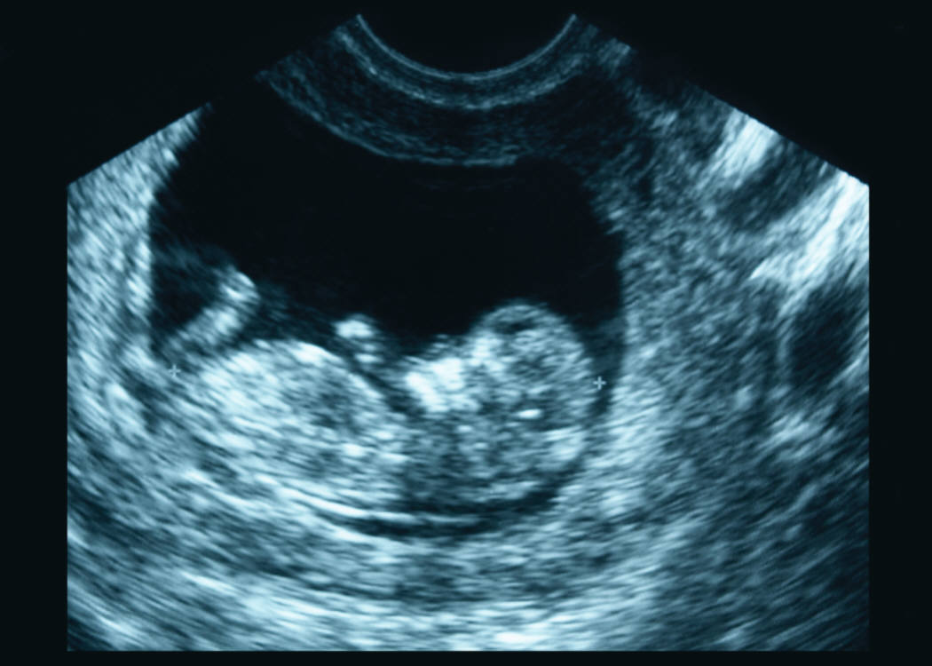

Slide 18
Pregnancy
After conception, a fertilized ovum continues to divide and move through the Fallopian tube. The cell divisions form a cluster of cells by the time they reach the uterus. These cells attach to the endometrium, which is the lining of the uterus. An embryo is a developing baby through the second month of growth after conception. A fetus is a developing baby from the ninth week after conception until birth.

Slide 19
What to Know About Pregnancy
The outer cells of the embryo and the cells of the endrometrium form the placenta. The placenta is an organ that anchors the embryo to the uterus. Other cells form the umbilical cord. The umbilical cord is a ropelike structure that connects the embryo to the placenta. The mother’s blood carries nutrients and oxygen to the embryo or fetus through the umbilical cord until birth. Waste products from the embryo move through the cord to the mother’s bloodstream to be excreted.
The first sign that indicates pregnancy is the absence of menstruation. However, a missed period doesn’t always indicate pregnancy. A pregnant female usually has other symptoms such as excessive tenderness of the breasts, fatigue, a change in appetite, and morning sickness. Some pregnant females have spotting or light, irregular menstrual flow.

Slide 20
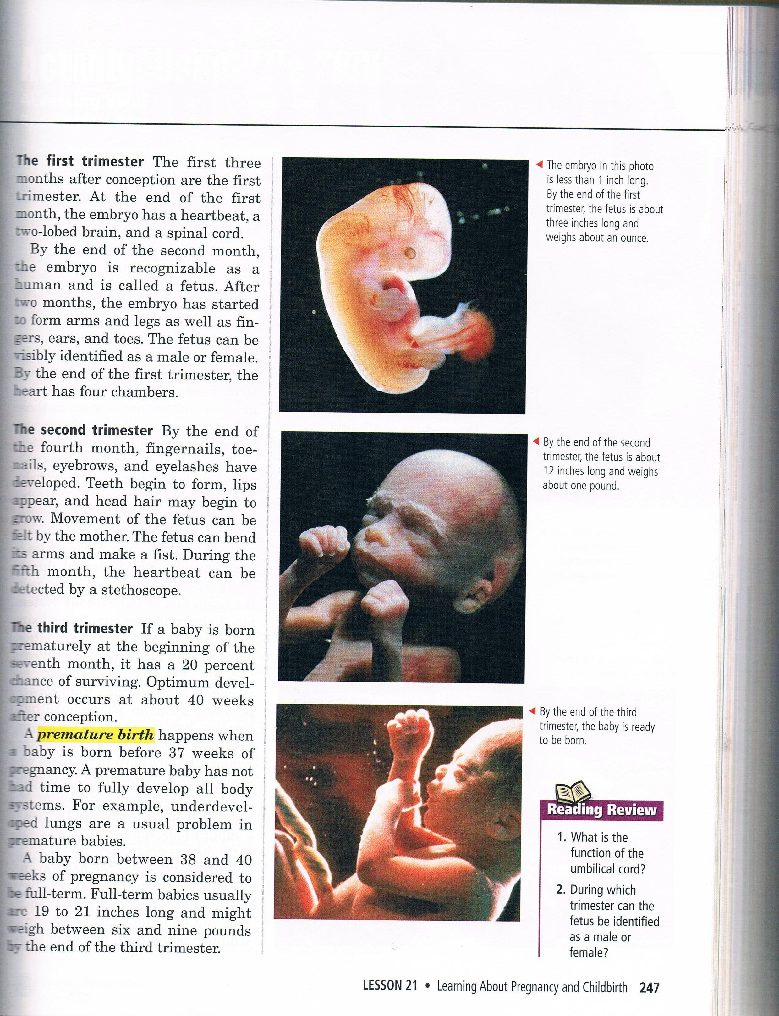

Slide 21
Prenatal Care Includes:
Routine medical examinations
Proper nutrition
Reasonable exercise
Extra rest and relaxation
Childbirth and child-care education
Avoidance of drugs and other risk behaviors
Practice of common sense

Slide 22
What to Know About Prenatal Care
Premature birth is the birth of a baby before it is fully developed – less than 37 weeks from the time of conception.
Low birth weight is a weight at birth that is less than 5.5 pounds. Premature and low birth weight are associated with mental disability and infant death.
Fetal Alcohol Syndrome (FAS) is the presence of severe birth defects in babies born to mothers who drink alcohol during pregnancy. FAS includes damage to the brain and to the nervous system, facial abnormalities, small head size, below normal I.Q., poor coordination, heart defects, and behavior problems.
Miscarriage is the natural ending of a pregnancy before a baby is developed enough to survive on its own outside the mother’s body. A stillbirth is the birth of a dead fetus.

Slide 23
Childbirth
The process of birth is called labor. During labor muscular contractions of the uterus start, become more intense, last longer, and become more frequent. The amniotic sac may rupture shortly before or after labor begins – “the water breaking.” Bloody show which is the discharge of the mucous plug that sealed the cervix during pregnancy also may be experienced.

Slide 24
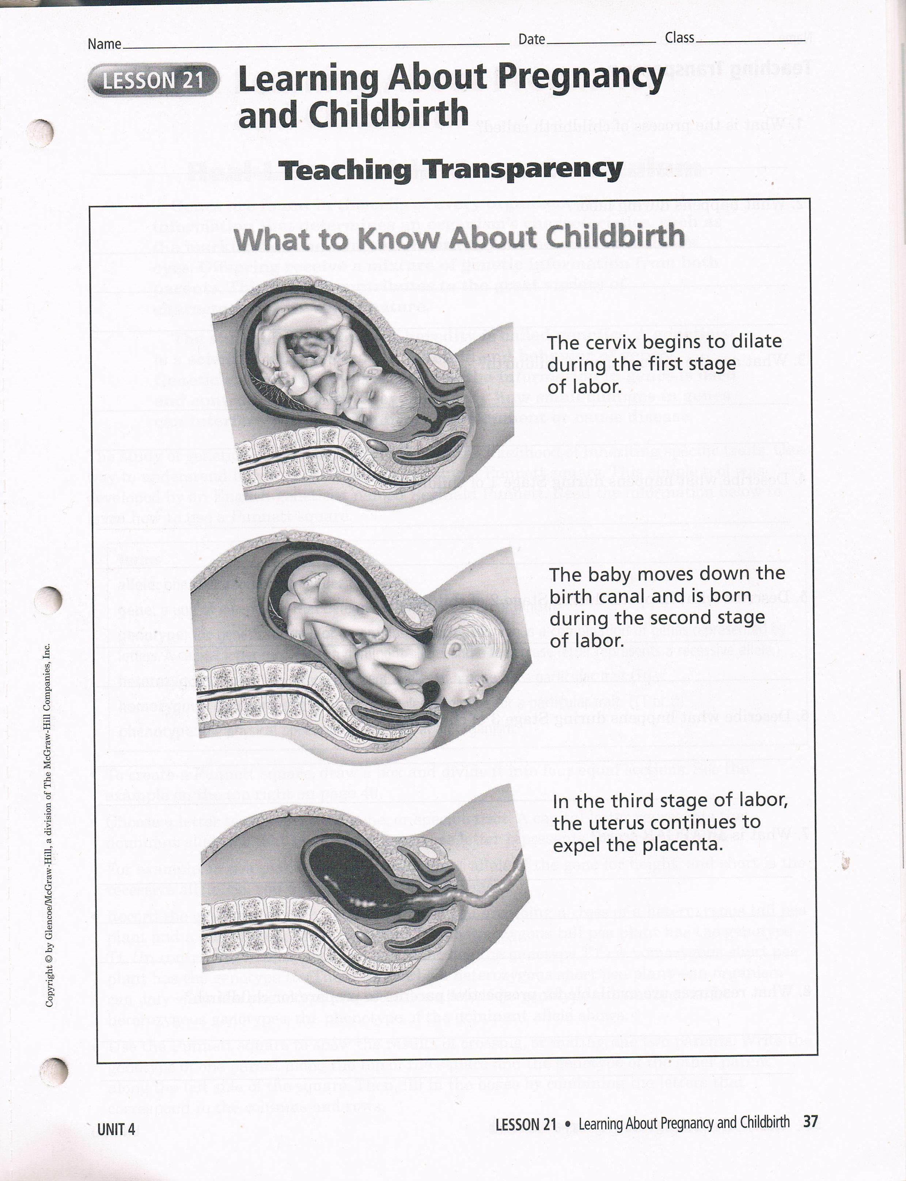

Slide 25
Complications During Pregnancy & Childbirth
Ectopic Pregnancy – is a pregnancy that occurs outside of the uterus. The embryo becomes implanted in the Fallopian tube or another location in the abdomen. This can be caused by scarring from STD’s. Symptoms include cramping, severe abdominal pain, and spotting. Surgery is often needed to remove the embryo. An ectopic pregnancy can be fatal.
RH incompatibility – a mismatch between the blood of a pregnant female and the blood of the developing baby. The mother’s blood produces an antibody that attacks a substance in the developing baby’s blood. May occur when mother’s blood is Rh negative and the developing baby’s is Rh positive. Can be treated with an injection to the mother.
Toxemia of Pregnancy - a condition characterized by a rise in the pregnant female’s blood pressure, swelling, and leakage of protein into the urine. Untreated toxemia can result in death of the female or the developing baby.
Miscarriage - the natural ending of a pregnancy before a baby has developed enough to survive on its own. Happen most often during first trimester. They may be caused by a defect in the fetus or a medical condition of the fetus or pregnant female. Signs of miscarriage include, cramping, severe pain, spotting, and bleeding.
Cesarean section - “ C” section – a surgical procedure in which a baby id removed from the mother by making an incision through the mother’s abdomen and uterus and removing the baby. This may be performed if the baby is too large to pass through the mother’s pelvis, is not positioned correctly, or the doctor determines that a vaginal delivery may be dangerous to the health of the mother or the baby. Recovery from a Cesarean section is longer than recovery from a vaginal delivery.
Stillbirth – a fully developed baby that is born dead. May be caused by a defect in the baby or a medical condition or the baby or pregnant female.

Slide 26
Lesson 21
Vocabulary Practice
&
Lesson 21 Quiz
(graded as an assignment not a quiz)

Slide 27
Journey into Life Video

Slide 28
Congratulations!
You’re a parent now.

