Slide 2
character
a recognizable inherited feature or characteristic of an organism

Slide 3
trait
a genetically determined characteristic

Slide 4
hybrid
the offspring of a cross between parents that have contrasting traits. Also known as heterozygous

Slide 5
generation
the entire group of offspring produced by a given group of parents

Slide 6
allele
one of two or more alternative forms of a gene, each leading to a unique trait

Slide 7
dominant
dominant describes an allele that is fully expressed whenever the allele is present in an individual

Slide 8
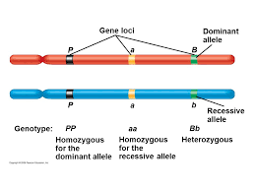
recessive
describes an allele that is expressed only when there is no dominant allele present in an individual

Slide 9
genotype
a specific combination of alleles in an individual- the LETTERS

Slide 10
phenotype
the detectable trait or traits that result from the genotype of an individual- physical description

Slide 11
homozygous
describes an individual that carries two identical alleles of a gene

Slide 12
heterozygous
describes an individual that carries two different alleles of a gene

Slide 13
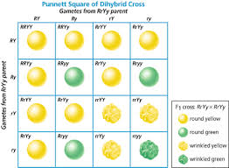
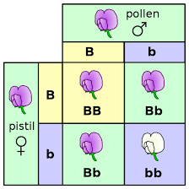
Punnett square
a graphic used to predict the results of a genetic cross

Slide 14

probability
the likelihood that a specific event will occur

Slide 15
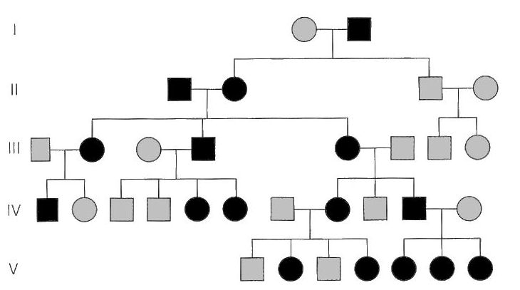
pedigree
a diagram that shows the occurrence of a genetic trait in several generations of a family

Slide 16
genetic disorder
an inherited disease or disorder that is caused by a mutation in a gene or by a chromosomal defect

Slide 17
polygenic
character a character that is influenced by more than one gene

Slide 18
codominance
a condition in which both alleles for a gene are fully expressed- equally powerful

Slide 19
linked
in genetics, describes two or more genes that tend to be inherited together

Slide 20
Helpful video
https://youtu.be/Y1PCwxUDTl8

Slide 21
Helpful video amoeba sisters
https://youtu.be/qIGXTJLrLf8

Slide 22
Dominance video
https://youtu.be/YJHGfbW55l0

