Slide 1
Chapter 3 lab-Title-you decide
Purpose- What were we trying to do? Hint- what is combustion like?

Slide 2
Background- 1. what is a calorie? 2. What is a Calorie? 3. What does a calorie actually mean? 4. What is the formula you used to find the calories in a sample? 5. Why can we burn these items and infer calories from that?

Slide 3
Data- Include the chart in the lab and then the calories per gram (experimental value) in a separate chart as well as the expected calories per gram from the food labels

Slide 4
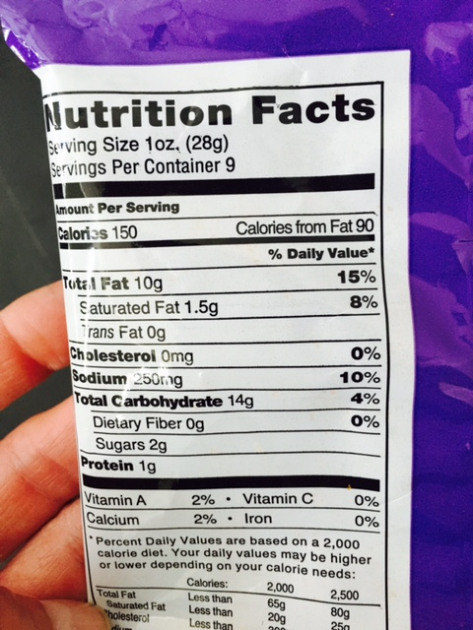
funions

Slide 5
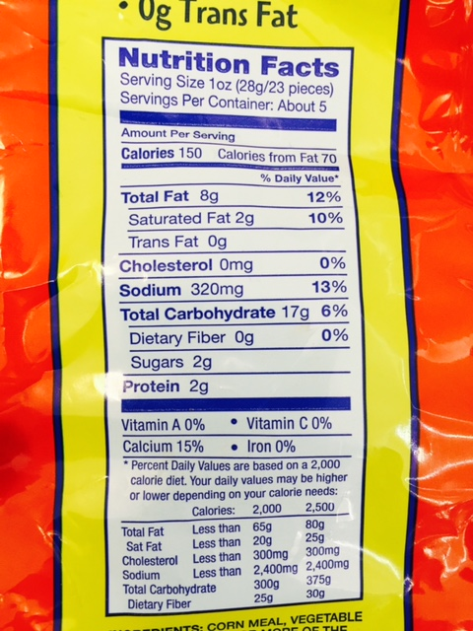
Cheese curls and balls

Slide 6
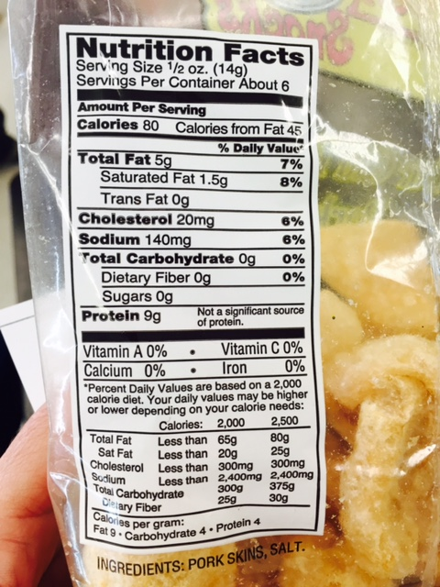
Pork rinds

Slide 7
 | cheetohs | nut | cheetoh | goldfish
Mass before burning
Mass after burning
Change in mass
Mass of water
Initial temperature
Final temperature
Change in temperature
Calories per food sample
Calories per gram

Slide 8
 | cheetohs | nut | cheetoh | goldfish
Mass before burning | 2.2g | .7g | 38.8g | 1g
Mass after burning | .9g | .3g | 35.5g | .5g
Change in mass | 1.3g | .4g | 3.3g | .5g
Mass of water | 15g | 15g | 15g | 15
Initial temperature | 40 | 22° | 20˚ | 20˚
Final temperature | 76 | 43˚ | 38˚ | 28˚
Change in temperature | 36° | 21˚ | 18˚ | 8˚
Calories per food sample
Calories per gram

Slide 9
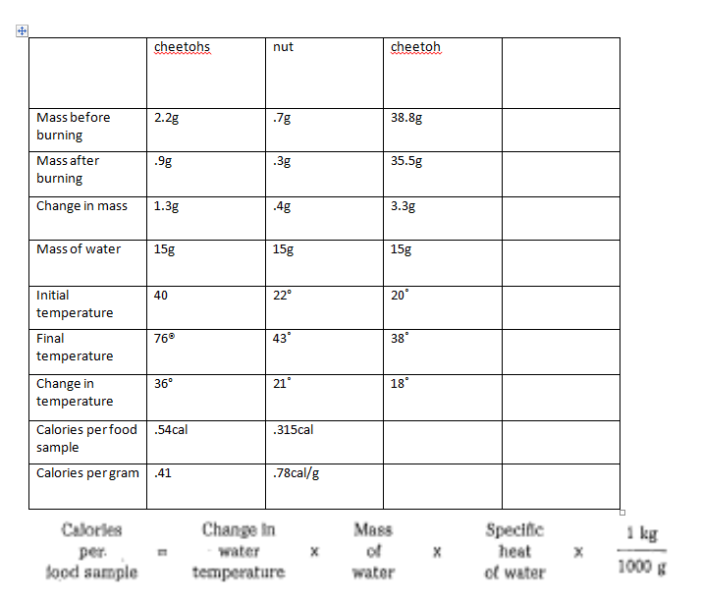

Slide 10
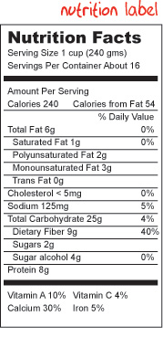

Slide 13
Conclusion- calculate the percentage error by getting the absolute value for the accepted value minus your experimental value, then dividing by percentage value times 100%
Then explain any experimental error

Slide 15
