Slide 1
Jeopardy
Hosted
by
tribs

Slide 2
actions
water
chems
energy
100
100
100
100
200
200
200
200
300
300
300
300
400
400
400
400
500
500
500
500

Slide 3
substrate
The molecule on which an
enzyme acts is called a(n).
Row 1, Col 1

Slide 4
adhesion
The attraction that causes
water and other liquids to climb up
a capillary tube
or travel through xylem is called
.
1,2

Slide 5
electrons
The negatively
charged particles
in an atom are called
.
1,3

Slide 6
phosphate groups.
ATP (adenosine triphosphate)
stores energy
in the bonds between its
.
1,4

Slide 7
basic
Substances with a pH greater than 7 are
2,1

Slide 8
Lowers activation energy
the action of
enzymes on reactants.
2,2

Slide 9
ionic bond
The attraction between oppositely
charged ions results
in the formation of a(n)
.
2,3

Slide 10
substrate.
The molecule
on which an
enzyme acts is called a(n).
2,4

Slide 11
atoms.
All matter is composed of
.
3,1

Slide 12
its side group
What gives each amino
acid its unique properties?
.
3,2

Slide 13
Fats, waxes and steroids
3 examples of lipids .
3,3

Slide 14
active site
The portion of an
enzyme molecule into
which a specific
substrate can fit is called the
.
3,4

Slide 15
quartenary
The overall shape of three
chains of amino
acids in a protein,
including folds, is that protein’s
.
4,1

Slide 16
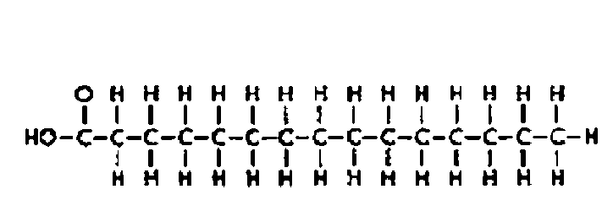
lipid
What type of biomolecule is this?.
4,2

Slide 17
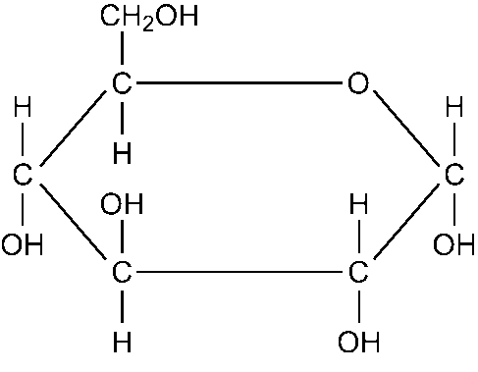
Carb-saccharide
What type of biomolecule is this?.
.
4,3

Slide 18
Pure water
A strong acid and a strong base
Will react to form what?.
4,4

Slide 19
Acidic
More H+
ions mean the solution is?.
5,1

Slide 20
Catalyst
An enzyme is also called a what
When talking about chemical reactions.
5,2

Slide 21
Arms out-it is the sequence of amino acides
What is the primary protein
structure? Demonstrate AND
explain
5,3

Slide 22
Oil is nonpolar and water is polar
Oil and water don’t mix because….
5,4

