Slide 1
Genetic engineering

Slide 2
timeline- https://history.nih.gov/exhibits/genetics/sect4.htm

Slide 3
CRISPR
Stands for Clustered Regularly Interspaced Short Palindromic Repeat . A combination of RNA (tracr RNA and crRNA) and CAS9 protein (an endonuclease that can cut DNA) that are a type of “Bacterial immune system” allow a specific region of DNA to be cut. This allows insertion or deletion of a short segment of DNA. The complementary segment of RNA can be custom tailored to “find” any sequence in a genome and cut immediately downstream to this recognition sequence. This was just discovered for use in genome editing in 2012. It has the potential to “cure” genetic disorders, cancer, aquired diseases as well as more easily create transgenic organisms and modify human embryos.

Slide 4
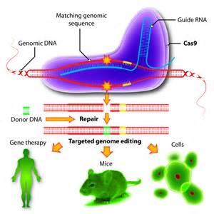

Slide 6
GENE THERAPY
Uses a virus as a vector
Replacing a mutated gene that causes disease with a healthy copy of the gene.
Inactivating, or “knocking out,” a mutated gene that is functioning improperly.
Introducing a new gene into the body to help fight a disease.

Slide 7
DESIGNER BABIES
There are two approaches to this. Both mandate invitro fertilization. Process 1 is the fertilization of harvested ova with donor sperm. Upon differentiation into blastula, a single cell is removed to test for genetic defects and sex. Those ova that do NOT have genetic abnormalities are considered for implantation into the hormonally receptive human female. This can also extend to determining the sex of the offspring. Process 2 is the same invitro fertilization with the genetic analysis of blastulas. In process 2, the ova is then “improved” or edited with CRISPR/CAS9. This is in the experimental stages but would allow changes to almost any known gene.

Slide 8
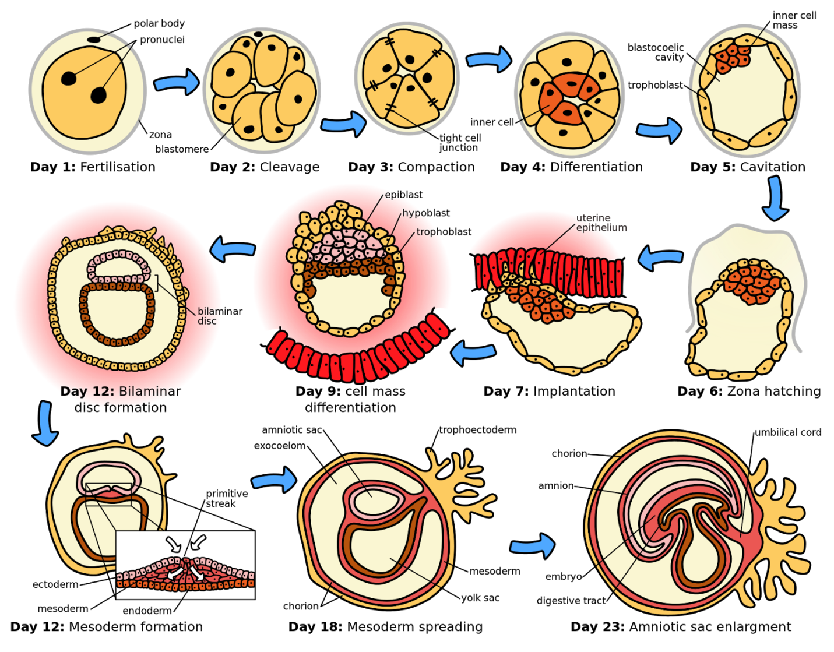

Slide 9
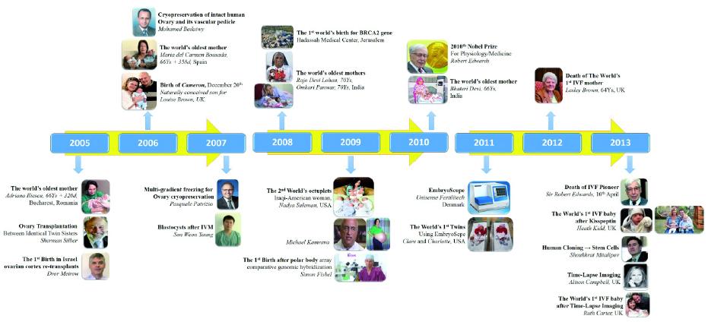

Slide 10
CLONING
Also known as somatic cell nuclear transplant. When an ova is emptied of genetic material (this is called an enucleated oocyte) and somatic cell (diploid) genetic material is introduced and encouraged to divide (electrical shock). The nuclear transfer blastocyte is then implanted into a receptive female of the same species. The offspring is a “clone” of the somatic cell donor- it has the same DNA. Be aware though that the genetic donor and the clone will NOT be the same age. Nor will they be exactly the same in behavior. Just as twins do not have the same personality but often behave similarly, the clone will have the gentic predisposition to be similar in nature and thought to the donor individual, but it will be exposed to different stimuli and therefore develop differently. ALso, clones have shorter life spans than natural offspring. This is thought to be caused by a combination of shortened telomeres from the done who has already undergone many rounds of mitosis, but also partially because of the artificial process to encourage division of the “zygote

Slide 11
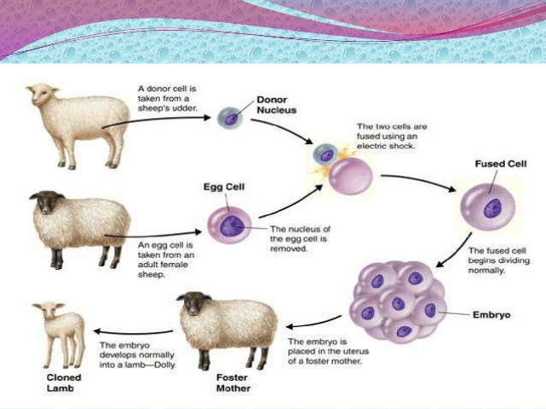

Slide 12
TRANSGENIC ORGANISMS
Any organism (prokaryotic or eukaryotic) that has had a functional gene inserted into its genome. These include camels that can produce human hormones in their milk (goats are engineered to do this as well). Phenopthalein (Equal) is produced by transgenic bacteria
Spidersilk goats, fern-spider cross, flying lizards, enviropig
http://www.insidermonkey.com/blog/5-fascinating-examples-of-genetically-modified-organisms-gmos-172347/

Slide 13
DNA SEQUENCING
Small amounts of DNA first need to be amplified. This is done via PCR- polymerase chain reaction. Using the same enzymes found endogeously in the cell,the dna is first denatured by heat, a primer binds to a sequence and replicates the DNA. (DNA polymerase) It is at this point when preparing to complete the Sanger method that dideoynucleotides are added to solutions to terminate replication.
DNA fingerprinting is a method of identifying DNA while not knowing the sequence. This includes PCR, followed by cleavage with restriction enzymes. Restriction enzymes are proteins that are another bacterial immune system component. Restriction enzymes cut DNA at particular sequences leaving sticky ends. these are single stranded bits where the cut is made that are receptive to base pairing to any complementary sequence (therefore, any sequence cut with the same restriction enzyme will have a complementary sequence)
Microarrays are small chips that have sequences that can look for genetic diseases (and predisposition)

Slide 14
Genetic Tests
Some of the diseases for which genetic tests are currently available:
Cancer (some forms, predisposition only)
Cystic Fibrosis
Down syndrome
Fragile-X Syndrome
Hemophilia
Huntington's Disease
Lou Gehrig's Disease
Neurofibromatosis
Muscular Dystrophy
Phenylketonuria
Sickle Cell Anemia
Tay-Sachs Disease

Slide 15
MEDICAL USES (include vaccinations, insulin production, growth hormone)
transgenic organisms can produce insulin (bacteria), antithrombin (goats and camels in milk) and vaccines (bannannas-- hep c, cholera). eggs from transgenic hens can produce interferon and cancer fighting drugs

Slide 16
Stem cells

