Slide 1
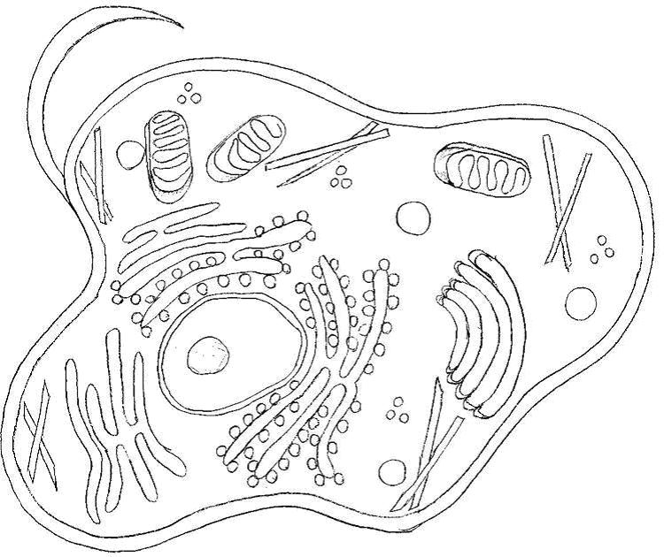
Chromosome simulation project
By Jonathan Eick and Michael Reid

Slide 2
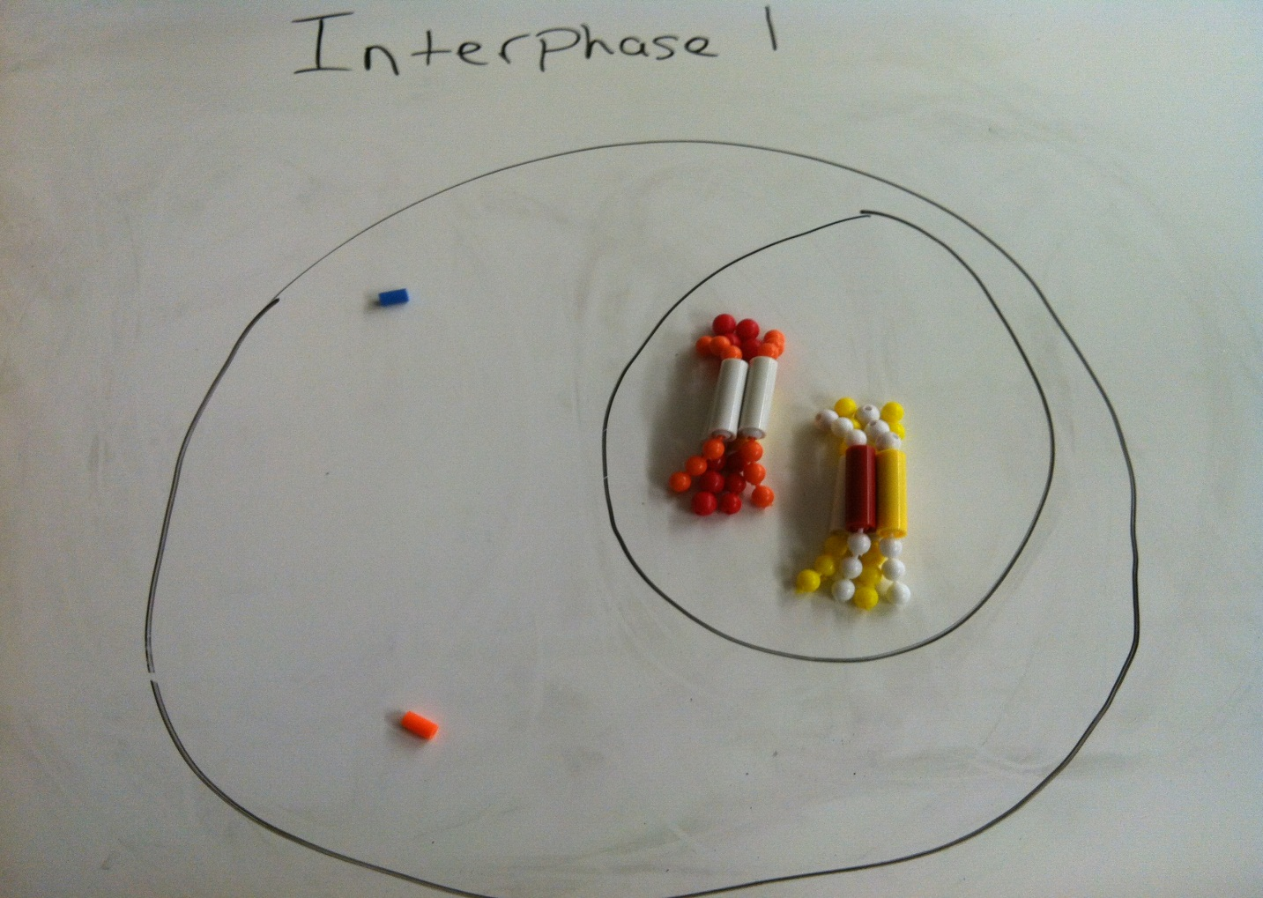
Interphase 1
The chromosomes duplicate within the nuclear membrane, the centrioles start to move to the north and south poles

Slide 3
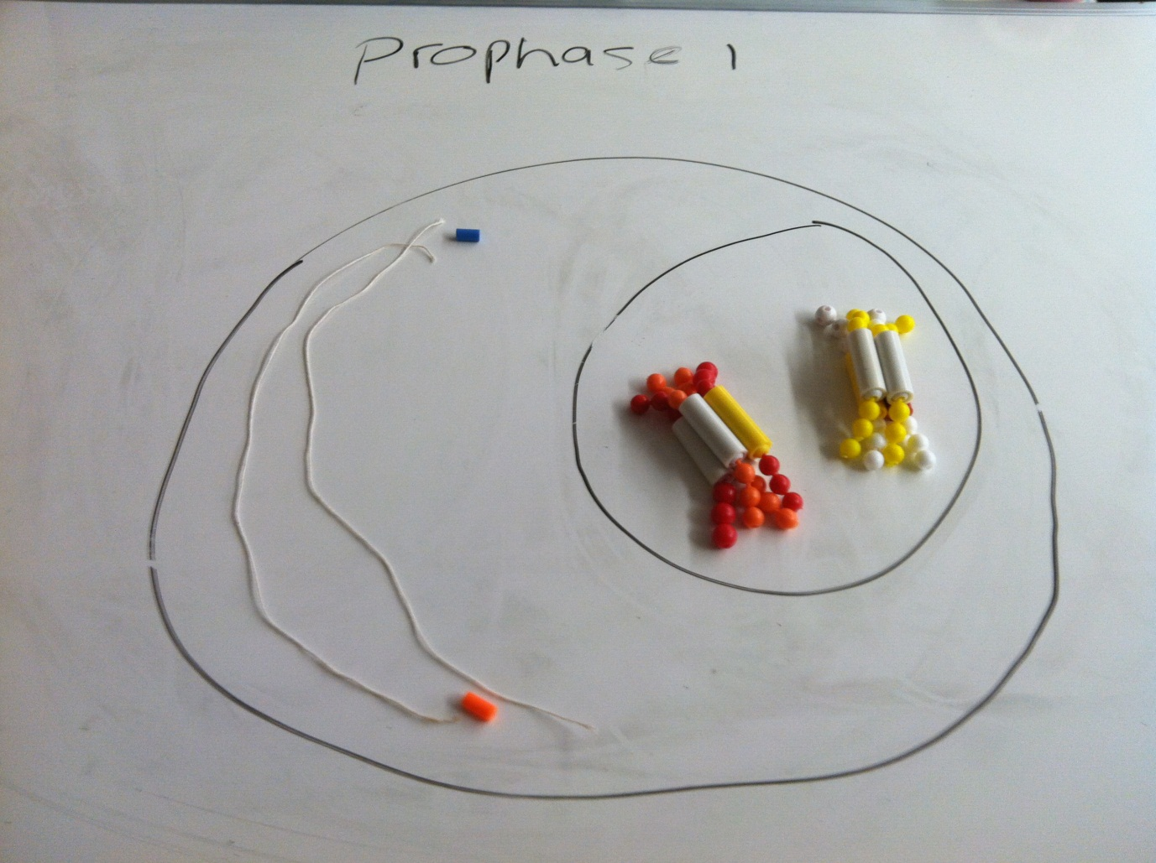
Prophase 1
The chromosomes become visible, nuclear membrane breaks down, crossing over occurs, and spindle fibers form

Slide 4
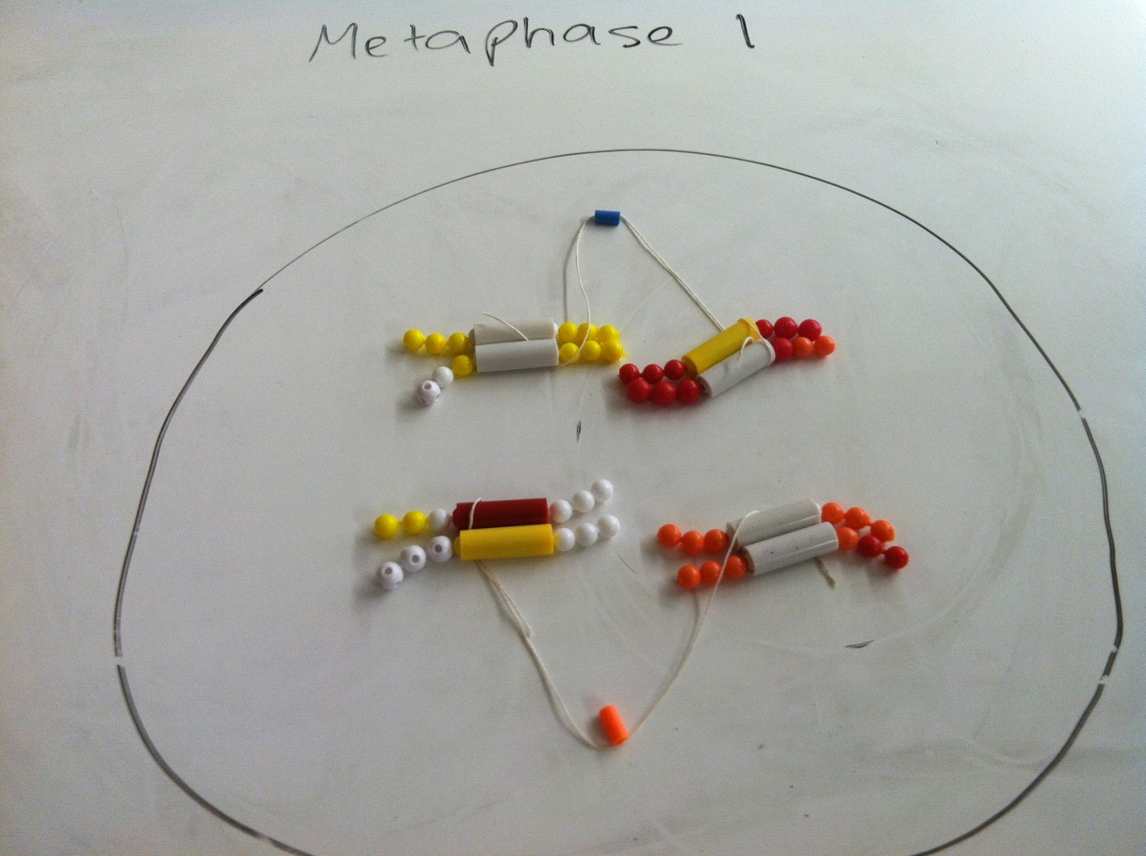
Metaphase 1
Pairs of homologous Chromosomes move to the equator of the cell

Slide 5
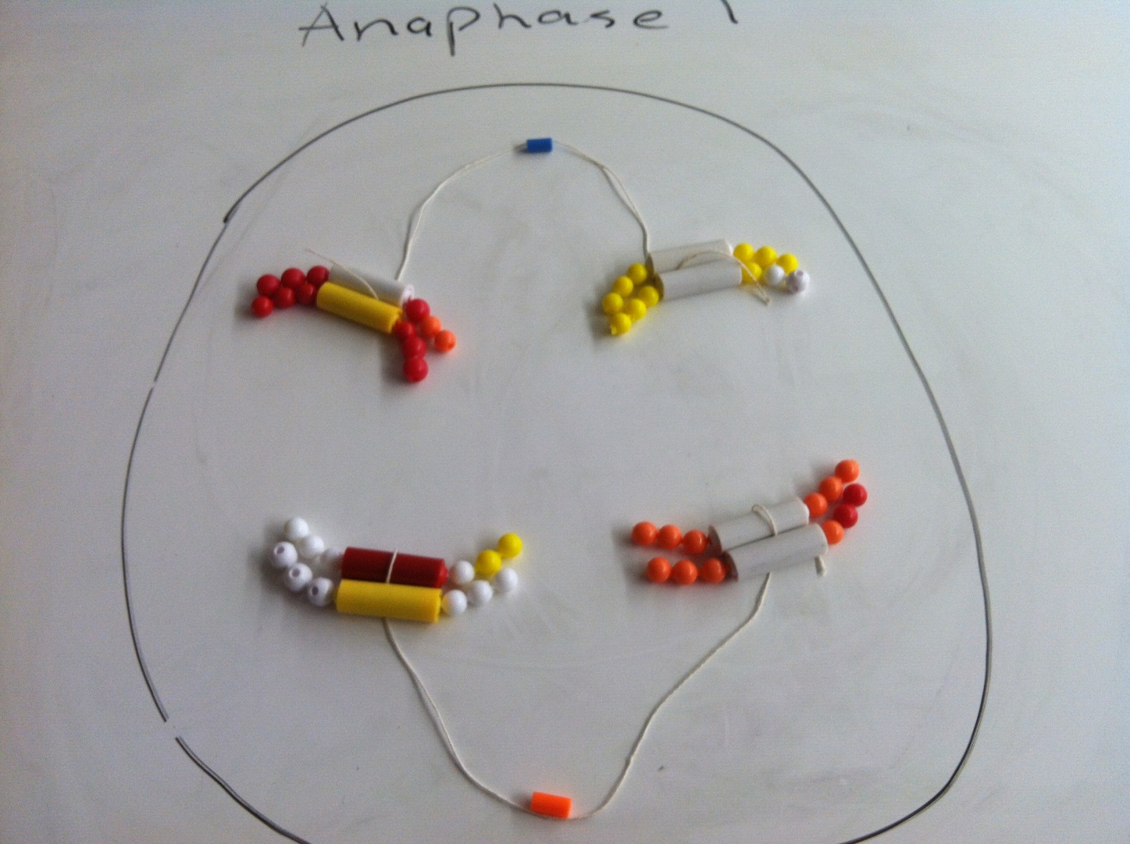
Anaphase 1
Homologous chromosomes move outward to opposite poles of the cell

Slide 6
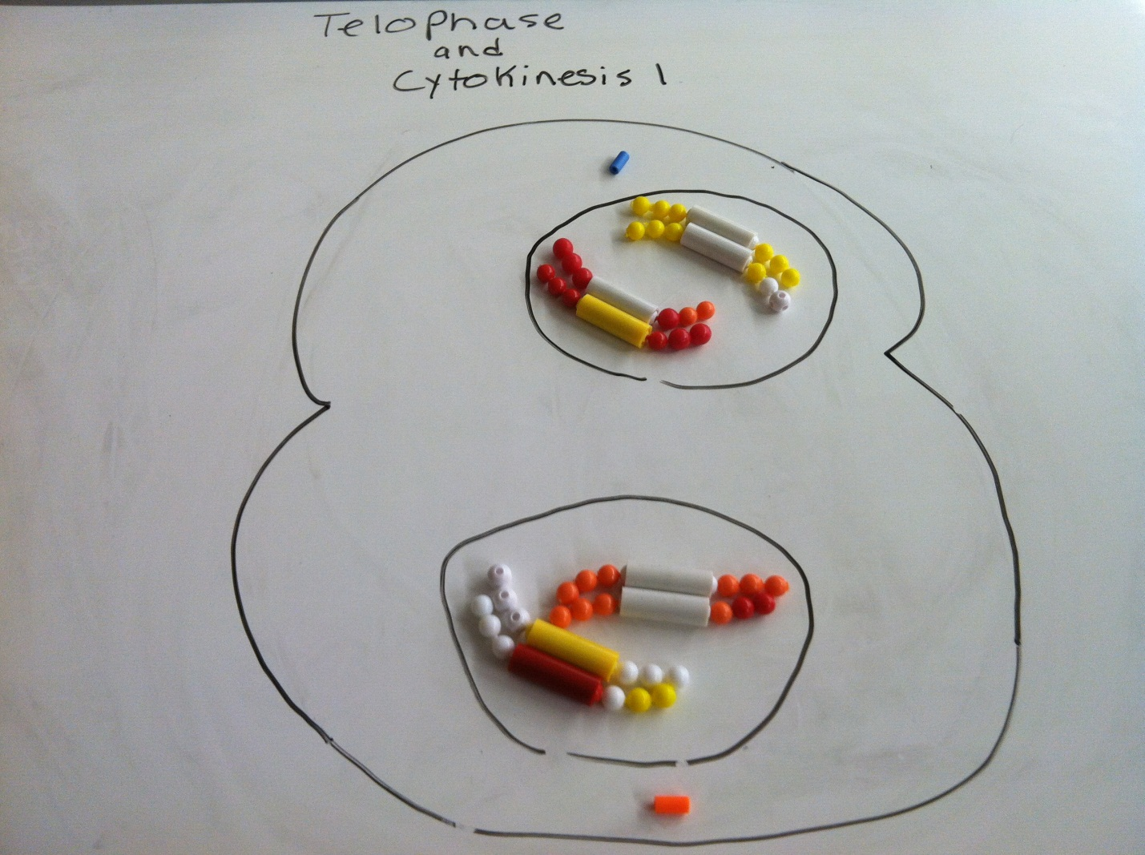
Telophase 1 and cytokinesis
Chromosomes gather at the poles of the cell and cytoplasm divides

Slide 7
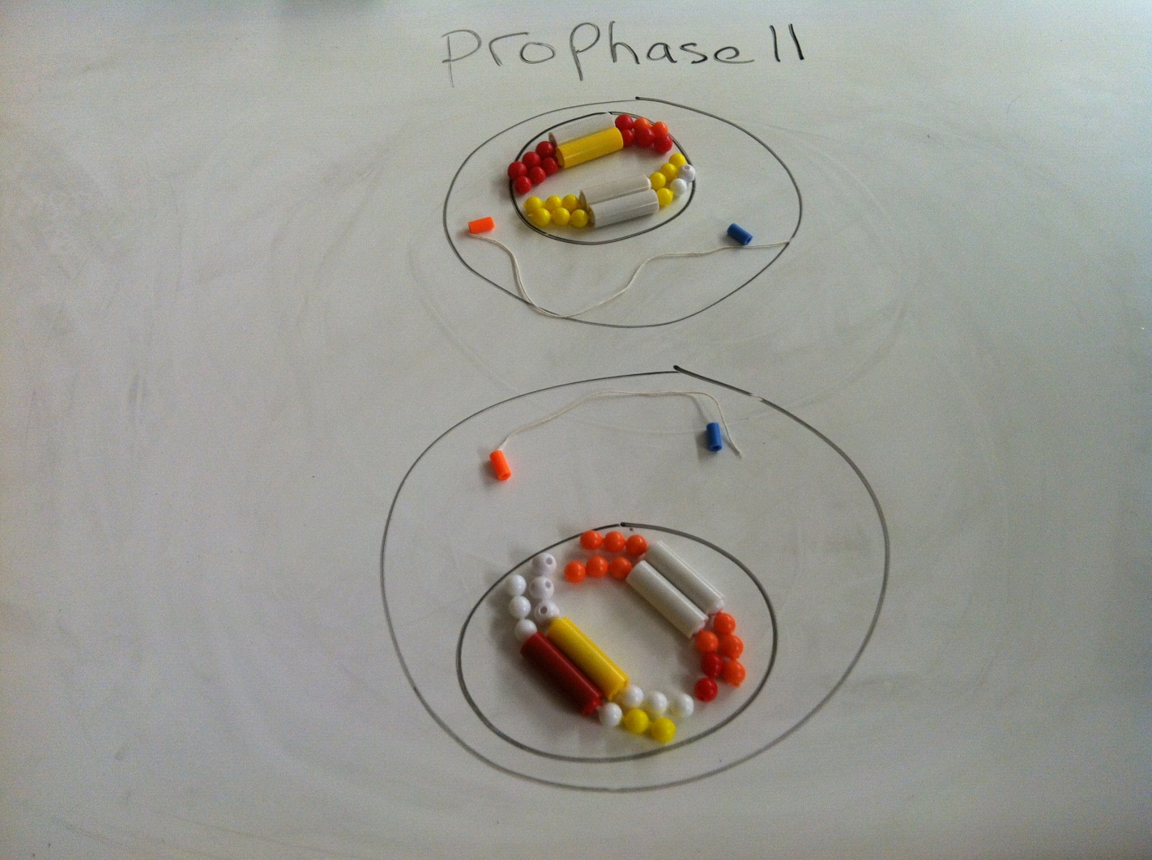
Prophase 2
A new spindle fiber forms around the chromosomes

Slide 8
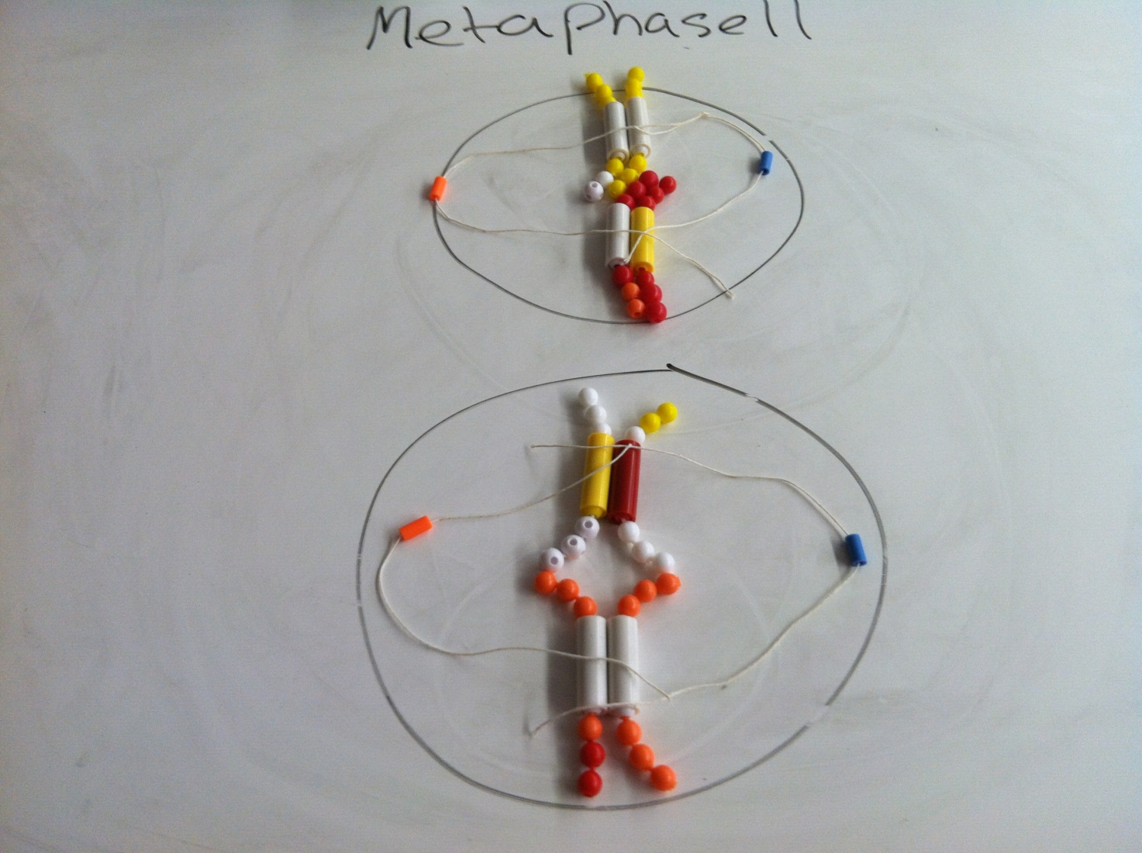
Metaphase 2
Chromosomes line up at the equator

Slide 9
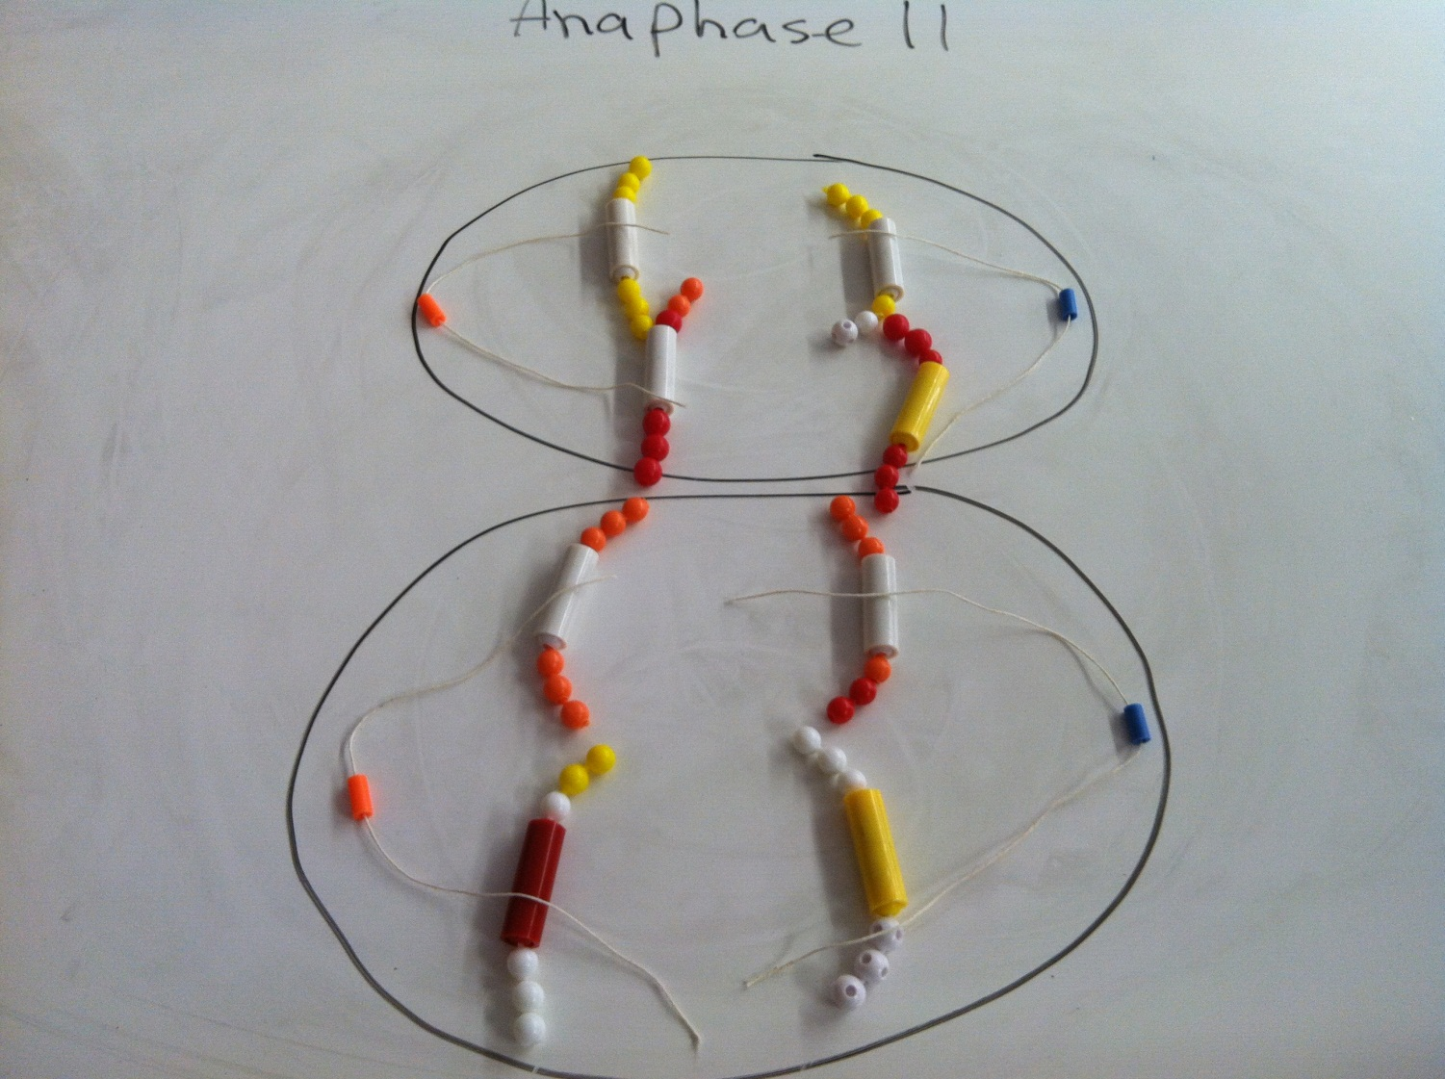
Anaphase 2
Centromeres divide, chromatids move to the opposite poles of the cell

Slide 10
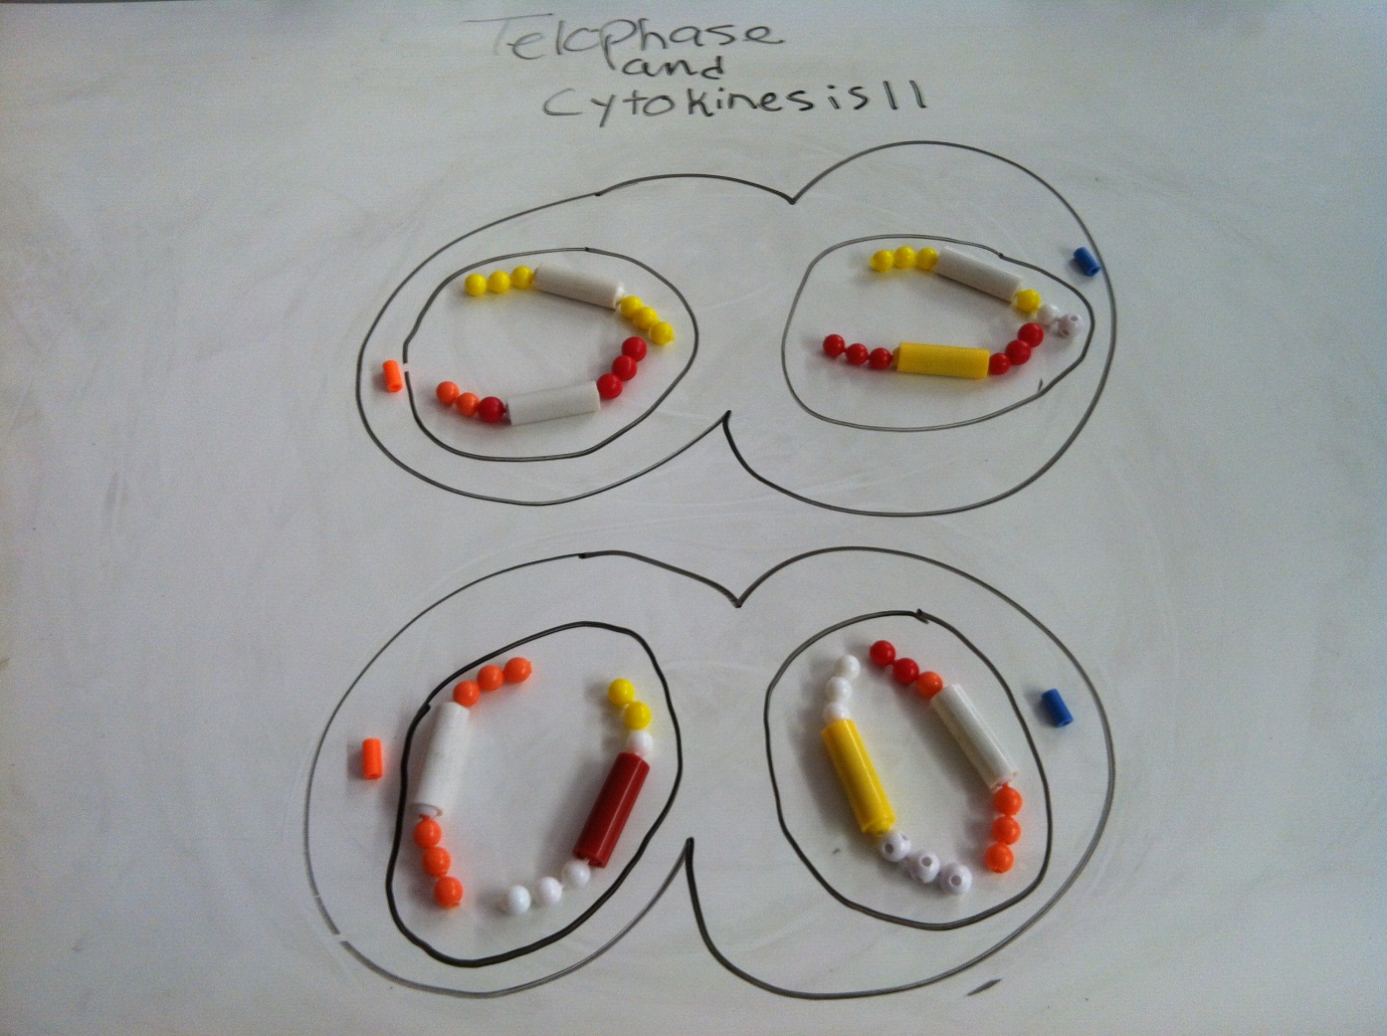
Telophase 2 and cytokinesis
A nuclear membrane forms around each set of chromosomes, the cytoplasm divides, and 4 new haploid offspring cells are formed.

