Slide 2
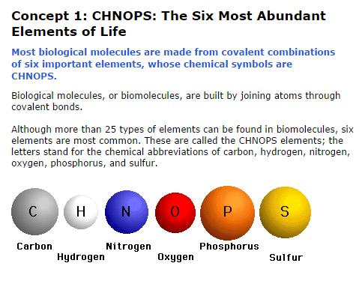

Slide 3
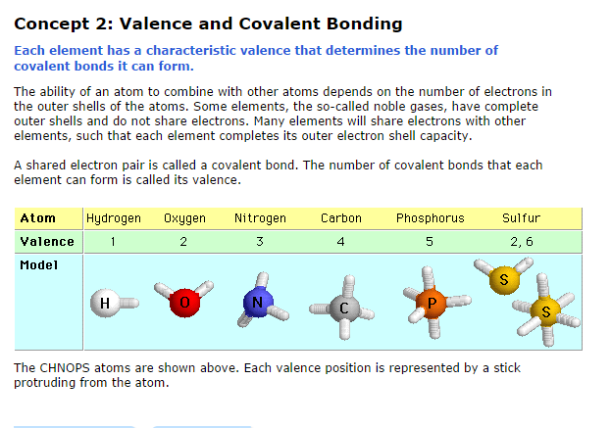

Slide 4
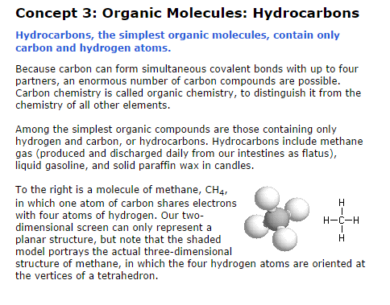

Slide 5
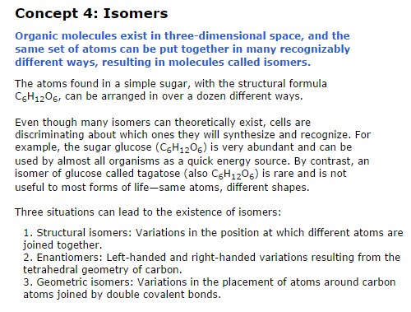

Slide 6
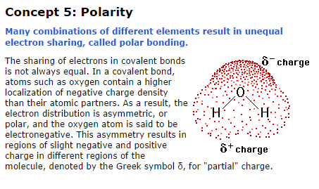

Slide 7
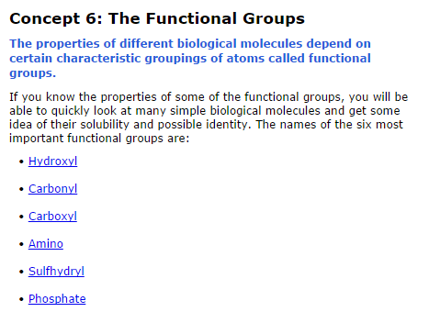

Slide 8
www.phschool.com/science/biology_place/biocoach/biokit/quiz.html
http://www.phschool.com/science/biology_place/biocoach/biokit/quiz.html

Slide 9
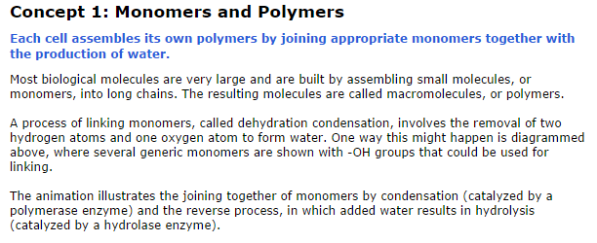

Slide 10
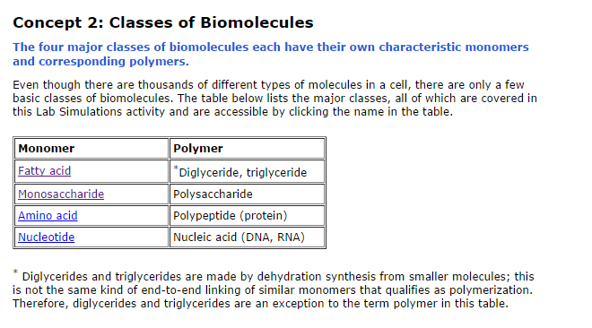

Slide 11
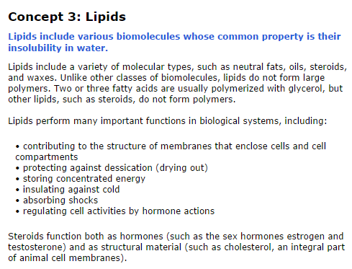

Slide 12
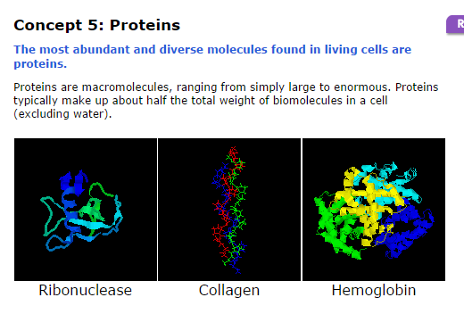

Slide 13
http://www.phschool.com/science/biology_place/biocoach/bioprop/quiz.html

