Slide 1
READ THE LAB REPORT INFORMATION

Slide 4
TITLE
CH 0 CALIBRATING THE FIELD OF VIEW OF A LIGHT MICROSCOPE
MEASURING WITH A MICROSCOPE

Slide 5
PURPOSE
THIS LAB ALLOWED CALIBRATION OF THE FIELD OF VIEW FOR MULTIPLE OBJECTIVES SO THAT ACCURATE MEASUREMENTS OF SPECIMENS CAN BE MADE IN FUTURE LABS

Slide 6
BACKGROUND
COMPOUND LIGHT MICROSCOPE
FIELD OF VIEW
TYPES AND MAGNIFICATION OF 3 OBJECTIVES
MICROMETER TO MILLIMETER
HOW TO CALCULATE FIELD OF VIEW WITH A KNOWN OBJECT

Slide 7
DATA
LENS | TOTAL MAGNIFICATION | FIELD OF VIEW IN MICROMETERS

Slide 8
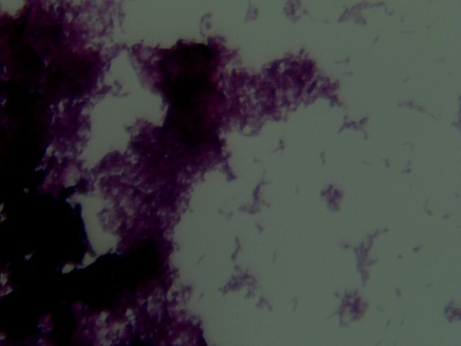
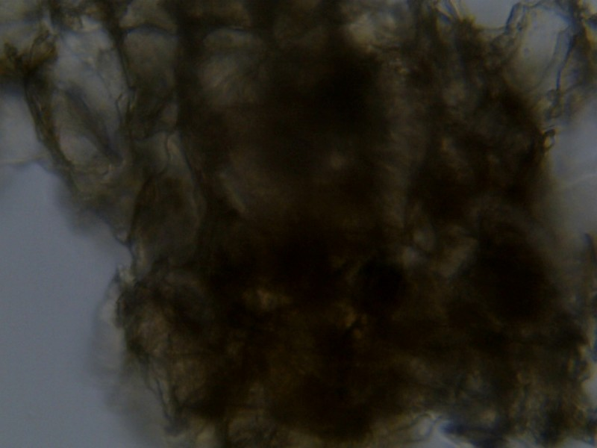
BAMBOO WET MOUNT 400X
μ
600 μm
600 μm
CORK WET MOUNT 400X

Slide 9
ONION SKIN WET MOUNT 400X
CAN BE ATTACHED AS SEPERATE SHEET BUT MUST BE LABELED
BUCCAL CELL WET MOUNT 400X

Slide 10
CONCLUSION
What are the sizes of your four specimens?
What are the steps to take if you can not find anything on your slide? Be specific.
What happens to the field of view as you increase magnification?
What happens to the plane of focus when you increase magnification and why is this important?

Slide 11
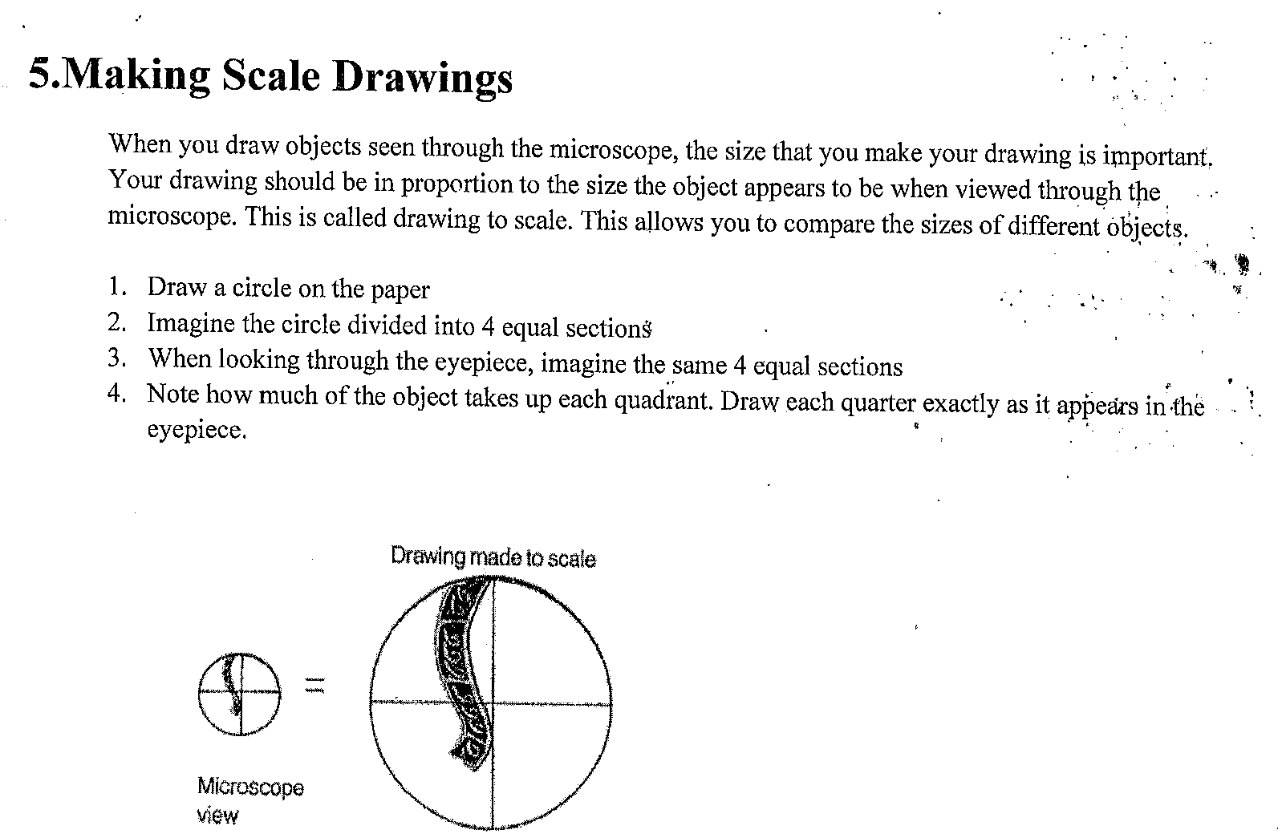

Slide 12
