Slide 1
ensci

Slide 2
Hosphorous P Cycle
Phosphorous cycle is important for
ATP- energy currency of cells
Cell membrane- phospholipid bilayer
DNA- sugar phosphate backbone that holds helical structure

Slide 4
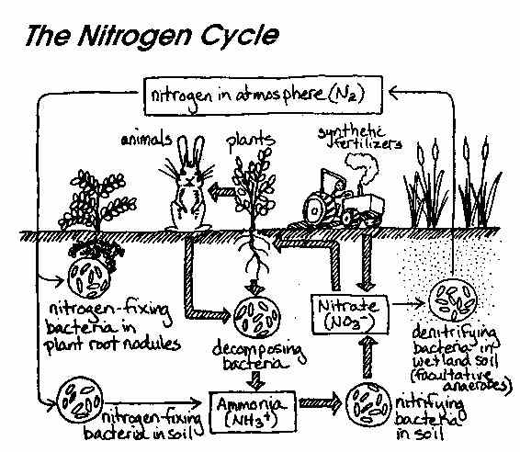

Slide 5
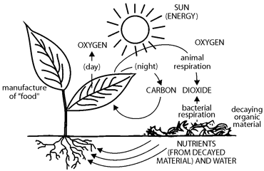

Slide 7
