Slide 1
READ THE LAB REPORT INFORMATION

Slide 4
TITLE
CH 0 CALIBRATING THE FIELD OF VIEW OF A LIGHT MICROSCOPE
MEASURING WITH A MICROSCOPE

Slide 5
PURPOSE
THIS LAB ALLOWED CALIBRATION OF THE FIELD OF VIEW FOR MULTIPLE OBJECTIVES SO THAT ACCURATE MEASUREMENTS OF SPECIMENS CAN BE MADE IN FUTURE LABS

Slide 6
BACKGROUND
COMPOUND LIGHT MICROSCOPE
FIELD OF VIEW
TYPES AND MAGNIFICATION OF 3 OBJECTIVES
MICROMETER TO MILLIMETER
HOW TO CALCULATE FIELD OF VIEW WITH A KNOWN OBJECT

Slide 7
DATA
LENS | TOTAL MAGNIFICATION | FIELD OF VIEW IN MICROMETERS

Slide 8
CONCLUSION

Slide 9
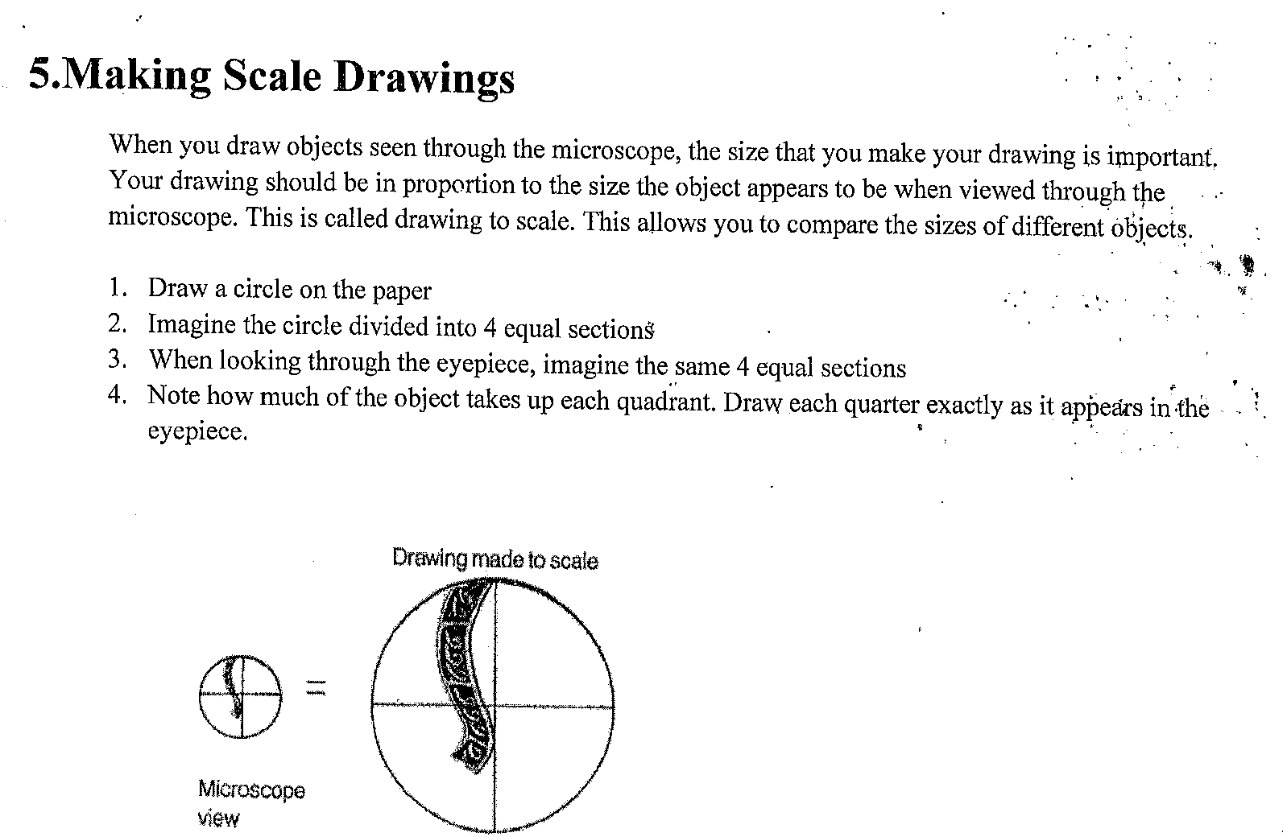

Slide 10
