Slide 1
serology

Slide 2
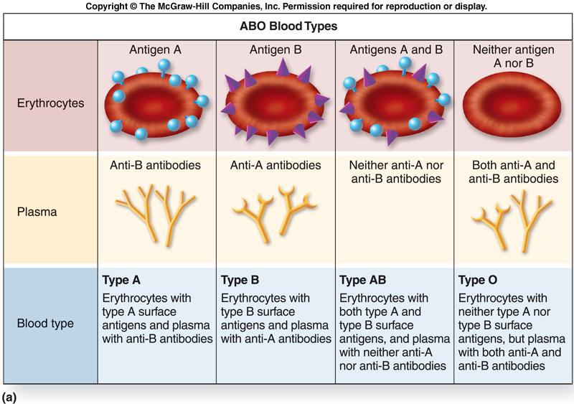

Slide 3
Antigen-Antibody Reaction
When an animal, such as a rabbit or mouse, is injected with an antigen its body will produce a series of different antibodies, all of which are designed to attack some particular site on the antigen of interest.
This collection of antibodies is known as polyclonal antibodies.
Alternately, a more uniform and specific collection of antibodies designed to combine with a single antigen site can be manufactured.
Such antibodies are known as monoclonals.

Slide 4
Forensics of Blood-The criminalist must be prepared to answer the following questions when examining dried blood:
1. Is it blood?
2. From what species did the blood originate?
3. If the blood is of human origin, how closely can it be associated to a particular individual? The determination of blood is best made by means of a preliminary color test.

Slide 5
The Tests
A positive result from the Kastle-Meyer color test is highly indicative of blood. Hemoglobin causes a deep pink color. Waiting longer than 30 seconds will cause the test to give false positives. Also- horseradish broccoli and cauliflower.

Slide 6
the luminol test is used to search out trace amounts of blood located at crime scenes. Produces light (luminescence) in a darkened area

Slide 7
Microcrystalline tests, such as the Takayama and Teichmann tests, depend on the addition of specific chemicals to the blood so that characteristic crystals will be formed

Slide 8
Once the stain has been characterized as blood, the precipitin test will determine whether the stain is of human or animal origin. Previously the Ouchturlony test was used with human tonsil extractions

Slide 9
The precipitin test uses antisera normally derived from rabbits that have been injected with the blood of a known animal to determine the species origin of a questioned bloodstain.

Slide 11
The transmission of hereditary material is accomplished by means of microscopic units called genes, located on chromosomes. Chromosomes are condensed DNA

Slide 12
Alternative forms of genes that influence a given characteristic (such as eye color or blood type) are known as alleles. Alleles are found at loci of each chromosome

Slide 13
Paternity testing has historically involved the A-B-O blood typing system, along with blood factors other than A-B-O.

Slide 14
Paternity testing has historically involved the A-B-O blood typing system, along with blood factors other than A-B-O.

Slide 15
Currently, paternity testing has implemented DNA test procedures that can raise the odds of establishing paternity beyond 99 percent.

Slide 20
Rape Evidence
The rape victim must undergo a medical examination as soon as possible after the assault.
At that time the appropriate items of physical evidence including clothing, hairs, and vaginal and rectal swabs can be collected for subsequent laboratory examination.

Slide 21
Rape Evidence
All outer and undergarments should be carefully removed and packaged separately in paper (not plastic) bags.
Bedding, or the object upon which the assault took place, may also be carefully collected.
If a suspect is apprehended within 24 hours of the assault, it may be possible to detect the victim’s DNA on the male’s underwear or on a penile swab of the suspect.

Slide 22
Rape Evidence
Items routinely collected from the suspect include all clothing, pubic hair, head hair, penile swab, and a blood sample or buccal swab for DNA typing.
The forceful physical contact between victim and assailant may result in a transfer of such physical evidence of blood, semen, saliva, hairs, and fibers.

Slide 23
Stain Patterns of Blood
The crime scene investigator must remember that the location, distribution, and appearance of bloodstains and spatters may be useful for interpreting and reconstructing the events that produced the bleeding.
Surface texture and the stain’s shape, size, and location must be considered when determining the direction, dropping distance, and angle of impact of a bloodstain.

Slide 24
Stain Patterns of Blood
Surface texture is very important In general, the harder and less porous the surface, the less spatter results.
The direction of travel of blood striking an object can be found because the pointed end of a bloodstain always faces its direction of travel.

Slide 25
Stain Patterns of Blood
The impact angle of blood on a flat surface can be determined by measuring the degree of circular distortion. At right angles the blood drop is circular, as the angle decreases, the stain becomes elongated.
The origin of a blood spatter in a two-dimensional configuration can be established by drawing straight lines through the long axis of several individual bloodstains. The intersection or point of convergence of the lines represents the origin point.

Slide 26
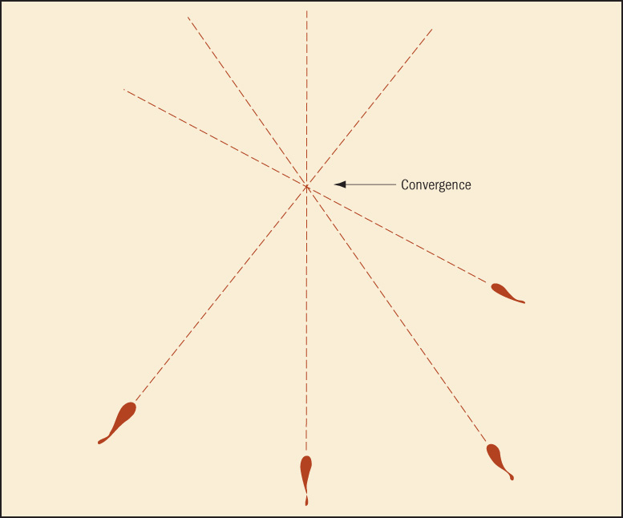
Stain Patterns of Blood

