Slide 1
Blood type lab

Slide 2
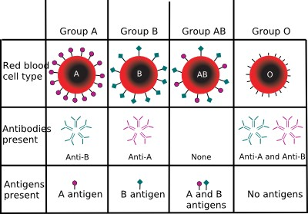

Slide 3
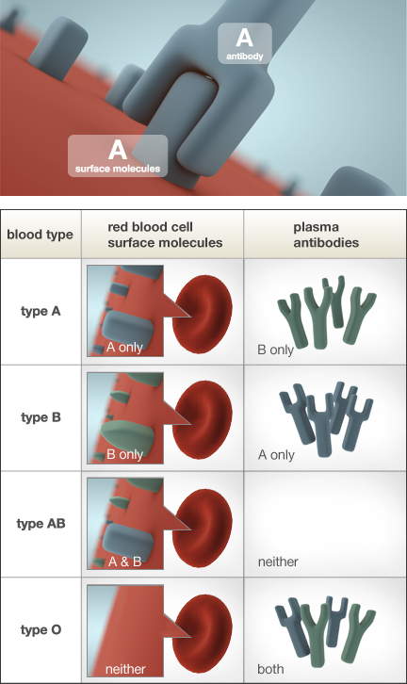

Slide 4
A
B
AB
O
B
AB
O
A
O
A
B
AB

Slide 5

A
B
AB
O
A
B
AB
O
A
B
AB
O

Slide 6
If there is a color change, then there would be a reaction between the blood types. This would result in death to the recipient (the person receiving the transfusion)
If the solution stays the same color, but gets lighter, this is not a color change
Rinse all your cups and place upside down on paper towel

Slide 7
 | A | B | AB | O
A | NO
B |  | NO
AB |  |  | NO
O |  |  |  | NO

