Slide 1
Unit 5.1 THE CELL CYCLE

Slide 2
CELLS REPRODUCE SO THAT GROWTH AND REPAIR CAN OCCUR. WHEN A CELL GETS TOO LARGE IT MUST DIVIDE. WHEN CELLS DIE OR ARE REMOVED, OTHER CELLS MUST DIVIDE TO FILL IN THE GAP

Slide 3
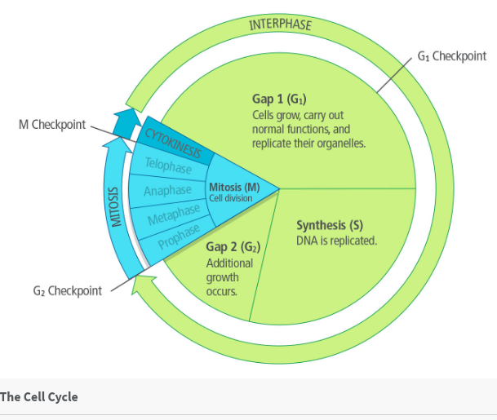

Slide 4
MITOSIS IS THE EXACT REPLICATION OF A CELL
MITOSIS IS A SMALL PART OF A CELL’S LIFE
THE CELL CYCLE IS THE PATTERN OF GROWTH, DNA REPLICATION AND CELL DIVISION THAT OCCURS IN EUKARYOTIC CELLS

Slide 5
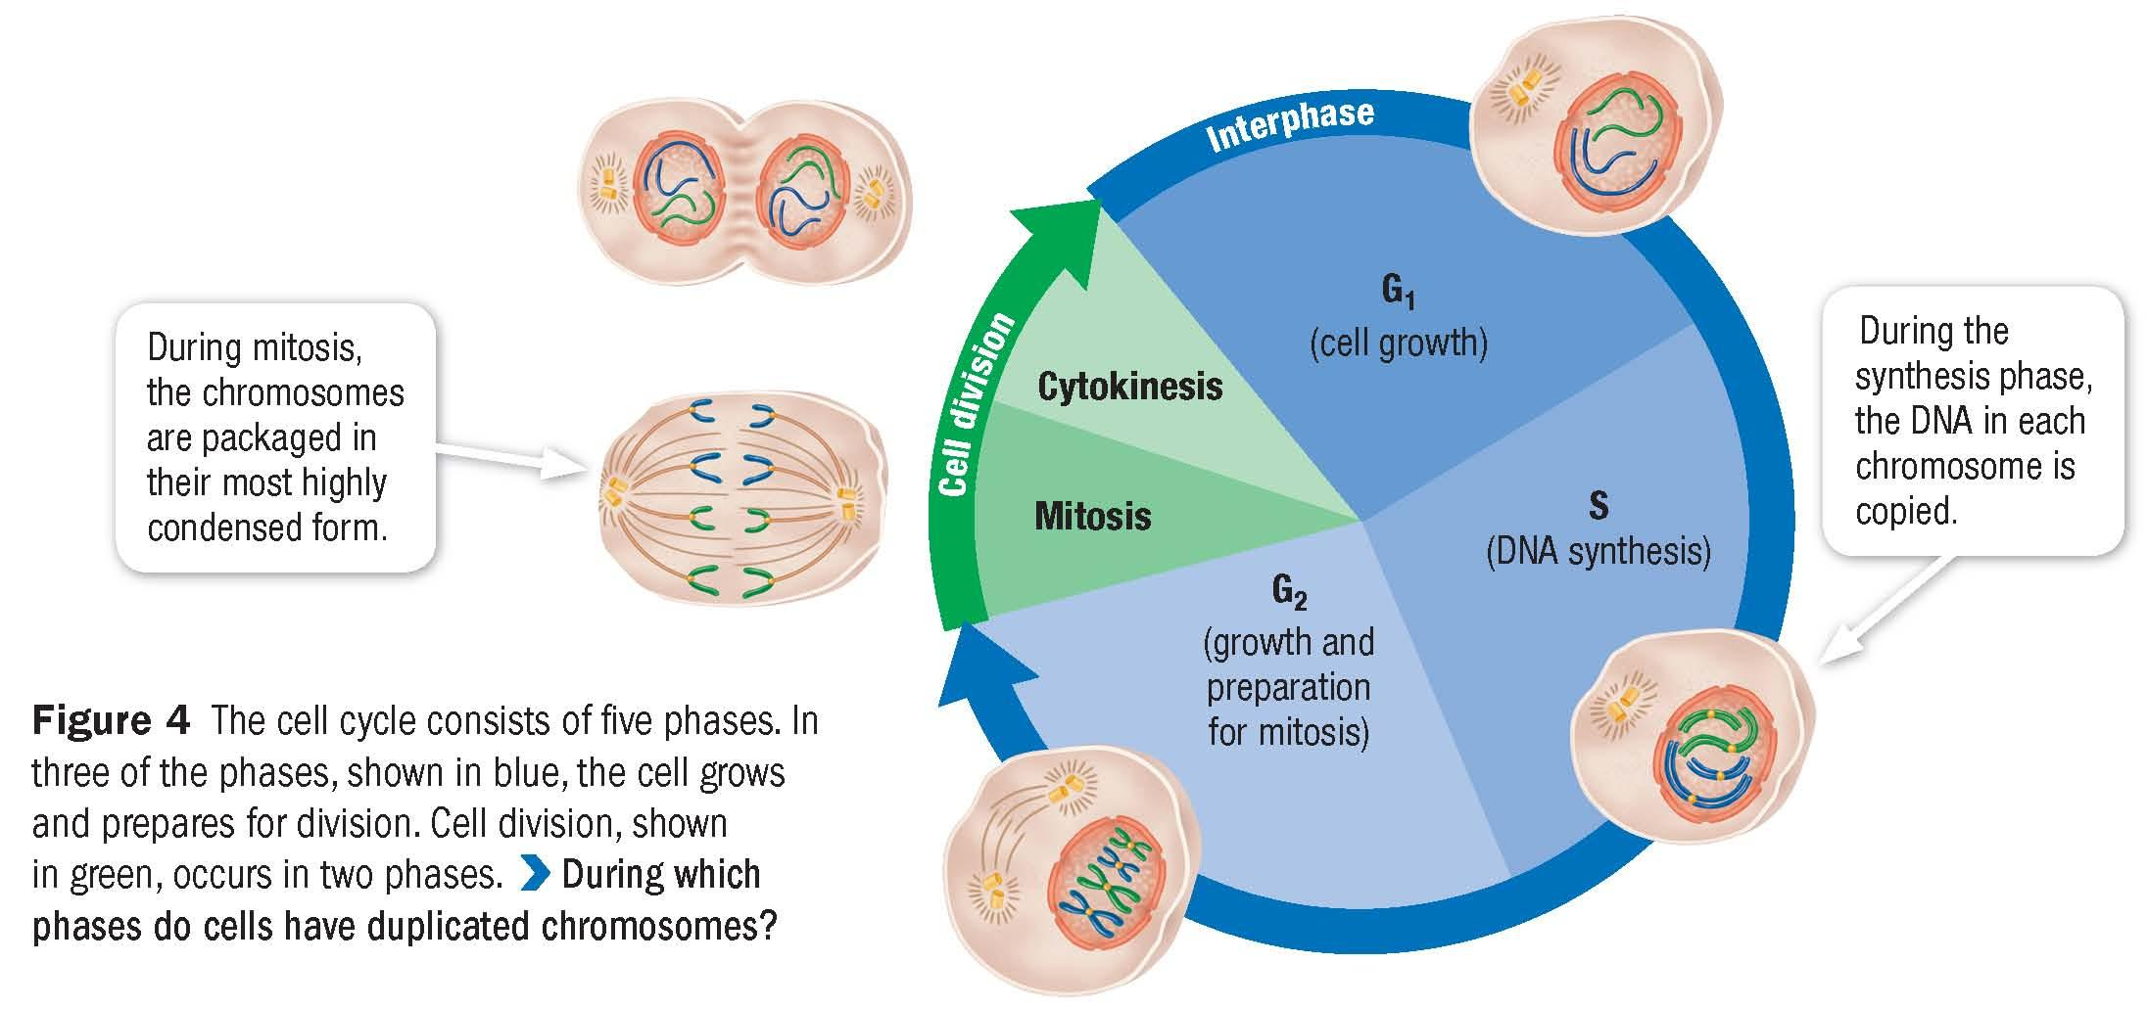

Slide 6
PROKARYOTES UNDERGO BINARY FISSION, NOT MITOSIS

Slide 7
THE CELL CYCLE IS CONTROLLED BY CHECKPOINTS. THINK OF THEM LIKE A STOP SIGN WHEN YOU ARE DRIVING. YOU STOP, CHECK WHETHER THERE IS TRAFFIC, DECIDE TO STAY OR GO.IF THERE IS TRAFFIC, YOU REMAIN STOPPED, IF THERE IS NO TRAFFIC AND IT IS SAFE, THEN YOU PROCEED FORWARD.

Slide 8
DIFFERENT TYPES OF CELLS UNDERGO DIFFERENT RATES OF DIVISION. CELLS THAT EXPERIENCE TOXIC OR DIFFICULT CONDITIONS (REPAIR) OR WHEN GROWTH IS CONSTANT TEND TO UNDERGO REPLICATION MOST FREQUENTLY.

Slide 9
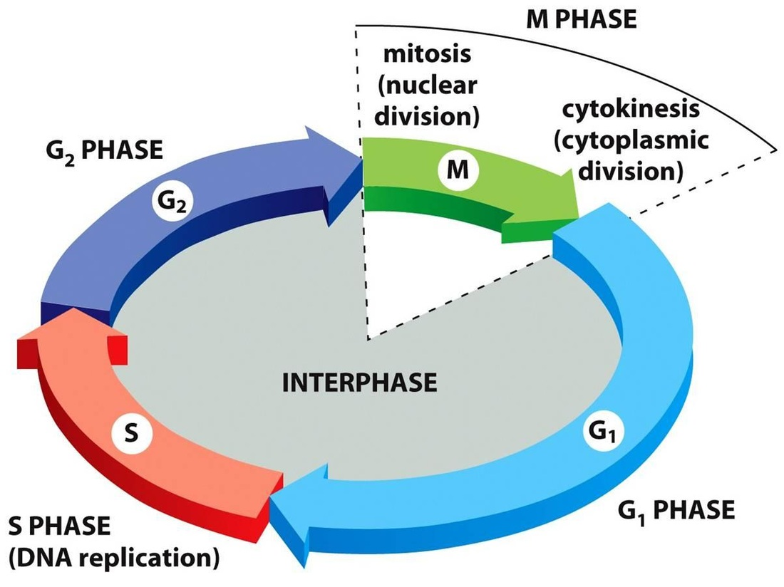

Slide 10
STAGES OF THE CELL CYCLE
G0- GAP STAGE ZERO- FOR CELLS THAT DO NOT NEED TO DIVIDE (NEURONS, LYMPHOCYTES). CELL DOES NOT GROW IN SIZE OR PREPARE TO DIVIDE
G1-GAP 1 PHASE- CELLS GROW, CARRY OUT NORMAL FUNCTIONS AND REPLICATE THEIR ORGANELLES IN PREPARATION FOR DIVISION

Slide 11
STAGES OF THE CELL CYCLE
S STAGE- SYNTHESIS- DNA IS REPLICATED
G2- GAP 2 STAGE- GROWTH AND MATURATION OF ORGANELLES OCCURS IN PREPARATION FOR DIVISION

Slide 12
STAGES OF THE CELL CYCLE
MITOSIS- CELL DIVISION- A SERIES OF STEPS DIVIDING THE GENETIC MATERIAL SO THAT EACH CELL GETS AN EXACT REPLICA OF THE PARENT CELL
CYTOKINESIS- THE ACTUAL SEPARATION OF THE CELL INTO TWO DISTINCT CELLS

Slide 13
REGULATION OF DIVISION
CELL DIVISION MUST BE REGULATED IN ORDER TO MAINTAIN STRUCTURE AND FUNCTION IN MULTICELLULAR ORGANISMS

Slide 14
REGULATION OF DIVISION
INTERNAL- CHECKPOINTS AND KINASES/CYCLINS
G1 CHECKPOINT
G2 CHECKPOINT
M CHECKPOINT
KINASE- PHOSPHORYLATES A TARGET MOLECULE
CYCLINS- WORKS WITH KINASES TO PUSH CELL THROUGH PARTS OF CYCLE (THINK OF POLICE OFFICER WAVING YOU THROUGH A STOP SIGN

Slide 17
The time it takes to divide differs- prokaryotes (bacteria)= 20min, eukaryotes =24 hours (S, G & M= 12 hours)
The rate of cell division differs depending upon tissue type
Some cells never divide (G0)- neurons do not, some do when necessary.
The cell cycle is regulated by internal factors and external factors.
Kinases and cyclins are two factors that play a role in regulating cell cycle by inhibiting or encouraging passage through checkpoints (S, G2 and M checkpoints)

Slide 19
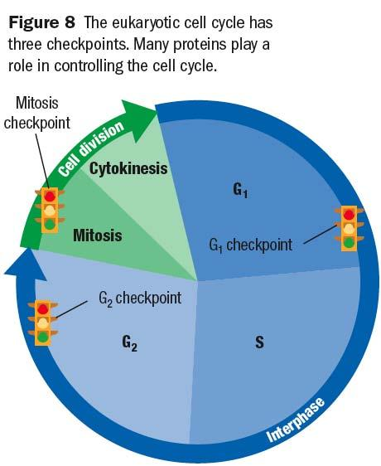

Slide 20
Factors affecting growth
Why arent we just one cell? Why are we made of small cells?

Slide 21
A cell's shape reflects the cell's function. Cell size is limited by a cell's surface area–to-volume ratio

Slide 22
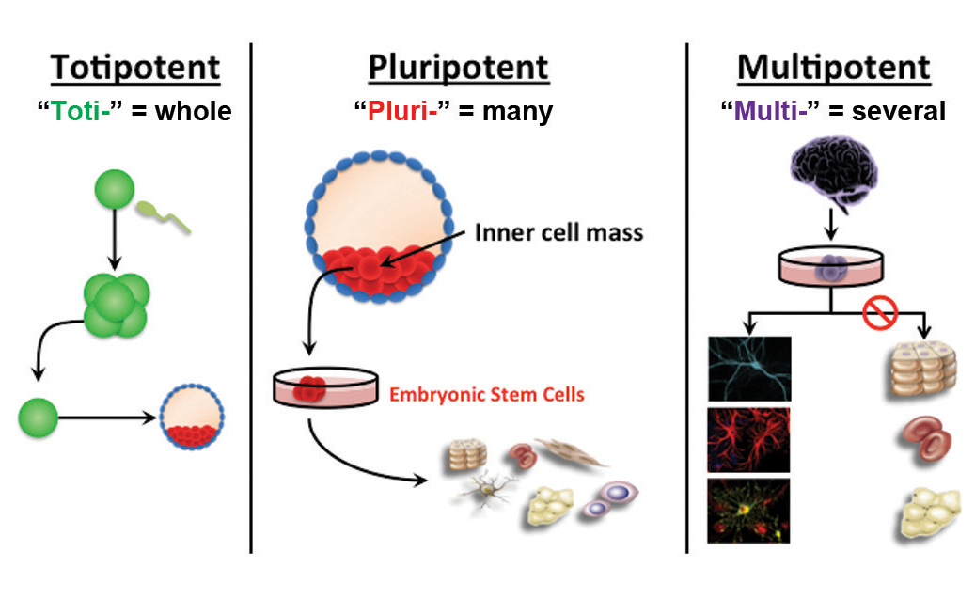

Slide 23
REGULATION OF DIVISION
EXTERNAL- TRIGGER INTERNAL SIGNALS TO ACTIVATE CELL CYCLE/GROWTH
CELL-TO CELL CONTACT
CHEMICAL SIGNALS (HORMONES, GROWTH FACTORS, ETC)

Slide 24
REGULATION OF DIVISION
WHEN REGULATION FAILS
WHEN THERE IS A FAILURE TO CONTROL CELL DIVISION, A TUMOR WILL GROW. REMEMBER THAT ALL CELLS THAT ARE REPRODUCED FROM THE ORIGINAL DEFECTIVE CELL WILL HAVE THE SAME DEFECT THAT CAUSES THEM TO REPRODUCE UNCHECKED

Slide 25
REGULATION OF DIVISION
BENIGN- WHEN THE UNCONTROLLED GROWTH DOES NOT INVADE OTHER TISSUES
CANCEROUS- WHEN THE CELLS WILL INVADE OTHER TISSUE. wHEN CANCER CELLS HAVE BROKEN OFF THE TUMOR AND MOVED TO OTHER AREAS OF THE BODY VIA THE BLOOD STREAM, THE CANCER HAS “METASTASIZED”. pROGNOSIS IN THIS CASE IS NOT GOOD, SINCE EVERY CELL CARRIES THE DEFECT AND WILL MAKE MORE TUMORS.

Slide 26
REGULATION OF DIVISION
CANCEROUS- WHEN THE CELLS WILL INVADE OTHER TISSUE. wHEN CANCER CELLS HAVE BROKEN OFF THE TUMOR AND MOVED TO OTHER AREAS OF THE BODY VIA THE BLOOD STREAM, THE CANCER HAS “METASTASIZED”. PROGNOSIS IN THIS CASE IS NOT GOOD, SINCE EVERY CELL CARRIES THE DEFECT AND WILL MAKE MORE TUMORS.

Slide 27
REGULATION OF DIVISION
REGULATION OF THE CELL CYCLE ALSO OCCURS BY CELLS COMMITTING SUICIDE. IF THERE IS A DEFECT IN DNA, WHEN CELLS HAVE DIVIDED TOO MANY TIMES (TELOMERES ARE TOO SHORT) AND WHEN TISSUE MUST BE REMOVED DURING DEVELOPMENT, CELLS CAN UNDERGO APOPTOSIS. THIS OCCURS IN EMBRYOS (ALL PEOPLE HAVE GILL SLITS, TAILS AND WEBBED FINGER AND TOES THAT ARE REMOVED VIA APOPTOSIS.

Slide 29
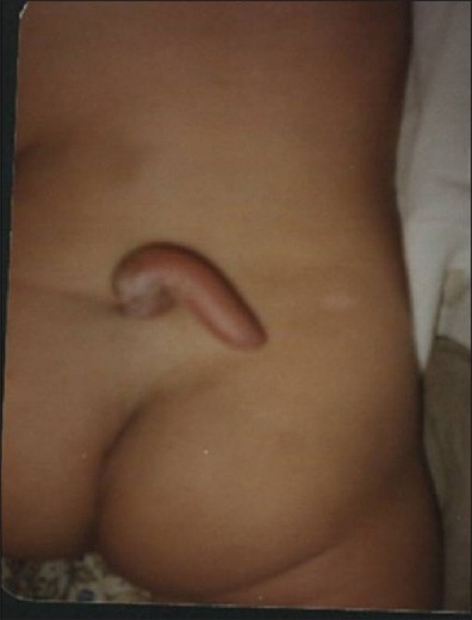

Slide 30
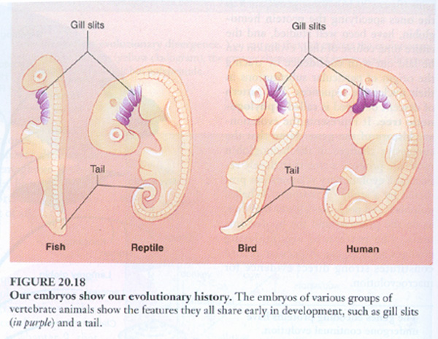
What process allows the tail and finger webbing to be removed during development?

Slide 31
LINK BETWEEN CELL SIZE AND DIVISION
ONE REASON THAT CELLS DIVIDE IS THAT THEY BECOME TOO LARGE. THE REASON THAT THEY MUST DIVIDE IS BECAUSE THE CELL SURFACE TO VOLUME RATIO BECOMES TOO SMALL.

Slide 32
Surface area = length x width X number sides
volume= length X width X height

Slide 33
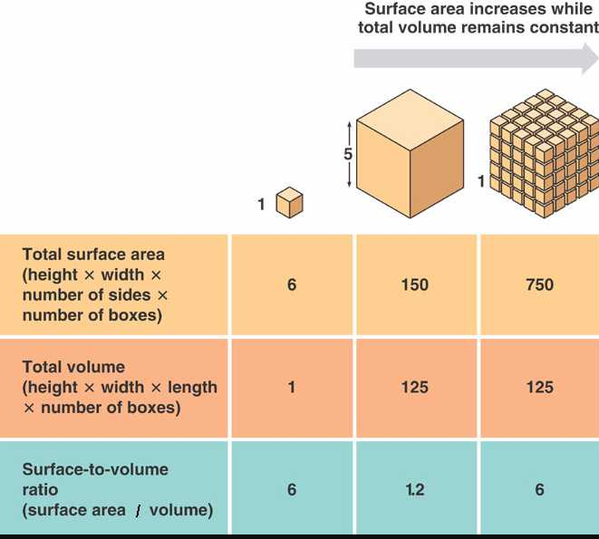

Slide 34
LINK BETWEEN CELL SIZE AND DIVISION
BECAUSE ALL MATERIALS (OXYGEN, GLUCOSE, WATER AND WASTE PRODUCTS) MUST COME THROUGH THE CELL MEMBRANE, THERE MUST BE ENOUGH CELL MEMBRANE TO SUPPORT THE VOLUME OF THE CELL.

Slide 35
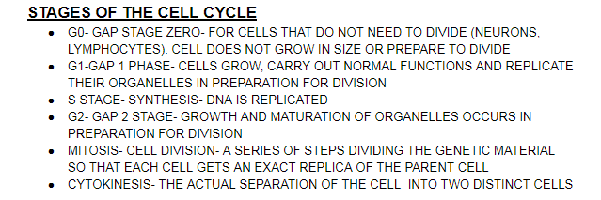
interphase

Slide 36
Cell Theory
All living organisms are composed of one or more cells.
The cell is the basic unit of structure and organization in organisms.
Cells arise from pre-existing cells.

Slide 40
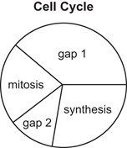
Unit 5.1 The Cell Cycle
The cell cycle is the regular pattern of growth, DNA replication and cell division in cells with nuclei

Slide 41
The time it takes to divide differs- prokaryotes (bacteria)= 20min, eukaryotes =24 hours (S, G & M= 12 hours)
The rate of cell division differs depending upon tissue type
Some cells never divide (G0)- neurons do not, some do when necessary.
The cell cycle is regulated by internal factors and external factors.
Kinases and cyclins are two factors that play a role in regulating cell cycle by inhibiting or encouraging passage through checkpoints (S, G2 and M checkpoints)

Slide 42
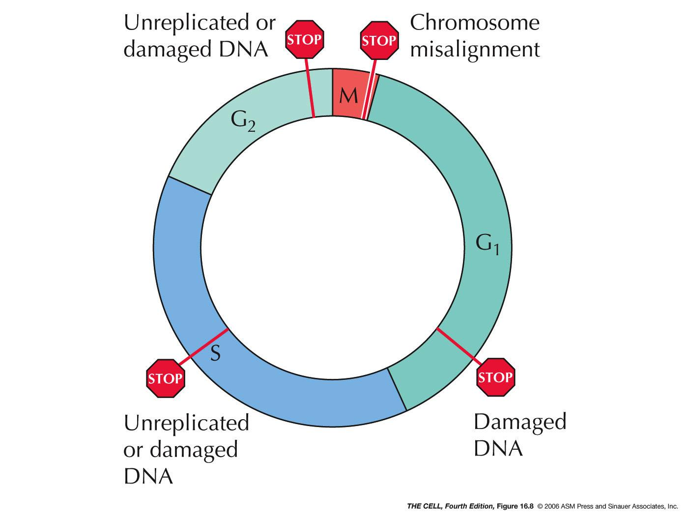
Germ layers

Slide 44
FActors affecting growth
Why arent we just one cell? Why are we made of small cells?

Slide 46
A cell's shape reflects the cell's function. Cell size is limited by a cell's surface area–to-volume ratio

Slide 47
What process allows the tail and finger webbing to be removed during development?

Slide 49
Germ layers

