Slide 1
Unit 2
Chemistry in Living Systems

Slide 2
Unit 2.1 Chemical Bonds and reactions
atom
element
ion
molecule
compound
chemical reaction
catalyst
enzyme

Slide 3
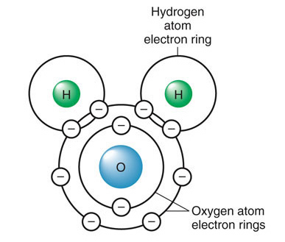
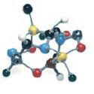
CHEMICAL BONDS -Chemical bonds form between groups of atoms because most atoms become stable when they have eight electrons in the valence shell

Slide 4
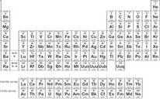

Slide 5
Valence electrons
Electrons in the outermost level, or shell, are called valence electrons.
Atoms tend to combine with each other such that eight electrons will be in the valence shell. When atoms combine, a force called a chemical bond holds them together.
When atoms of different elements combine, a compound forms. A compound is a substance made of the bonded atoms of two or more elements.

Slide 7
Valence electrons

Slide 9
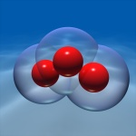
Types of bonds-
Covalent- sharing valence electrons forms a covalent bond.
.

Slide 10
Types of bonds-
Ionic bond- when one atom “steals” an electron from another atom- leaving a charge that makes each one “magnetic”(and both are happier atoms)
Atoms can achieve a stable valence level by losing or gaining electrons, resulting in a positive or negative charge. An ion is an atom or group of atoms that has an electric charge because it has gained or lost electrons. The attractive force between oppositely charged ions is an ionic bond.

Slide 11
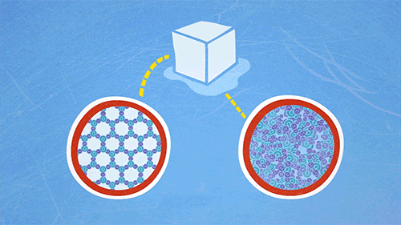
Molecule- two or more atoms held together by a covalent bond

Slide 12
Compounds- substances composed of atoms of two or more elements

Slide 13
Hydrogen Bond- when a hydrogen is bound to a highly electronegative atom, there is a slight positive charge on the hydrogen. This makes the molecule POLAR

Slide 14
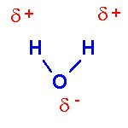
POLARITY – some bonds may have charges that are not distributed equally. Molecules with partial charges on opposite ends are said to be polar

Slide 15
In some covalent bonds, the shared electrons are attracted more strongly to one atom than to the other. As a result, one end of the molecule has a partial negative charge, while the opposite end has a partial positive charge.
The partially charged ends of polar molecules attract opposite charges. Because of this behavior, polar molecules can dissolve other polar molecules and ionic compounds.

Slide 16
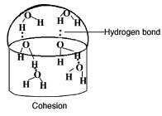
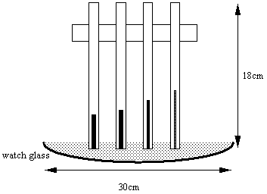
Properties of Hydrogen Bonds
High specific heat- this means it takes a lot of energy to raise or lower the temperature.
Cohesion- water molecules stick to themselves
Adhesion- water molecules stick to each other

Slide 17
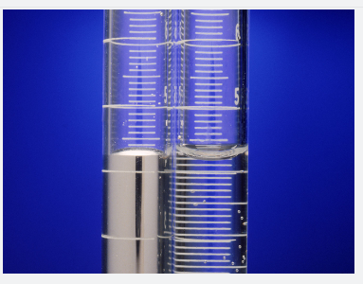
Bellringer: in your notebook
When water and mercury are placed in glass tubes, the water (in the right tube) adheres to the sides of the tube. The mercury (in the left tube) forms a rounded surface at the top of the liquid. Which of these substances has greater cohesion than adhesion? Explain your answer.

Slide 18
Water as a solvent
Like dissolves like
Think of an example where two things can not dissolve each other

Slide 19
pH
pH is a measure of how acidic or basic a solution is.
Each one-point increase in pH represents a 10-fold decrease in hydronium ion concentration. (logarithmic scale)
Pure water has a pH of 7. Acidic solutions have a pH below 7, and basic solutions have a pH above 7.
The pH of solutions in living things must be stable. For a stable pH to be maintained, the solutions in living things contain buffers.

Slide 20
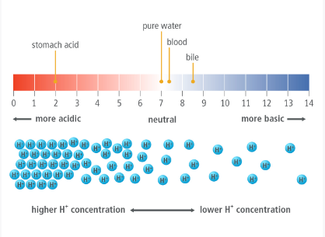
H+
OH-

Slide 21
WHich do you think is more dangerous? An acid or a base?

Slide 22
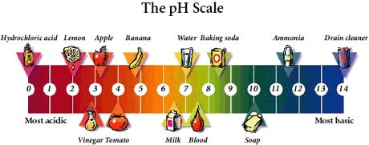
Acids Acids Bases

Slide 23
A buffer is a substance that reacts to prevent pH changes in a solution.

Slide 25
Chemical Reactions
A physical change occurs when only the form or shape of the matter changes.
A chemical change occurs when a substance changes into a different substance.
A chemical reaction changes a substance into a different substance by breaking the existing bonds and FORMING NEW CHEMICAL BONDS!!! It does not change the identity of the elements!!!!!

Slide 26
Chemical Reactions
Matter is neither created nor destroyed in any change. This observation is called the law of conservation of mass. Every change in matter requires a change in energy.
Energy may change from one form to another, but the total amount of energy does not change. This observation is called the law of conservation of energy.

Slide 27
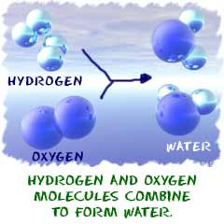
CHEMICAL REACTIONS -Chemical reactions can only occur when the activation energy is available and the correct atoms are aligned.

Slide 28
Chemical equilibrium
Irreversible chemical reaction proceeds in one direction until one reactant is completely consumed.
Think of an irreversible chemical reaction...

Slide 29
Chemical equilibrium
A reversible chemical reaction proceeds to an equilibrium point. The reaction does not stop but proceeds in both directions at equal rates so that the net amounts do not change.
Think of a reversible chemical reaction...
Notes:
Amonium chloride, carbonic acid (soda) salt in hot water, lithium ion batteries

Slide 30
Activation energy
A reactant is a substance that is changed in a chemical reaction.
A product is a new substance that is formed.
The activation energy of a reaction is the minimum kinetic energy required to start a chemical reaction. Even if enough energy is available, the product still may not form. The correct atoms must be brought together in the proper orientation.

Slide 31
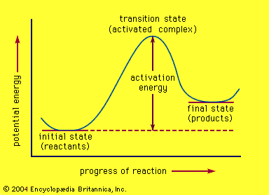

Slide 32
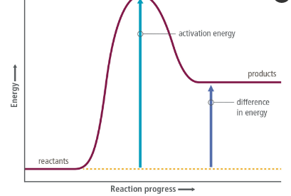
Endothermic and exothermic reactions
Endothermic reactions absorb heat from the environment

Slide 33
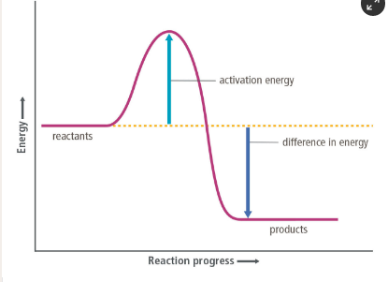
Endothermic and exothermic reactions
Exothermic reactions give heat into the environment

Slide 34
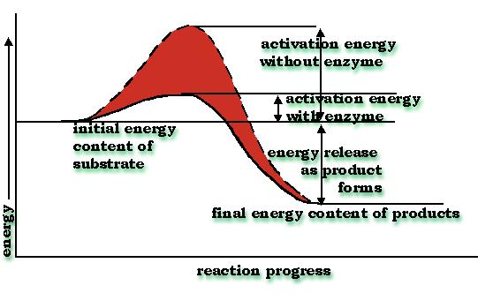
Catalyst- substance that increases the rate of a reaction but is not changed or consumed with the reaction. They lower the activation energy

Slide 35
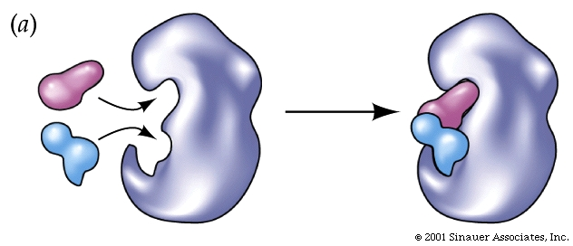
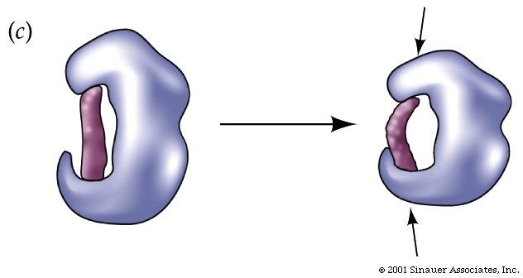
Enzymes act as biological catalysts. Enzymes are proteins that do something
By assisting in necessary biochemical reactions, enzymes help organisms maintain homeostasis.

Slide 36
Enzymes
In living things, chemical reactions occur between large, complex biomolecules. Many of these reactions require large activation energies.

Slide 37
An enzyme is a molecule that increases the speed of biochemical reactions.
Enzymes hold molecules close together and in the correct orientation. An enzyme lowers the activation energy of a reaction.
Each enzyme has an active site, the region where the reaction takes place.

Slide 38
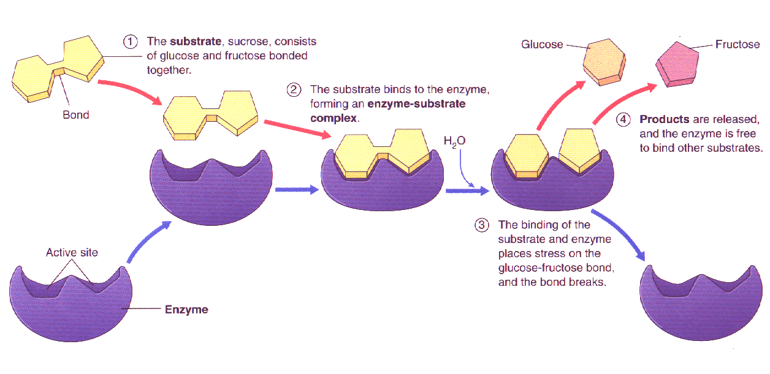

Slide 39
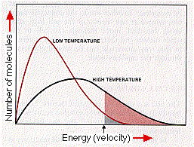
The shape of the active site determines which reactants, or substrates, will bind to it. Each different enzyme acts only on specific substrates.
Binding of the substrates causes the enzyme’s shape to change. This change causes some bonds in the substrates to break and new bonds to form.
Most enzymes need a certain range of temperatures and pH.

Slide 40
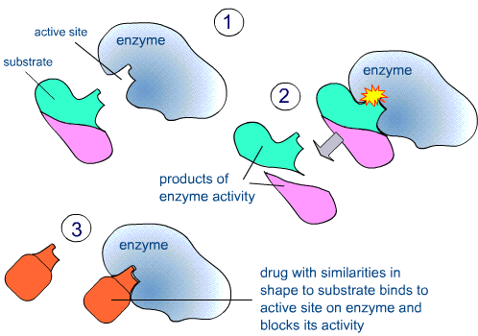

Slide 41
Enzymes are like a lock and key. This model is true in many areas of biology.
This prevents haphazard reactions.
When a substrate fits into the active site, the enzyme molds around it to tighten the fit. This is called the induced fit model (think of sticking your finger into a chinese finger lock)

Slide 42
Because enzymes are proteins, they work best in a certain temperature and pH range.
Changes in temperature and pH can decrease the effectiveness of the enzyme because it becomes denatured (the hydrogen bonds are no longer holding it into it “lock” shape

Slide 43
Catalase experiment

Slide 44
Unit 2.2
Exploration 1- Properties of carbon
Eplortaion 2- Structure and function of carbon based molecules
Exploration 3- chemical energy

Slide 45
polymer
hydrocarbon
carbohydrate
phospholipid
protein
amino acid
ATP
cell membrane

Slide 46
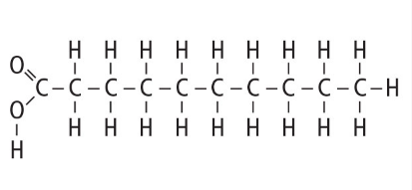
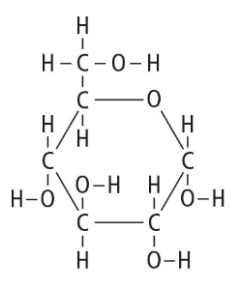
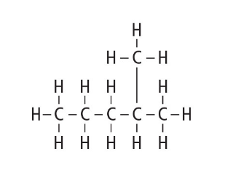
Types of Carbon Macromolecules
Straight chain
ring
Branched chain

Slide 47
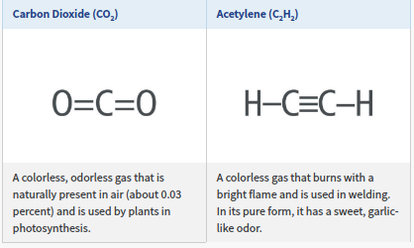
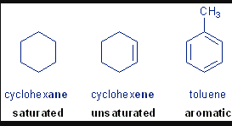
Carbon can form single, double or triple bonds- carbon rings often have floating bonds

Slide 48
4 types of macromolecules
Carbohydrates
Proteins
Nucleic acids
Lipids

Slide 49
Polymers are made up of repeating subunits called monomers
Proteins are polymers made of amino acids
Nucleic acids are polymers made of nucleotides
Carbohydrates are made of saccharides
Lipids are repeating subunits of carbon chains

Slide 50
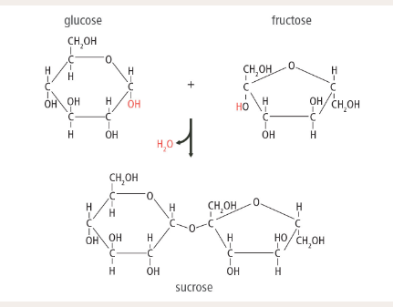
Polymers can be made through dehydration synthesis

Slide 51
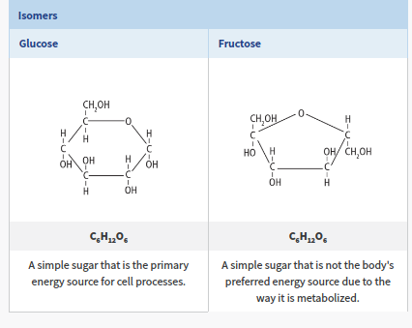
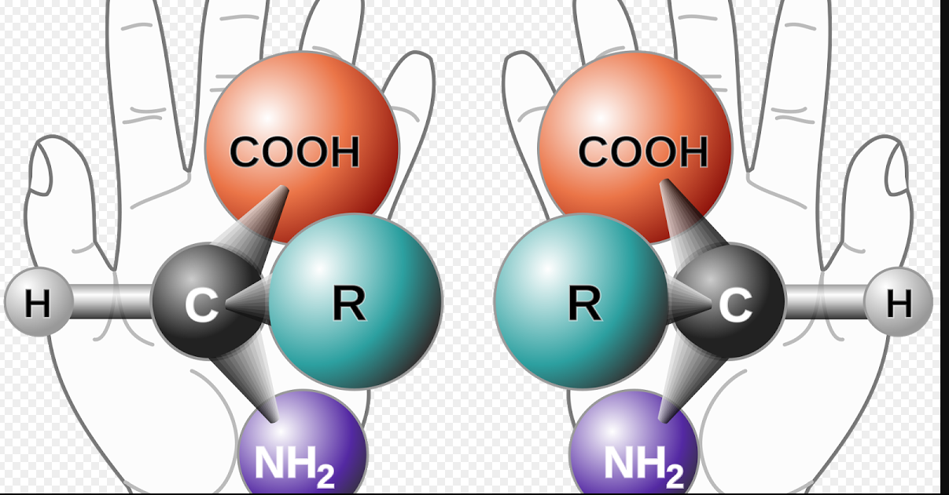
Isomers have the same chemical formula, but the atoms and bonds are rearranged. This gives them different properties

Slide 52
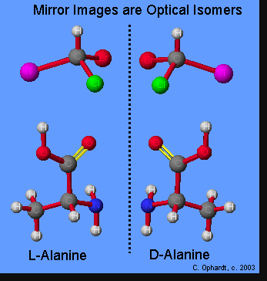

Slide 54
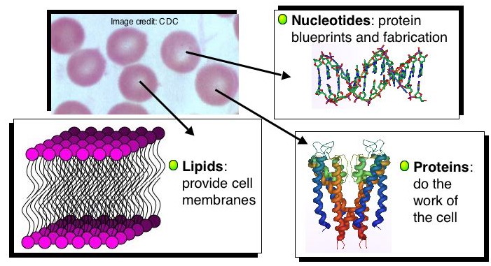
BUILDING BLOCKS OF CELLS – biomolecules contain carbon (also called organic). They include carbohydrates, proteins, lipids and nucleic acids

Slide 55
Carbohydrates
CARBOHYDRATES - Carbohydrates are molecules made of sugars. A sugar contains carbon, hydrogen, and oxygen in a ratio of 1:2:1.
Carbohydrates are a major source of energy
Chitin and cellulose are complex carbohydrates that provide support.
Chitin is found in the shells of insects and the cell walls of mushrooms.
Cellulose is found in the cell walls of plants.

Slide 56
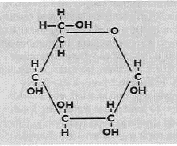

Slide 57
Lipids
LIPIDS - Lipids are another class of biomolecules, which includes fats, phospholipids, steroids, and waxes.
Lipids consist of chains of carbon atoms bonded to each other and to hydrogen atoms. This structure makes lipids repel water.
The main purpose of fats is to store energy. Fats can store energy even more efficiently than carbohydrates.
The cell’s boundary(cell membrane) is made of phospholipids. The structure of cell membranes depends on how this molecule interacts with water.

Slide 58
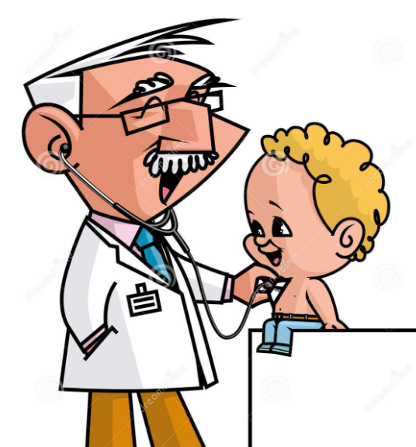
Coulrophobia -? pedophile?
pediatrician

Slide 59
Hydrophobic-fear of water
Hydrophilic- love of water

Slide 60
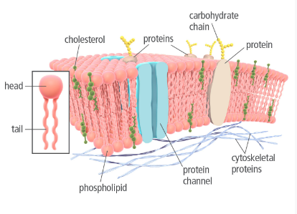
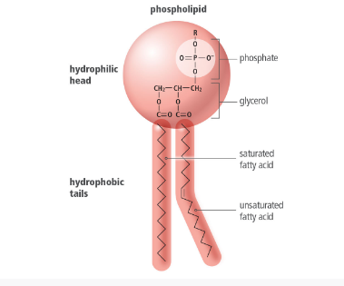
Lipids
Phospholipds contain a glycerol, rwo fatty acids and a phosphate group. These are the major components of cell membranes

Slide 62
Lipids
Waxes- solid at room temperature and hydrophobic

Slide 63
Lipids
STeroids- fused ring structure- important for cell membrane, hormones (both adrenal and sexual). Cholesterol (a steroid fat) can be made from the body by all cells but more frequently by the liver.
Why would this be important to know if you have high cholesterol?

Slide 65
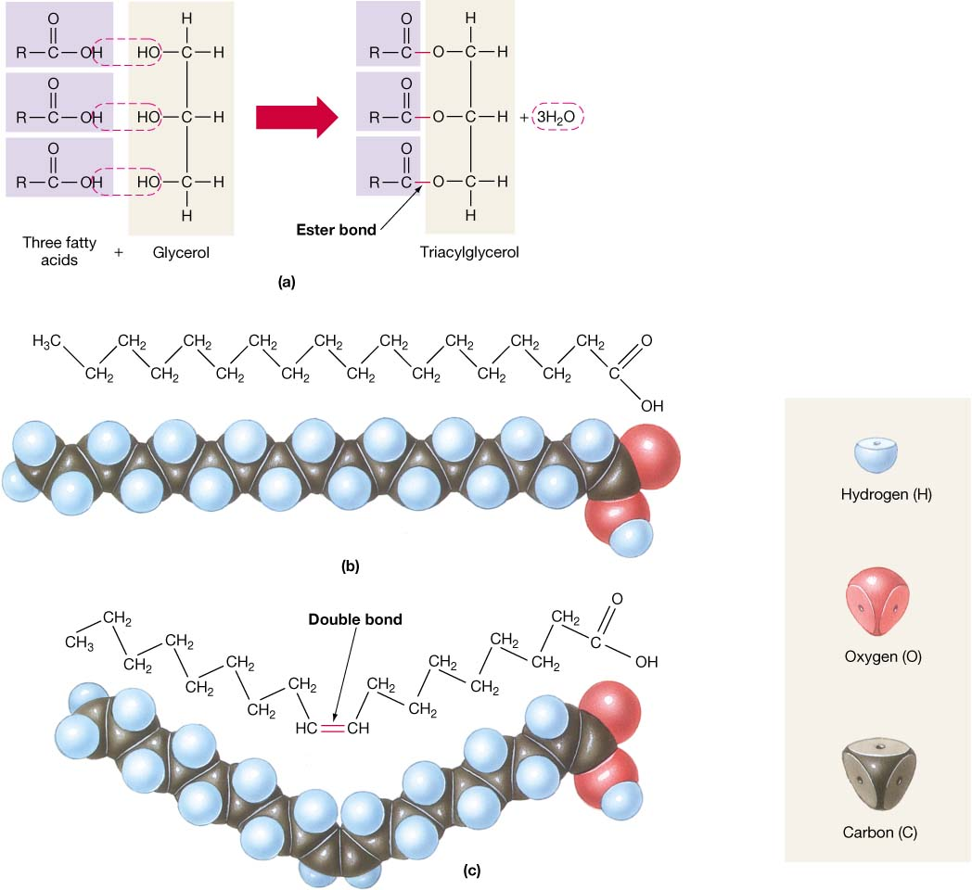

Slide 66
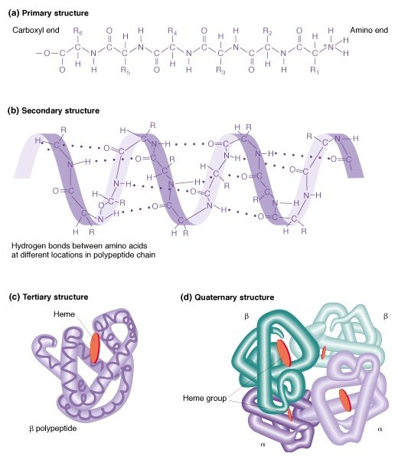
Proteins
PROTEINS -Proteins are chains of amino acids that twist and fold into certain shapes that determine what the proteins do. Proteins may be involved in structure, support, movement, communication, transportation, and carrying out chemical reactions.

Slide 67
A protein is a molecule made up of amino acids, building blocks that link to form proteins.
Every amino acid has an amino group and a carboxyl group.
Amino acids can form links called peptide bonds between two amino acids
The side group gives an amino acid its unique properties.
Twenty different amino acids are found in proteins.

Slide 68
For each type of protein, there are different levels of structure
amino acids are arranged in a specific order, the protein’s primary structure. 1
The interactions of the various side groups may form coils and folds, the protein’s secondary structure. 2
The overall shape of a single chain of amino acids is the protein’s tertiary structure. 3
The quaternary structure is the overall shape that results from combining the chains to form proteins. 4

Slide 69
The R group gives each amino acid its properties

Slide 70
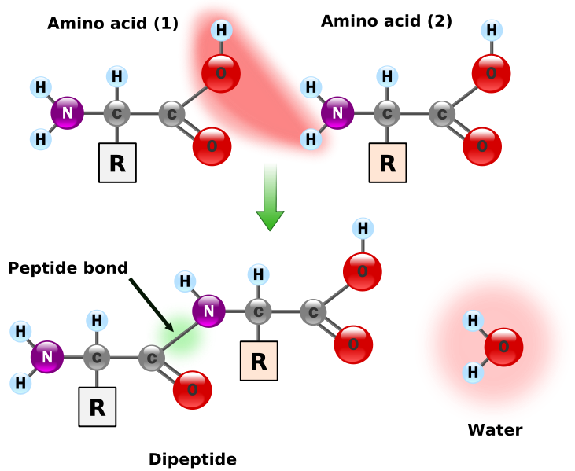

Slide 71
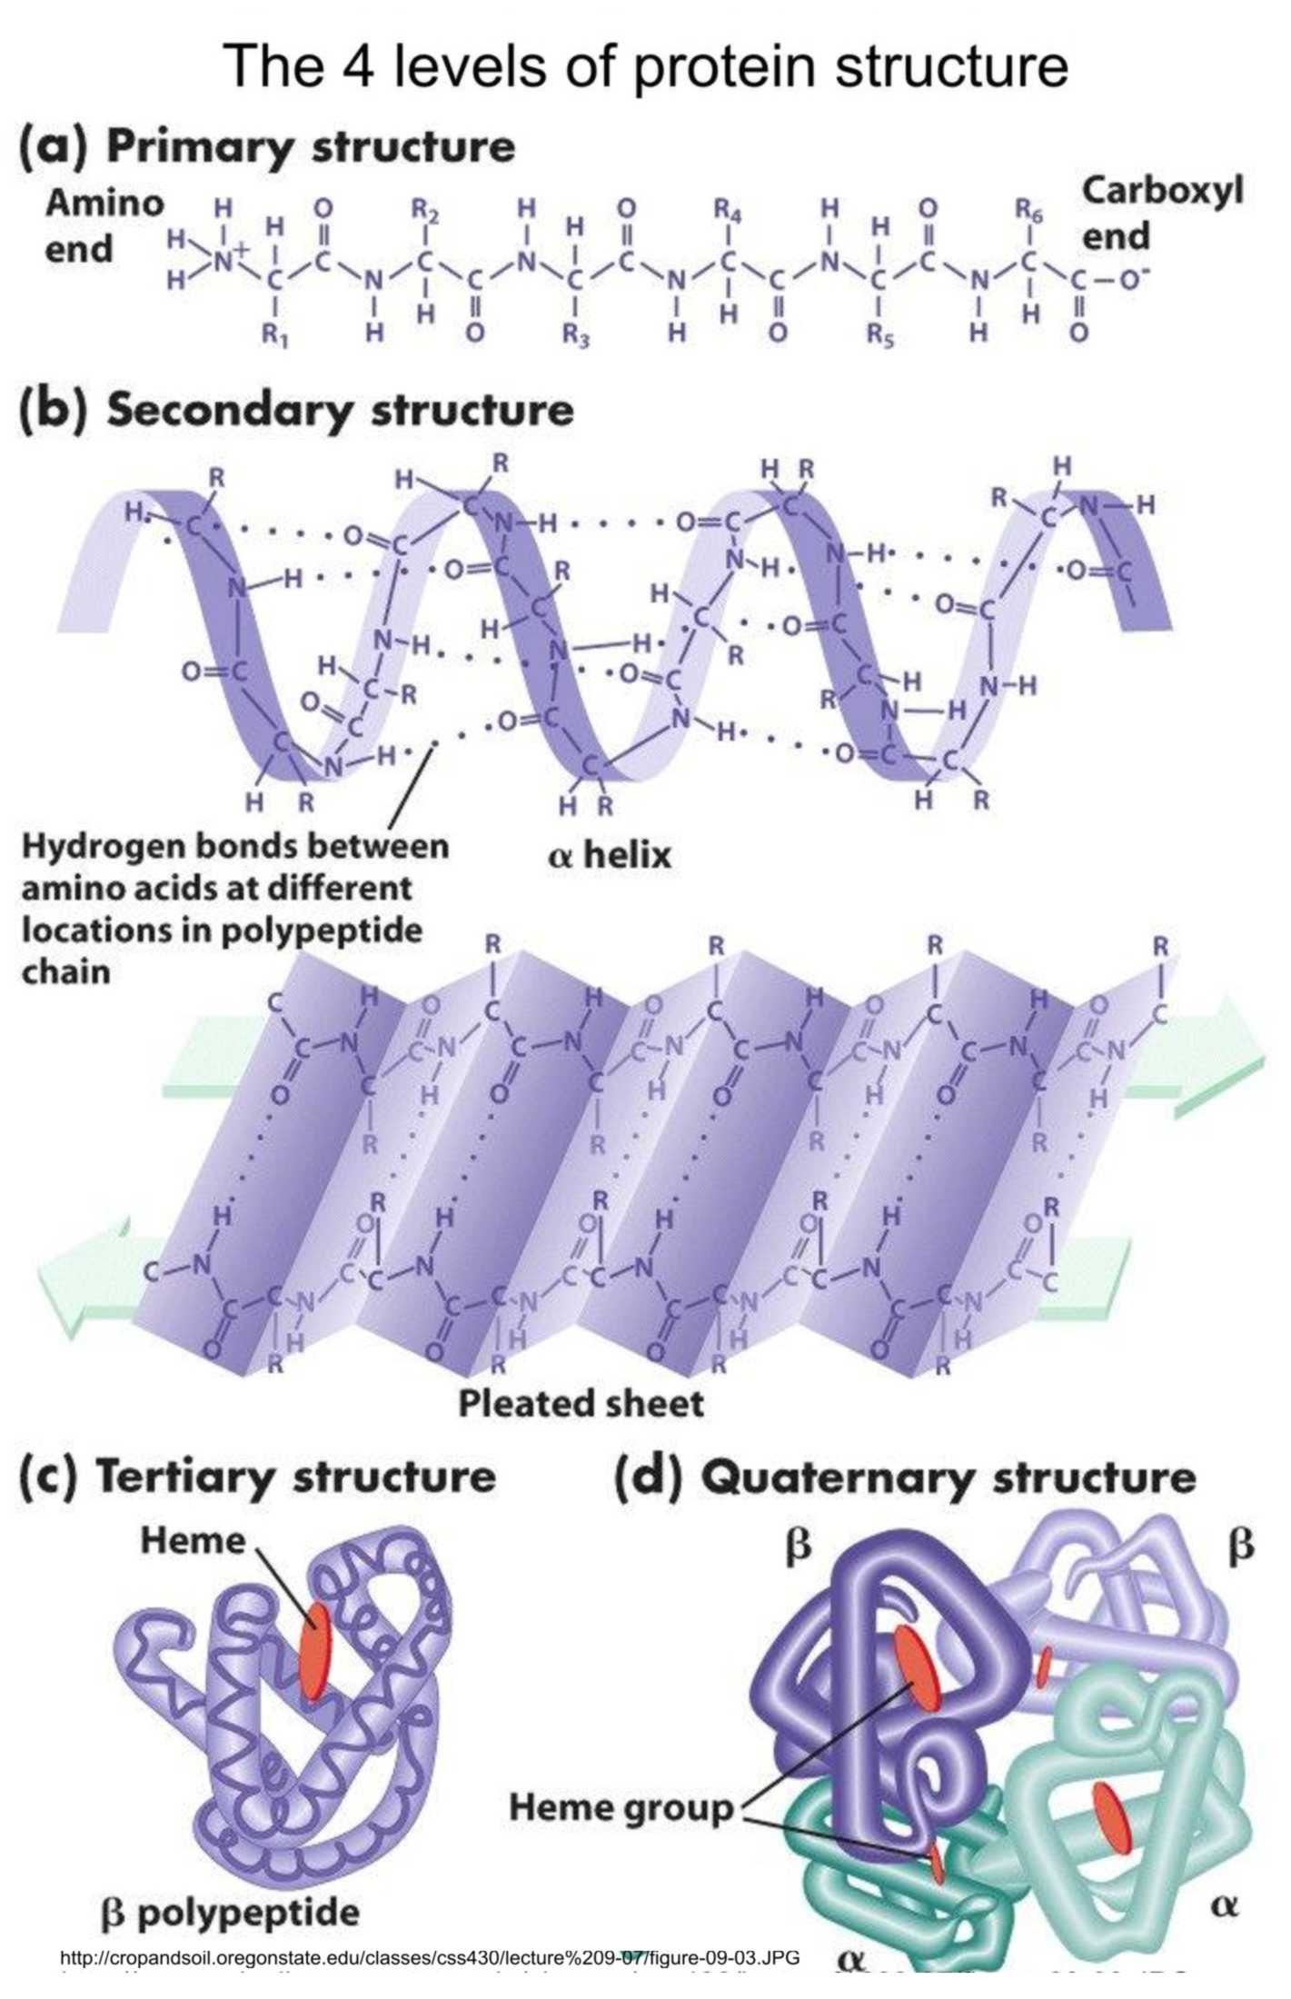

Slide 72
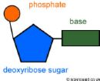
Nucleic Acids
NUCLEIC ACIDS - A nucleic acid is a long chain of nucleotide units.
A nucleotide is a molecule made up of three parts: a sugar, a base, and a phosphate group.

Slide 73
Nucleotides of deoxyribonucleic acid, or DNA, contain the sugar deoxyribose. DNA molecules act as “instructions” for the processes of an organism’s life
Nucleotides of ribonucleic acid, or RNA, contain the sugar ribose. RNA also interacts with DNA to help decode the information.
Adenosine triphosphate, or ATP, is a nucleotide that has three phosphate groups and supplies energy to cells. Energy is released in the reaction that breaks off the third phosphate group.

Slide 74
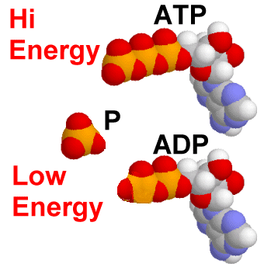

Slide 75
BIOMOLECULE | CAL/g | REPEATING SUBUNIT (MONOMER) | DRAW | IMPORTANCE INI THE CELL | WHY THEY ARE IMPORTANT IN BODY & EXAMPLES IN FOODS
CARBOHYDRATES | 4 | MONOSACCHARIDES |  | * CELL SURFACE MARKERS *ENERGY *LABELLING FOR EXPORT | *ENERGY SOURCE *RECOGNITION OF NON-SELF *BREAD, CEREALS, GRAINS, TUBERS

Slide 76
BIOMOLECULE | CAL/g | REPEATING SUBUNIT (MONOMER) | DRAW | IMPORTANCE INI THE CELL | WHY THEY ARE IMPORTANT IN BODY & EXAMPLES IN FOODS
PROTEINS | 4 | AMINO ACIDS |  | *ROCKSTARS *DO EVERYTHING *ENZYMES *STRUCTURES | *USED FOR STRUCTURES *MAKE ALL ENZYMES *ENZYMES DO EVERYTHING IN THE CELL AND BODY- MAKE NEW CELLS AND ALL REACTIONS *MEATS, BEANS, NUTS

Slide 77
BIOMOLECULE | CAL/g | REPEATING SUBUNIT (MONOMER) | DRAW | IMPORTANCE INI THE CELL | WHY THEY ARE IMPORTANT IN BODY & EXAMPLES IN FOODS
NUCLEIC ACIDS | 4 | NUCLEOTIDES |  | *CARRY GENETIC INFORMATION *ATP ENERGY CURRENCY OF CELL | *ALL CELLS HAVE DNA AND ATP *FOUND IN EVERYTHING WE EAT

Slide 78
BIOMOLECULE | CAL/g | REPEATING SUBUNIT (MONOMER) | DRAW | IMPORTANCE INI THE CELL | WHY THEY ARE IMPORTANT IN BODY & EXAMPLES IN FOODS
LIPIDS | 9 | FATTY ACIDS |  | *CELL MEMBRANE *LONG TERM ENERGY STORAGE | *USED FOR CELL MEMBRANES, INCLUDING NUCLEAR MEMBRANE * LONG TERM ENERGY STORAGE AND INSULATION *BUTTER, SEEDS, NUTS, GOOD FATS FROM FISH AND LEGUMES (BEANS)

Slide 79
Cell respiration
Cell respiration is not “breathing”
It is the use of glucose to create ATP.
ATP is then used to do anything in the cell (homeostasis, growth, digestion, reroduction, defense, movement)

Slide 80
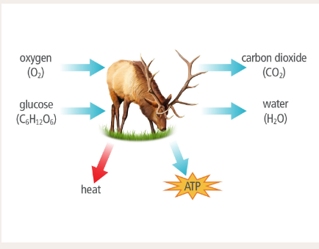

Slide 81
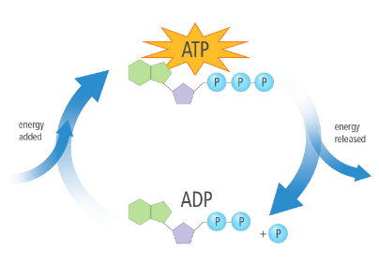
Energy is stored in the high energy phosphate bonds of ATP. This then turns to ADP when the phosphate bond is broken -letting off energy in the process

Slide 82
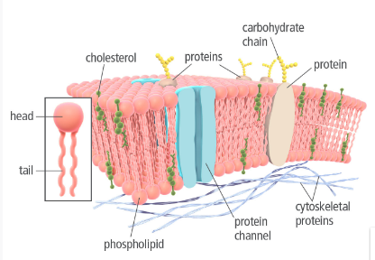
Cell membrane
The cell membrane is composed of a phopholipid bilayer. This allows the hydrophobic tails to be near the hydrophobic tails of another phospholipid

Slide 84
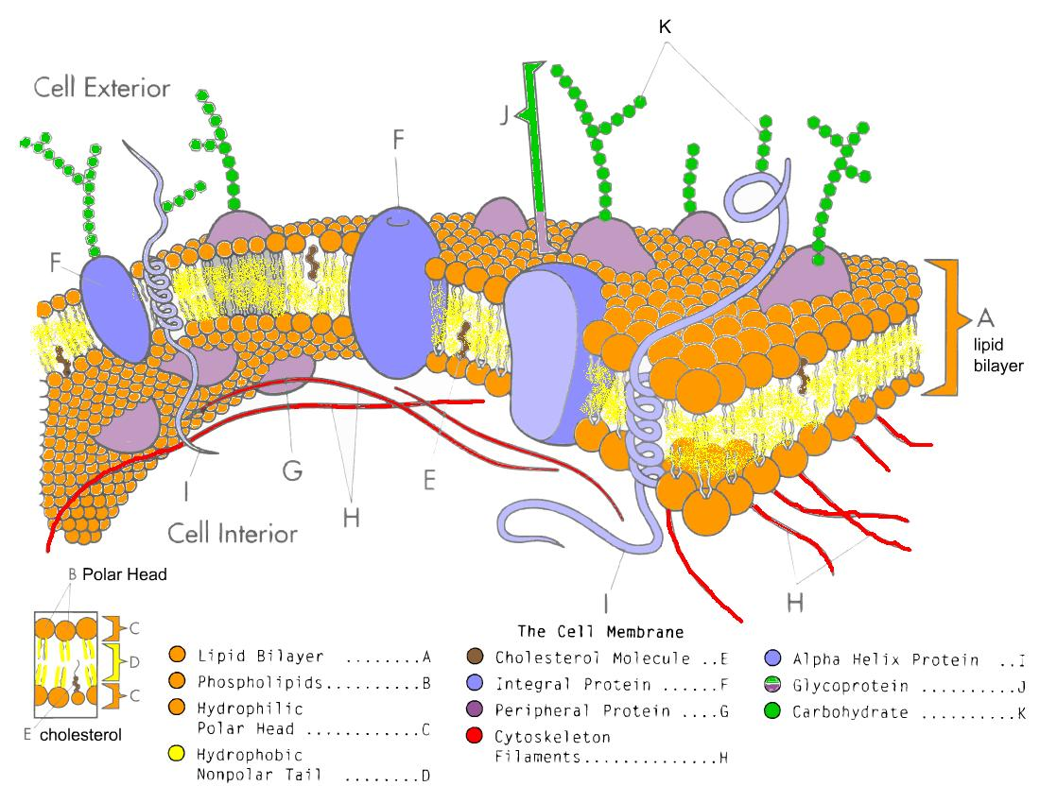

Slide 85
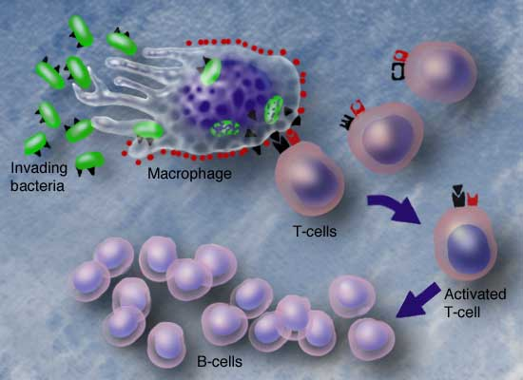
MEMBRANE PROTEINS-
Cell-surface markers -act like a name tag. A unique chain of sugars acts as a marker to identify each type of cell. These sugars (carbohydrates) are attached to the cell surface by proteins called glycoproteins. Glycoproteins help cells work together.

Slide 86
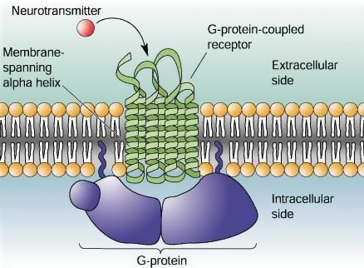
MEMBRANE PROTEINS-
Receptor proteins -enable a cell to sense its surroundings by binding to certain substances outside the cell. When this happens, it causes changes inside the cell.

Slide 87
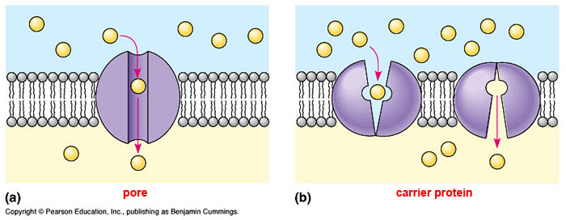
MEMBRANE PROTEINS-
Transport proteins -Many substances that the cell needs cannot pass through the lipid bilayer. Transport proteins aid the movement of these substances into and out of the cell.

Slide 88
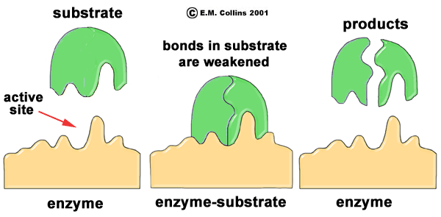
MEMBRANE PROTEINS-
Enzymes- allow reactions to take place- can break a larger molecule into 2 smaller molecules

Slide 89
TRANSPORT ACROSS THE MEMBRANE-
There are 2 types of transport-
Passive- does not require energy
Active- requires energy to happen

Slide 90
TRANSPORT ACROSS THE MEMBRANE-passive
PASSIVE TRANSPORT-In passive transport, substances cross the cell membrane down their concentration gradient. No energy is required for this. Passive transport includes
SIMPLE DIFFUSION- Small, nonpolar molecules can pass directly through the lipid bilayer. This type of movement is called simple diffusion. Oxygen moves down its concentration gradient into the cell. Carbon dioxide diffuses out of the cell. Also,natural steroid hormones, which are nonpolar and fat soluble, can also diffuse across the lipid bilayer.

Slide 91
TRANSPORT ACROSS THE MEMBRANE-passive
FACILITATED DIFFUSION- Many ions and polar molecules that are important for cell function do not diffuse easily through the nonpolar lipid bilayer. During facilitated diffusion, transport proteins help these substances diffuse through the cell membrane. Two types of transport proteins are

Slide 92
TRANSPORT ACROSS THE MEMBRANE-passive
FACILITATED DIFFUSION
channel proteins –channel proteins, sometimes called pores, serve as tunnels through the lipid bilayer. Each channel allows the diffusion of specific substances that have the right size and charge. Ions, sugars, and amino acids can diffuse through the cell membrane through channel proteins

Slide 93
TRANSPORT ACROSS THE MEMBRANE-passive
FACILITATED DIFFUSION-
carrier proteins- A carrier protein binds to a specific substance on one side of the cell membrane. This binding causes the protein to change shape. As the protein’s shape changes, the substance is moved across the membrane and is released on the other side.Carrier proteins transport substances that fit within their binding site.

Slide 94
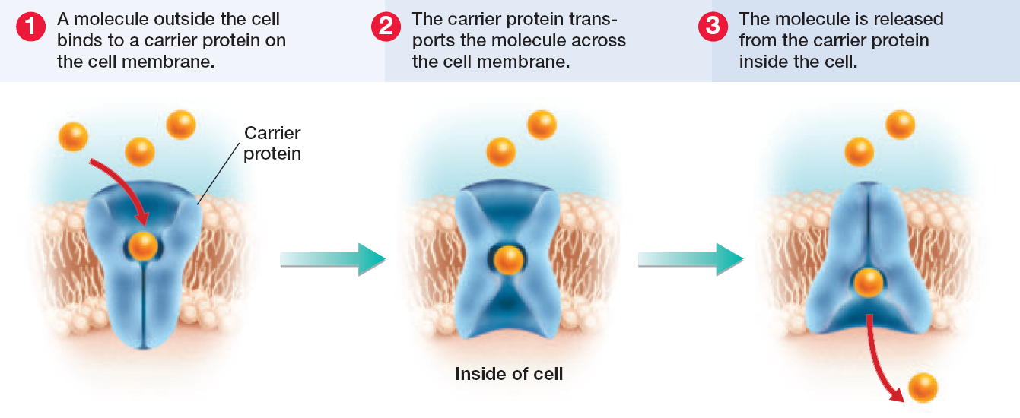

Slide 95
TRANSPORT ACROSS THE MEMBRANE-passive
OSMOSIS-Water can diffuse across a selectively permeable membrane in a process called osmosis. Osmosis allows cells to maintain water balance as their environment changes. Remember that in osmosis, ONLY the water molecules are free to move .

Slide 96
OSMOSIS- movement of water through a semi-permeable membrane down the concentration gradient

Slide 100
TRANSPORT ACROSS THE MEMBRANE- passive - osmosis
If the solution is hypertonic, or has a higher solute concentration than the cytoplasm does, water moves out of the cell. The cell loses water and shrinks

Slide 101
TRANSPORT ACROSS THE MEMBRANE- passive - osmosis
If the solution is isotonic, or has the same solute concentration that the cytoplasm does, water diffuses into and out of the cell at equal rates. The cell stays the same size .

Slide 102
TRANSPORT ACROSS THE MEMBRANE- passive - osmosis
If the solution is hypotonic, or has a lower solute concentration than the cytoplasm does, water moves into the cell. The cell gains water and expands in size. If left unchecked, the swelling caused by a hypotonic solution could cause a cell to burst.

Slide 103
TRANSPORT ACROSS THE MEMBRANE- passive - osmosis
The rigid cell walls of plants and fungi prevent the cells of these organisms from expanding too much. In fact, many plants are healthiest in a hypotonic environment.

Slide 104
TRANSPORT ACROSS THE MEMBRANE- active transport
ACTIVE TRANSPORT- Active transport requires energy to move substances against their concentration gradients. In order to move substances against their concentration gradients, cells must use energy. Most often, the energy needed for active transport is supplied directly or indirectly by ATP.

Slide 105
TRANSPORT ACROSS THE MEMBRANE- active transport
Pumps- In active transport, the carrier proteins do require energy to “pump” substances against their concentration gradient.
The sodium-potassium pump is a carrier protein that actively transports three sodium ions out of the cell and two potassium ions into the cell. This pump is one of the most important carrier proteins in animal cells. It prevents sodium ions from building up in the cell, resulting in osmosis into the cell making it burst.
The concentration gradients of sodium ions and potassium ions also help transport other substances, such as glucose, across the cell membrane.

Slide 106
TRANSPORT ACROSS THE MEMBRANE- active transport
The sodium-potassium pump is a carrier protein that actively transports three sodium ions out of the cell and two potassium ions into the cell. This pump is one of the most important carrier proteins in animal cells. It prevents sodium ions from building up in the cell, resulting in osmosis into the cell making it burst.
The concentration gradients of sodium ions and potassium ions also help transport other substances, such as glucose, across the cell membrane.

Slide 107
TRANSPORT ACROSS THE MEMBRANE- active transport
Vesicles- Many substances, such as proteins and polysaccharides, are too large to be transported by carrier proteins. Instead, they cross the cell membrane in vesicles, which are membrane-bound sacs made by pinching off of the membrane.

Slide 108
TRANSPORT ACROSS THE MEMBRANE- active transport
ENDOCYTOSIS- The movement of a large substance into a cell by means of a vesicle.

Slide 109
TRANSPORT ACROSS THE MEMBRANE- active transport
EXOCYTOSIS- The movement of material out of a cell by means of a vesicle.

Slide 110
SENDING SIGNALS- Cells communicate and coordinate activity by sending chemical signals that carry information to other cells.
A signaling cell produces a signal, often a molecule, that is detected by the target cell. Target cells have specific proteins that recognize and respond to the signal. These proteins are usually on the cell membrane (except in steroids)
Neighboring cells can communicate through direct contact between their membranes.
Long-distance signals are carried by hormones and nerve cells.

