Slide 2
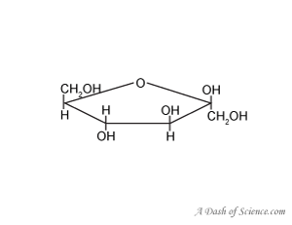
CARBOHYDRATES
4 KCAL/G,
REPEATING SUBUNIT (THE BUILDING BLOCKS) MONOSACCHARIDES
IMPORTANCE IN CELL
CELL SURFACE MARKERS
*ENERGY
*LABELLING FOR EXPORT
IMPORTANCE IN BODY
*ENERGY SOURCE
*RECOGNITION OF NON-SELF
*BREAD, CEREALS, GRAINS, TUBERS

Slide 3
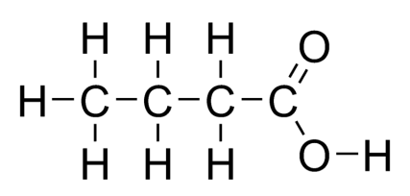
LIPIDS
9 KCAL/G,
REPEATING SUBUNIT (THE BUILDING BLOCKS)
FATTY ACIDS
IMPORTANCE IN CELL
*CELL MEMBRANE
*LONG TERM ENERGY STORAGE
IMPORTANCE IN BODY
*USED FOR CELL MEMBRANES, INCLUDING NUCLEAR MEMBRANE
* LONG TERM ENERGY STORAGE AND INSULATION
*BUTTER, SEEDS, NUTS, GOOD FATS FROM FISH

Slide 4
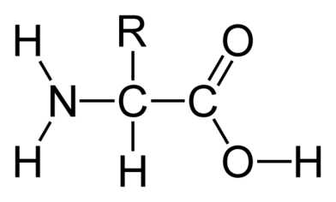
PROTEINS
4 KCAL/G,
REPEATING SUBUNIT (THE BUILDING BLOCKS) AMINO ACIDS
IMPORTANCE IN CELL
**ROCKSTARS
*DO EVERYTHING
*ENZYMES *STRUCTURES
IMPORTANCE IN BODY
*USED FOR STRUCTURES
*MAKE ALL ENZYMES
*ENZYMES DO EVERYTHING IN THE CELL AND BODY- MAKE NEW CELLS AND ALL REACTIONS *MEATS, BEANS, NUTS

Slide 5
NUCLEIC ACIDS
4 KCAL/G,
REPEATING SUBUNIT (THE BUILDING BLOCKS) NUCLEOTIDES
IMPORTANCE IN CELL
*CELL SURFACE MARKERS
*ENERGY
*LABELLING FOR EXPORT
IMPORTANCE IN BODY
*ENERGY SOURCE
*RECOGNITION OF NON-SELF
*BREAD, CEREALS, GRAINS, TUBERS

Slide 6
CHANGING MATTER
A physical change occurs when only the form or shape of the matter changes.
A chemical change occurs when a substance changes into a different substance.
Matter is neither created nor destroyed in any change. This observation is called the law of conservation of mass. Every change in matter requires a change in energy.
Energy may change from one form to another, but the total amount of energy does not change. This observation is called the law of conservation of energy.

Slide 7
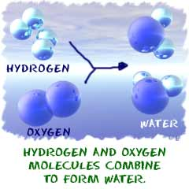
CHEMICAL REACTIONS -Chemical reactions can only occur when the activation energy is available and the correct atoms are aligned.

Slide 8
Activation energy
Changing a substance requires a chemical reaction. During this process, bonds between atoms are broken, and new ones are formed.
A reactant is a substance that is changed in a chemical reaction.
A product is a new substance that is formed.
Chemical reactions can only occur under the right conditions. The activation energy of a reaction is the minimum kinetic energy required to start a chemical reaction. Even if enough energy is available, the product still may not form. The correct atoms must be brought together in the proper orientation.

Slide 9
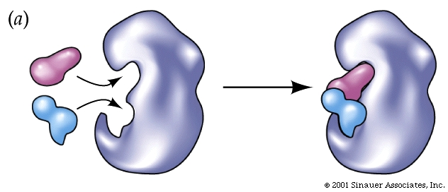
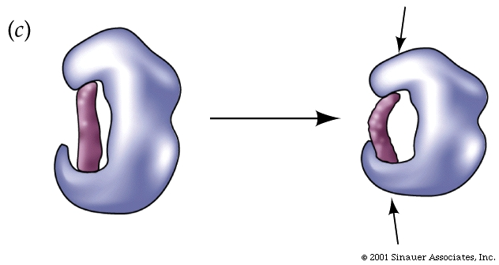
BIOLOGICAL REACTIONS - By assisting in necessary biochemical reactions, enzymes help organisms maintain homeostasis.

Slide 10
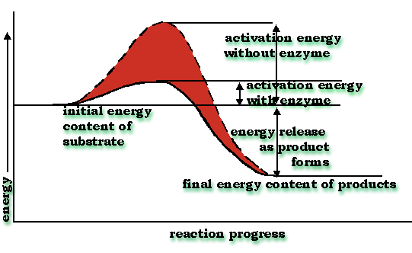
Enzymes
In living things, chemical reactions occur between large, complex biomolecules. Many of these reactions require large activation energies.

Slide 11
An enzyme is a molecule that increases the speed of biochemical reactions.
Enzymes hold molecules close together and in the correct orientation. An enzyme lowers the activation energy of a reaction.
Each enzyme has an active site, the region where the reaction takes place.

Slide 12
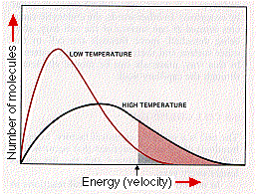
The shape of the active site determines which reactants, or substrates, will bind to it. Each different enzyme acts only on specific substrates.
Binding of the substrates causes the enzyme’s shape to change. This change causes some bonds in the substrates to break and new bonds to form.
Most enzymes need a certain range of temperatures and pH.

