Slide 2
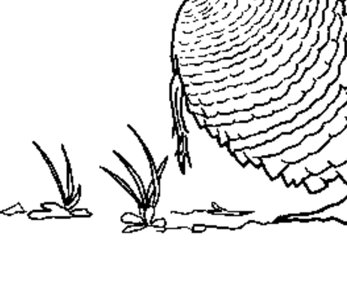
Draw what is inside the blue box on an index card

Slide 3
Questions for group
How does a cut or broken bone heal? Nothing to do with immune system
How do we develop from a fertilized egg?
Do all of your cells have the same DNA? How do you know?
Why do we look like our parents?
What makes you YOU? And you can not answer dna, heredity, or genes)

Slide 4
search-ms:displayname=Search%20Results%20in%20beneduccim%20(%5C%5Cwctech2%5CUsers.school_wctsap01)%20(H%3A)&crumb=location:H%3A%5C\mitosis muheisen
H:\ch01\mitosis muheisen

Slide 5
The following organelles and structures are required for the project
DNA- 2 copies of chromosome 1. you must label at least one chromatid for at least 5 pages | purple
centromere | red
nuclear membrane | green
spindle fibers | yellow
cell membrane | black

Slide 6
 | YES=1 POINTS | NO= ZERO
ALL STAGES OF MITOSIS ARE PRESENT-PROPHASE METAPHASE ANAPHASE TELOPHASE CYTOKINESIS
EACH PAGE HAS THE CORRECT STAGE ON THE BOTTOM EDGE OF THE FLIPBOOK THAT IS LEGIBLE
SCIENCE NUMBER AND NAME ARE ON THE BACK OF THE FLIPBOOK
ANIMATION IS NOT JUMPY AND MOVEMENT OF THE CHROMOSOMES IS SPREAD OUT OVER ENOUGH PAGES TO BE SMOOTH
ALL PARTS THAT ARE REQUIRED ARE PRESENT- CHROMOSOME, CHROMATID, CENTROMERE, NUMCLEAR MEMBRANE, SPINDLE FIBERS, CELL MEMBRANE
ALL PARTS ARE CORRECTLY COLORED AND CHROMATID IS LABELLED FOR 5 SLIDES
BOOK IS NEAT - NO CROSSOUTS, SCRIBBLES ETC
BOOK IS NEATLY BOUND AND EASY TO FLIP
THE BOOK IS AT LEAST 40 PAGES OF DRAWINGS
THE RUBRIC IS INCLUDED WITH THE PROJECT AND THE FLIPBOOK IS PLACED WITHIN THE FOLDED SHEET WITH THE TOP OPEN FOR REMOVAL AND THE SIDES STAPLED

Slide 7
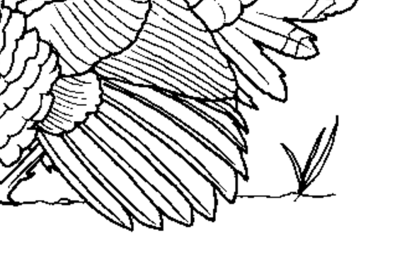
Draw what is inside the blue box on an index card

Slide 8
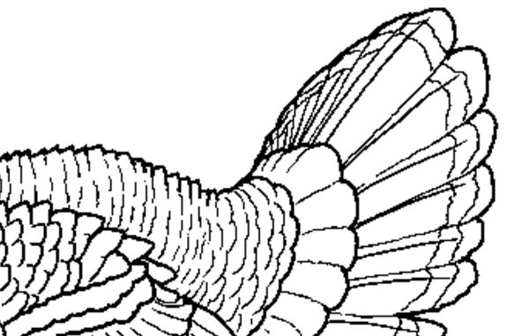

Slide 9
