Slide 1
Digital microscope

Slide 2
on list on page 31
Onion skin
Cork
Bamboo
cheek cells stained with methylene blue
All under high power cheek cells on digital microscope

Slide 6
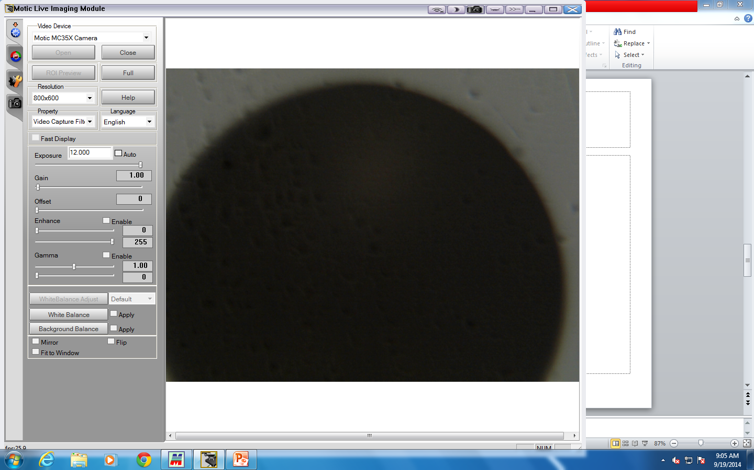

Slide 7
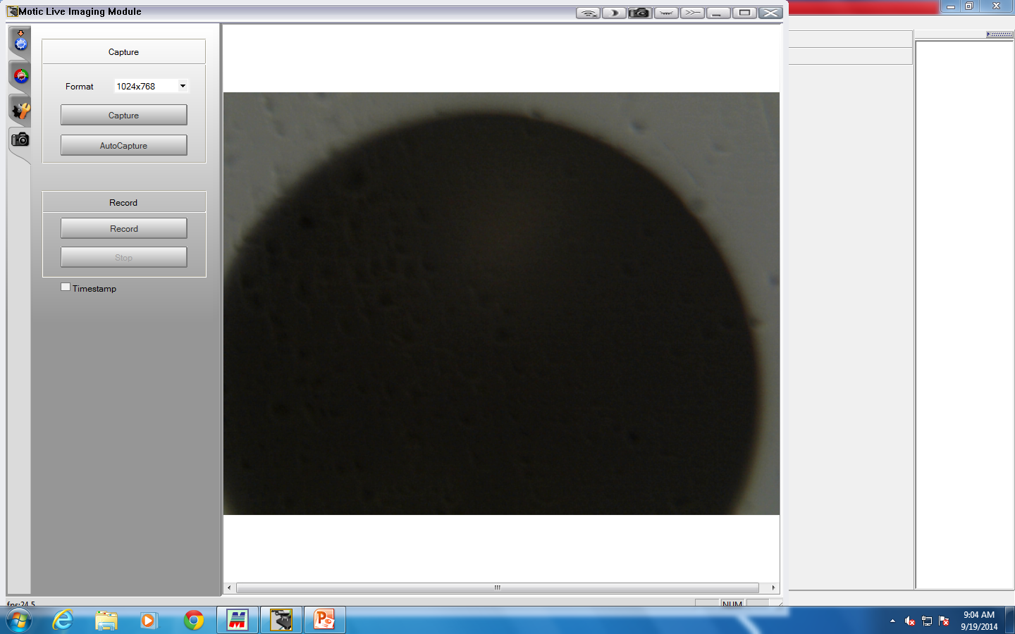

Slide 8
