Slide 1
The Periodic Table
Section 1: Organizing the Elements
Section 2: Exploring the Periodic Table
Section 3: Families of Elements

Slide 2
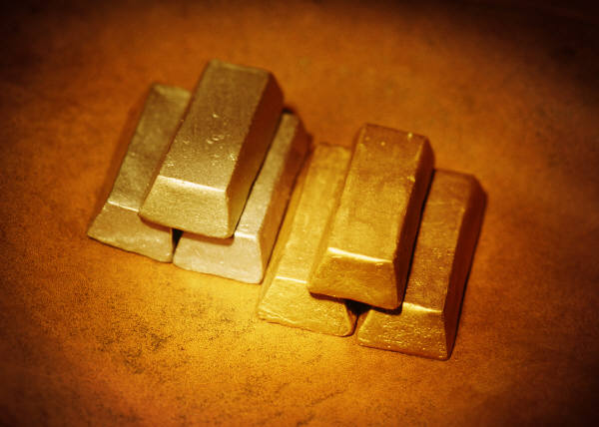

Organizing the Elements
Why It Matters:
Gold and silver—both used in jewelry –have similar properties and are, therefore, located in the same column of the periodic table.

Slide 3
Recognizing a Pattern
Dmitri Mendeleev, a Russian chemist, was one of the first scientists to design a way of organizing the elements.
He studied the properties of the elements and looked for patterns among the properties.
He found that if the elements were listed by increasing atomic mass, certain properties appeared at certain intervals within the list.

Slide 4
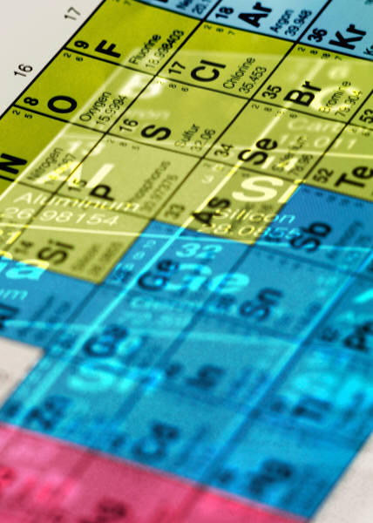
In 1869, Mendeleev published the first periodic table of the elements.
In this periodic table, Mendeleev arranged the elements in rows by increasing atomic mass.
He started a new row each time the chemical properties of the elements repeated. So, for any column, all of elements in that column had similar properties.

Slide 5
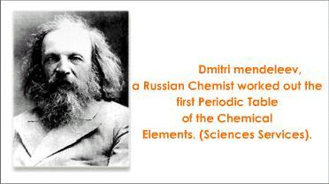

Slide 6
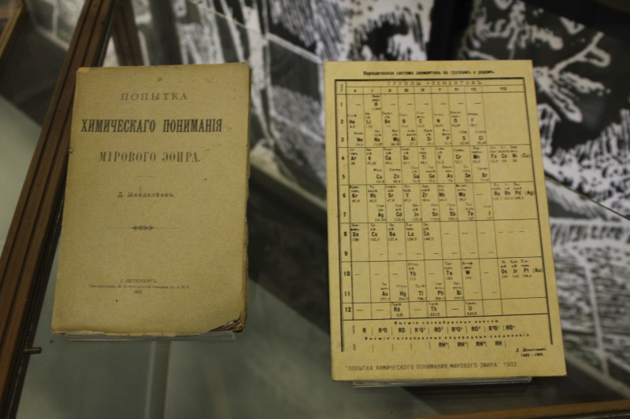

Slide 7
Mendeleev was able to predict new elements.
He arranged the elements and made a list, he left gaps in the list. He then constructed a table from the list and left gaps in the table as well.
He placed a question mark where there was no known element whose properties fit the pattern.
He predicted new elements would be discovered to fill those gaps.

Slide 8
He left a space for an element after silicon. He predicted that this element would be a grey metal that has a high melting point.
In 1886, the element germanium was discovered. The properties of germanium were similar to those Mendeleev predicted.
Also discovered were two other elements that closely matched Mendeleev’s predictions. They were gallium and scandium.

Slide 9
Mendeleev was not the first person to develop a periodic table, but he was the first to use the table to make predictions.
He is considered the father of the periodic table.
The element mendelevium was named in his honor.

Slide 10
A few elements did not fit the pattern.
He had to reverse positions of the elements tellurium and iodine. They were then in columns with similar elements. However they were no longer in order of increasing atomic mass.

Slide 11
Changing the Arrangement
As more information is learned about the structure of the atom, scientists are then able to improve on Mendeleev’s table.
About 40 years after Mendeleev published his table, the English chemist Henry Moseley arranged the elements by atomic number rather than by atomic mass. Most elements did not change their placement in the table, but some did. This new arrangement fixed discrepancies with the elements tellurium and iodine.

Slide 12
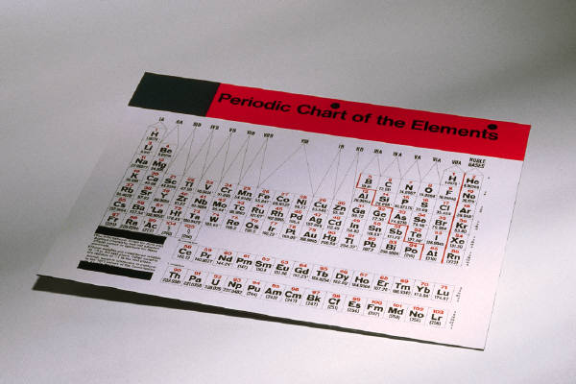
The modern periodic table organizes elements by atomic number. When the elements are arranged in this way, elements that have similar properties appear at regular intervals. This principle is known as the periodic law.
Periodic law--the law that states that the repeating chemical and physical properties of elements change periodically with the atomic number of the elements.

Slide 13
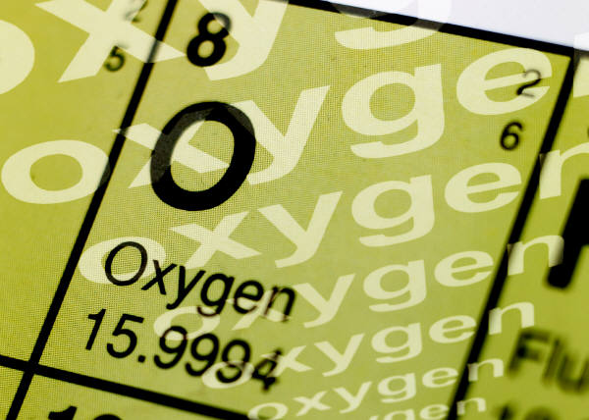
Elements become less metallic across each period.
Each row of the periodic table is a period. It has seven periods. As you move left to right across a period, properties such as reactivity and conductivity change, and the elements become less metallic.
Period--a horizontal row of elements in the periodic table.

Slide 14
Elements in a group have similar properties
Each column of the periodic table is a group. All the elements in that group have similar chemical properties.
There are 18 groups across the periodic table.
Group--a vertical column of elements in the periodic table, elements in a group share chemical properties.

Slide 15

Exploring the Periodic Table
Section 2
Why It Matters
The properties of metals make metals useful for conducting electricity . For example, wires that carry electricity are made of metal.

Slide 16

Why is neon an unreactive element?
Why is sodium so reactive that it reacts violently with moisture and oxygen in the air?
These chemical properties are related to the number of electrons in each element.

Slide 17
The role of electrons
The periodic table is arranged by atomic number.
For a neutral atom, the number of protons equals the number of electrons.
The periodic trends in the periodic table are a result of electron arrangement.
The chemical properties of each group are largely determined by the number of valence electrons.
They are considered part of the outer “shell” of electrons.

Slide 18
Valence electrons account for similar properties
The number of valence electrons determines many of the chemical properties of the element.
Example: look at 2 elements from Group 1, lithium and sodium. Both have one valence electron, so they have similar chemical properties.
In general elements in a group have chemical and physical properties in common because they have the same number of valence electrons.
They do however differ in the number of protons they have, and the number of electrons in their filled inner energy levels.

Slide 19
An element’s location in the periodic table is related to electron arrangement.
You can find out how the electrons are arranged in atoms of an element if you know where the element is located in the periodic table.
Open your text book to page 152, and lets look at figure 2, and the charts discussing the s & p orbitals by the number of electrons.

Slide 20
Ion Formation
Atoms whose outermost orbitals are not filled may undergo a process called ionization. Atoms may gain or lose electrons so they have a filled outermost orbital.
If an atoms gains or loses electrons, it no longer has an equal number of electrons and protons. Because these charges do not cancel completely, the atom has a net electric charge.
A charged atom is called an ion.

Slide 21
Group 1 elements form positive ions
Lithium is a Group 1 elements. It is reactive in air, water, and especially in acid. The atomic structure of lithium explains lithium’s reactivity.
It has three electrons—2 in the first energy level in the s orbital and only 1 occupies the second energy level. This single valence electron is easily removed which makes lithium reactive.
Removing the electron forms a positive ion, or cation.
Other atoms is Group 1 also have 1 valence electron and behave similar to lithium and are reactive.

Slide 22
Group 17 elements form negative ions
Fluorine is also very reactive. Each fluorine atom has 9 electrons, 2 of these are in the first energy level. The other 7 are valence electrons and they are in the second energy level.
It needs only one more electron to have a filled outermost energy level. An atom of fluorine easily gains this electron to form a negative ion, or anion. Because an ion of fluorine has a filled outer energy level the ion is more stable and less reactive than a fluorine atom.

Slide 23
A positive ion is written Li+ and a negative ion is written Fˉ.
Why do Group 1 and Group 17 elements easily form ions?
Because the addition or removal of a single electron creates a full outer energy level.

Slide 24
How are Elements Classified
The elements of the 18 groups are classified into three main categories. These three categories are based on general properties that the elements in the categories have in common.
All elements are either metals, nonmetals, or metalloids sometimes called semiconductors.

Slide 25
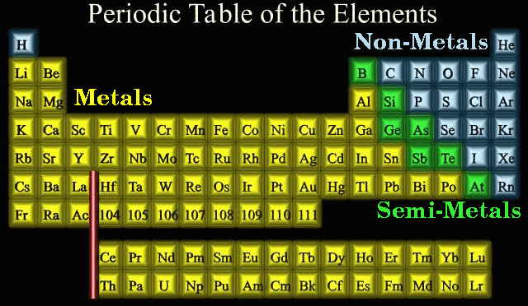

Slide 26
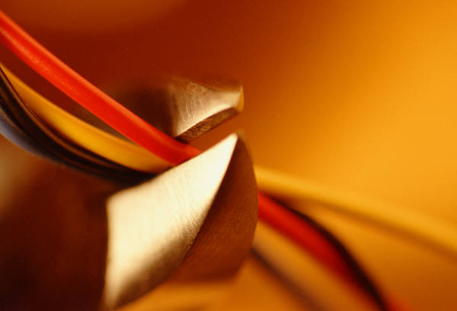
Elements in each category have similar properties
Most elements are metals. Most metals are shiny solids that can be stretched and shaped. They are also good conductors of heat and electricity.
Nonmetals except for the hydrogen, are found on the right side of the periodic table. They maybe solids, liquids or gases at room temperature. Solid nonmetals are often dull and brittle. They are poor conductors of heat or electricity and are sometimes called insulators.

Slide 27
Semiconductors or metalloids can conduct electricity under certain conditions.
See the book chart on page 155 for the properties of each of the categories.

Slide 28
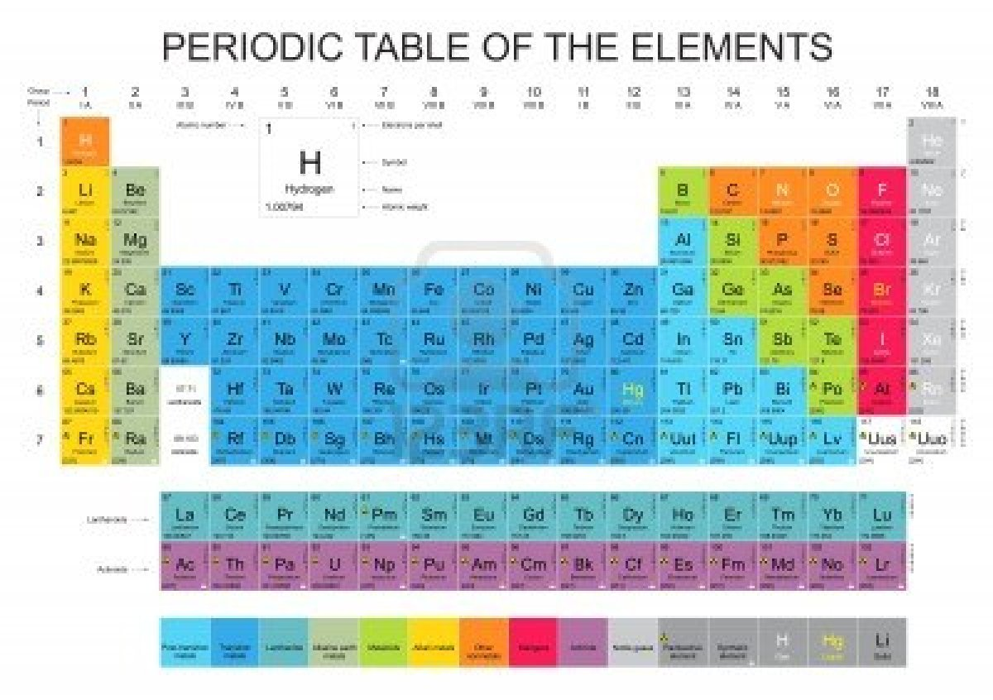

Slide 29
Families of Elements
Section 3
Why It Matters
The tiny chip in electronic devices contain semiconductors, such as silicon. Semiconductors give chips properties that allow computers to work.

Slide 30
Sometimes, one or more groups in the periodic table are categorized as being members of a unit called a family.
Consider your own family. Each member is unique, but you all share some features.
Members of a family in the periodic table have properties in common as well.

Slide 31
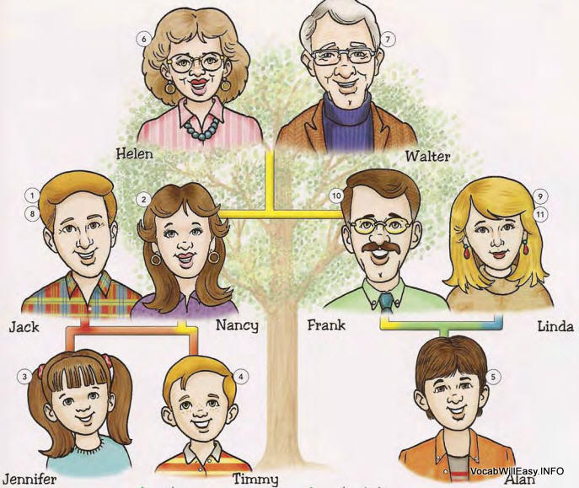

Slide 32
Classifying Elements Further
The elements in a family have the same number of valence electrons.
Elements are classified as Metals, Nonmetals, and Metalloids/Semiconductors.

Slide 33
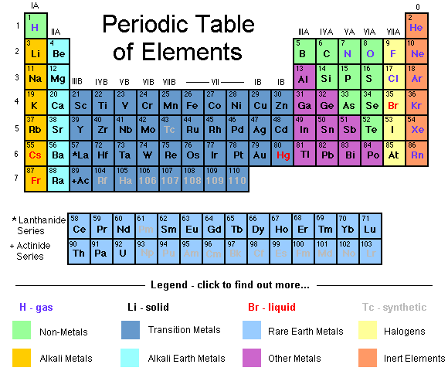

Slide 34
Metals
Many elements are classified as metals. All metals conduct heat and electricity. Most metals can also be stretched and shaped into flat sheets, or pulled into wires.
Families of metals include the alkali metals, the alkaline-earth metals, and the transition metals.

Slide 35
The alkali metals are very reactive.
Sodium is found in Group 1, like other alkali metals it is soft and shiny and reacts violently with water.
Alkali metals are often stored in oil to prevent them from reacting with moisture in the air.
An atom of an alkali metal is very reactive because it has one valence electron that can easily be removed to form a positive ion.
Because they are very active they are not found in nature as uncombined elements.

Slide 36
Alkaline-earth metals from compounds that are found in limestone and in the human body.
Calcium is in Group 2 of the periodic table.
Calcium is an alkaline-earth metal. In general they are harder, denser, stronger, and have higher melting points than alkali metals.
They have two valence electrons, they are less reactive than alkali metals but they still react to form positive ions.
The ions have a plus 2+ charge, because it loses it’s two valence electrons. Ca²+. They combine with other elements to form compounds.

Slide 37
Calcium compounds make up the hard shells of many sea animals. When the animal dies their shells settle to form large deposits that eventually become limestone or marble.
The coral reef is made of limestone.
Your bones and teeth get their strength from calcium compounds.
Magnesium is the lightest of all structural metals.
It activates many of the enzymes that speed up the processes in the human body.
In medicines we have milk of magnesia & Epsom salts.

Slide 38
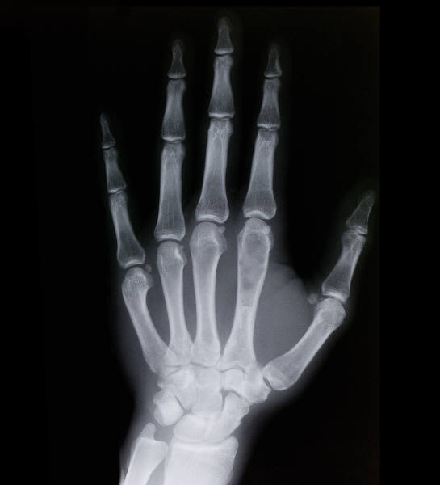



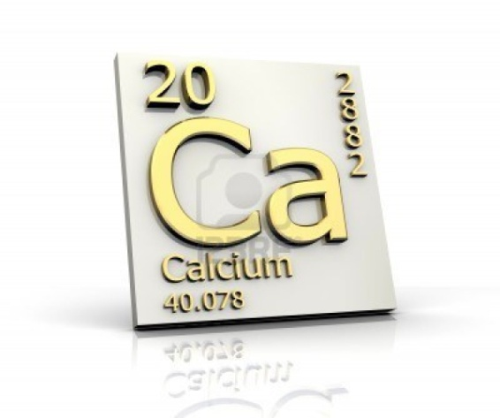
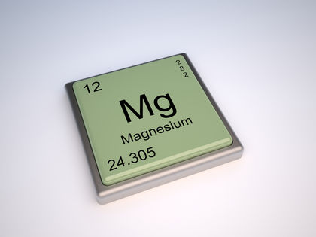

Slide 39
Transition metals are in the middle of the periodic table.
Gold is a valuable transition metal.
These metals are found in Groups 3 -12 of the periodic table.
These metals such as gold are less reactive than sodium or calcium.
Unlike most transition metals, gold is not found in nature combined with other elements.
Transition metals can lose electrons to form positive ions.

Slide 40
These are two possible cations of gold, Au+ if it loses one valence electron and Au³+ if it loses 3 electrons.
Some transition metals can form as many as four differently charged cations because of their complex arrangement.
Mercury is the exception as it is a liquid at room temperature, transition metals are harder, more dense, and have higher melting points than alkali metals and alkaline-earth metals.
Gold, silver, and platinum are used in jewelry and copper is used in plumbing and wiring.

Slide 41
Some elements are synthetic
All elements that have an atomic number greater than 92 are synthetic. Created in a lab.
These elements are radioactive which means the nuclei of their atoms are continually decaying to produce different elements.

Slide 42
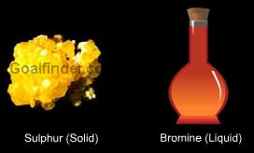
Nonmetals
Except for hydrogen, nonmetals are found on the right side of the periodic table.
Nonmetals include some elements in Groups 13-16 and all of the elements in Group 17 and 18.
Families of nonmetals include the noble gases and the halogens.

Slide 43

The noble gases are relatively inert
Neon is one of the noble gases that make up Group 18 of the periodic table.
Neon is responsible for the bright reddish orange light of neon signs and mixing neon with other substances can change the color.

Slide 44
Noble gases are different from most elements that are gases because noble gases exist as single atoms instead of as molecules.
Like other members of Group 18, neon is inert, or unreactive because its s and p orbitals are filled. For this reason, neon and other neon gases do not gain or lose electrons to form ions.
Under most normal conditions, most noble gases do not join with other atoms to form compounds.
Examples: helium is used in blimps and balloons and argon is used to fill light bulbs because its lack of reactivity prevents the bulbs’ filaments from burning.

Slide 45
The halogens combine easily with metals to form salts
Chlorine and other halogens belong to Group 17 of the periodic table. The halogens are the most reactive nonmetals.
Halogens have seven valence electrons and with the addition of a single electron, halogens become stable.
They combine easily with alkali metals and combine with other metals as well. Compounds that result from such combinations are called salts.
Example: NaCl

Slide 46

Halogens all have the same number of valence electrons, seven. This configuration is one electron short of the complete octet found in noble gas atoms. As a result, halogen elements react by gaining one electron to form ions with a 1- charge.

Slide 47

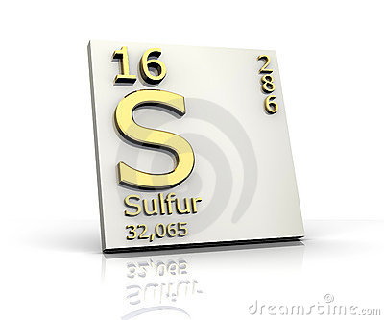

Nonmetals and their compounds are plentiful on Earth
Six other nonmetals are on the right side of the periodic table.
Oxygen, nitrogen, and sulfur are common nonmetals.
They may gain electrons to form negative ions.
Oxygen forms oxide, O²ˉ, nitrogen forms nitride, N³ˉ, and sulfur forms sulfide, S²ˉ.

Slide 48
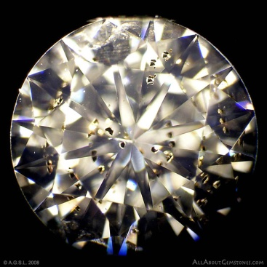
Carbon can form many compounds.
In its pure form it can be found as graphite (pencil lead) or as diamonds.
The existence of fullerenes, a third form of carbon was confirmed in 1990.
Carbon can combined with other elements to form millions of carbon-containing compounds.
Carbon compounds are found in both living and nonliving things.

Slide 49
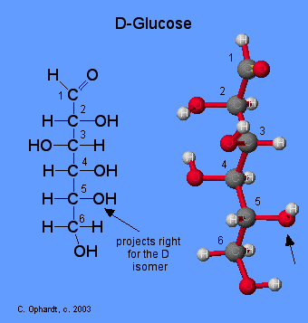
There are many examples of carbon compounds such as glucose, chlorophyll, isooctanes.

Slide 50
Semiconductors
Six elements that are referred to as metalloids or semiconductors are boron, silicon, germanium, arsenic, antimony, & tellurium.
They are not metals but have some properties of metals.
As their name suggests, semiconductors are elements that are able to conduct heat and electricity under certain conditions.

Slide 51
Hydrogen is in a class by itself
It has one proton and one electron.
It does not behave like the other elements and as a result it is in a class by itself in the periodic table.
It is the most abundant element in the universe.
For about every four atoms in the universe three are hydrogen.
With its one electron hydrogen can react with many other elements including oxygen.
The compound water is essential to life and is present in all living organism.

Slide 52
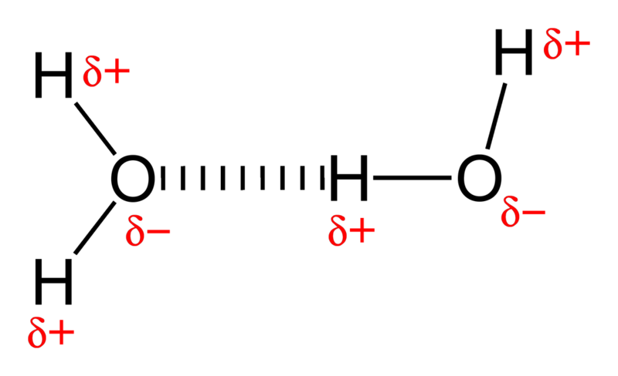
Hydrogen bonding in water--

Slide 53
Why are alkali metals very reactive?
Because each atom has one valence electron that can easily be removed and this helps them form compounds very easily?
What are some examples of transition metals?
There are many some examples: gold, silver, platinum, and titanium.

Slide 54
Why are the noble gases unreactive?
Because their s and p orbitals are full of electrons.
What are some examples of carbon compounds?
There are many examples some being glucose, chlorophyll, & isooctane.

