Slide 1
Chapter 3
States of Matter
Section 1: Matter and Energy
Section 2: Changes of State
Section 3: Fluids
Section 4: Behavior of Gases

Slide 2
States of Matter
This chapter covers the kinetic theory of matter, changes of state, the law of conservation of mass, and the law of the conservation of energy. This chapter then introduces the characteristics and behavior of fluids. This chapter ends with the properties and behavior of gases, as well as Boyle’s, Charles’s and Gay-Lussac’s laws.

Slide 3
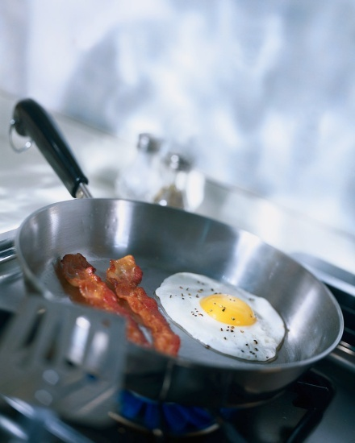
Matter and Energy
When you are cooking, energy is transferred from the stove to the food. As the temperature increases, some particles in the food move very fast and spread through the air in the kitchen. The state, or physical form of a substance is determined partly by how the substance’s particles move.

Slide 4
First: assume atoms and molecules within the food substances are always in motion and are colliding with each other.
Kinetic Theory
When you visit a restaurant kitchen you can smell the food even before you reach the stove.
One way to explain this phenomenon is to make some assumptions.
First: Assume atoms and molecules within the food substances are always in motion and are colliding with each other.
Second: Assume that the atoms and molecules move faster as the temperature increases.

Slide 5
A theory based on this assumption is called kinetic theory of matter.
According to the kinetic theory of matter, matter is made of atoms and molecules. These atoms and molecules act like tiny particles that are always in motion.

Slide 6

Observations of particles in motion
  The higher the temperature of the substance is, the faster the particles move.
  At the same temperature, more massive particles move slower than less massive ones.
Cup of hot tea: First the particles move very quickly and as the tea cools, its particles begin to slow down.

Slide 7
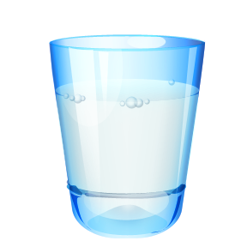
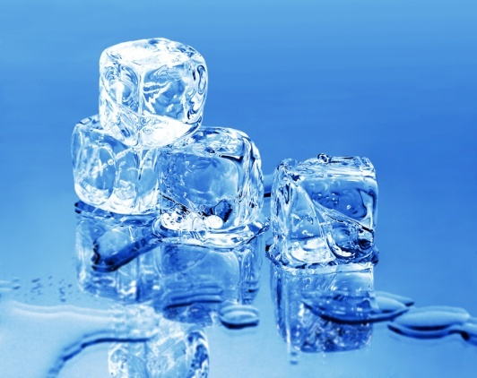
States of Matter
There are three: Solid, liquid, and gas
In a solids the particles vibrate in place
In a liquid the particles are closely packet, but they can still slide past each other
In a gas the particles are in constant motion and do not usually stick together.

Slide 8
You can classify matter as a solid, a liquid, or a gas by determining whether the shape and volume are definite or variable.
Solids have a definite shape and volume. These particles are held closely in place by strong attractions, and they vibrate in place.
Liquids change shape, not volume. These particles fast enough to overcome the forces of attraction between them. Liquids are able to able to take the shape of their containers. They change shape but they do not easily change volume. The volume of a liquid remains constant.

Slide 9
Gases change both shape and volume. Like liquids gases do not have fixed shapes. Liquids and gases can move past each other, they are fluids. Gases can change shape and volume. Fluids are a nonsolid state of matter in which the atom, or molecules are free to move past each other, as in a gas or liquid.
  Example: open a bottle of perfume the liquid particles will escape as a gas and you will smell it around the room.
The amount of empty space between the particles changes, and the gas expands to fill the space. Gas can be compressed in a smaller container or spread out.

Slide 10
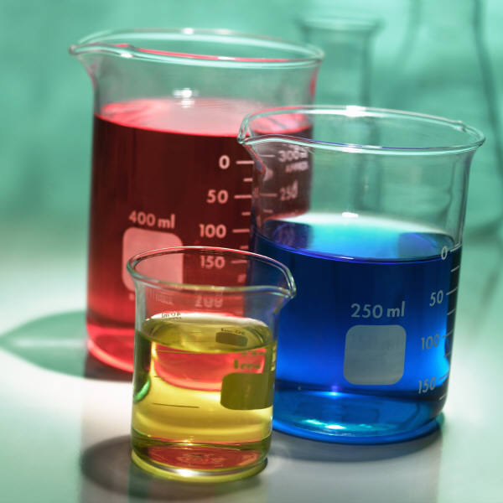
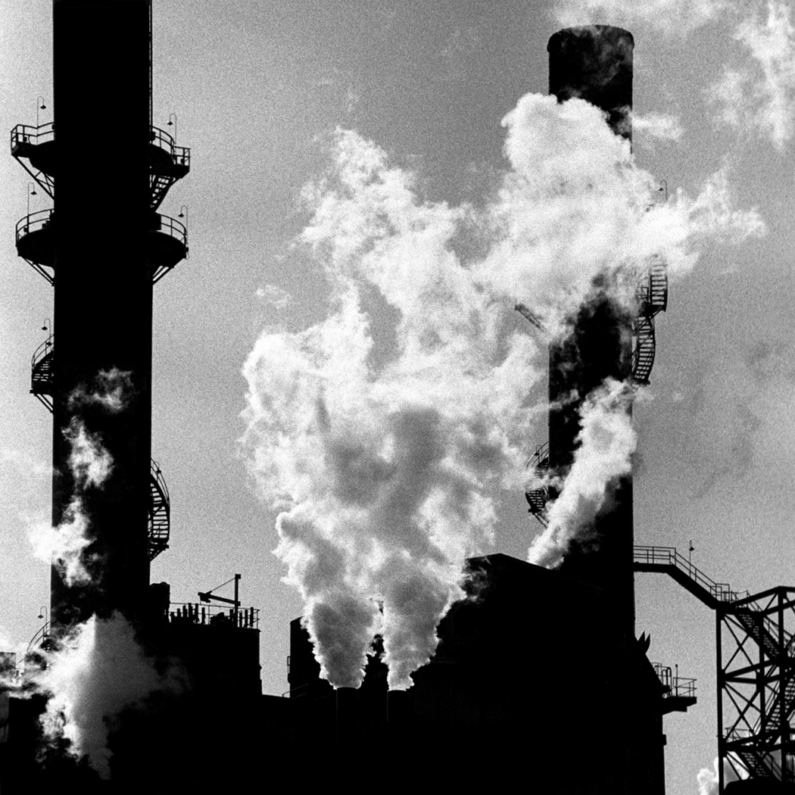
So what is the one difference between liquids and gases?
Liquids do not change volume, but gases do.

Slide 11
Plasma is most common state of matter
Scientist estimate that 99% of the known matter in the universe, including the sun and other stars, is made of plasma.
Plasma—a state of matter that consists of free-moving ions and electrons.
Plasma particles are electrically charged or ionized.
Natural plasmas are found in lighting, fire, and the aurora borealis (Northern lights). Artificial forms of plasma, which is formed by passing electric currents through gases, are found in fluorescent lights.

Slide 12
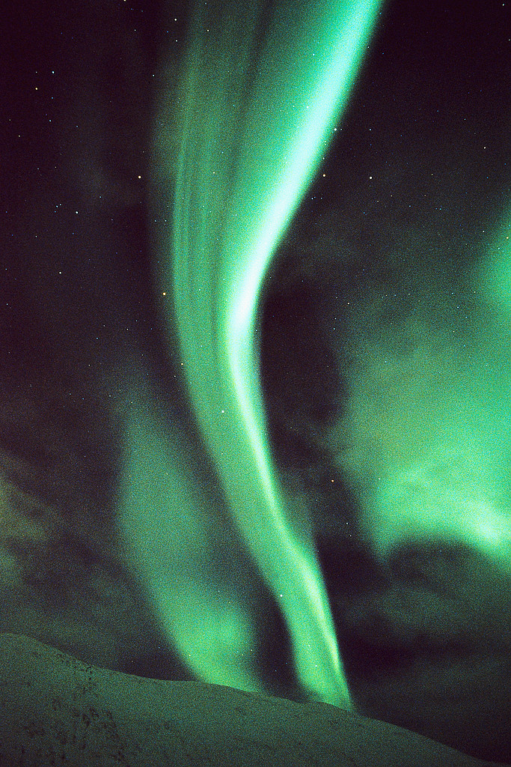
Plasma are similar to gases but have some properties that are different from the properties of gases. Plasma conduct electric current, while gases do not.

Slide 13


Energy’s Role
What energy sources would you use if your electricity went out?
  Candles
  Batteries for flashlights and clocks
Electricity, candles, and batteries are sources of energy.

Slide 14
The food you eat is also a source of energy.
Energy—is the capacity to do the work. It can change or move matter to do work.
The energy of motion is called kinetic energy.
According to kinetic theory, all matter is made of particles—atoms and molecules—that are constantly in motion.
Because they are in motion, all particles of matter have kinetic energy.

Slide 15
Temperature is a measure of average kinetic energy
So….. Do you think temperature is a measure of how hot or cold something is?
  Specifically temperature is a measure of the average kinetic energy of the particles of an object.
Particles of matter are constantly moving, but they don’t all move at the same speed. This means some particles have more kinetic energy then others have. So taking a measure of an objects temperature, you are measuring the average kinetic energy of a particle. The more kinetic energy an object has the higher the temperature will be.

Slide 16
Thermal energy depends on particle speed and number of particles.
Thermal energy—is the total kinetic energy of a substances atoms.
Temperature of a substance is not determined by how much of a substance you have. For example a teapot holds more than a mug of tea, but the temperature is the same in both containers. However its total kinetic energy of the particles in each container is different.
The total kinetic energy of the particles that make up a substance is thermal energy.

Slide 17
Particles of matter move faster at higher temperatures than they do in lower temperatures, the faster the particles move in a substance the more kinetic energy they have.
However the total kinetic energy or thermal energy of a substance depends on the number of particles in that substance

Slide 18

Changes of State
What causes dew drops to form or cause ice to melt?
Its caused by energy.
These changes of state are conversions of a substance from one physical form to another.

Slide 19
The identity of a substance does not change during a change of state, but the energy of a substance does change.
Water can go from a solid to a liquid by melting or back to a solid by freezing. It can go to a gas from a liquid by evaporating or go back to a liquid from a gas by condensation. It can also go from a solid directly to a gas by sublimation.
Sublimation, melting, and evaporation require energy and freezing and condensation release energy.

Slide 20
Some changes of state require energy.
The melting point is the temperature at which a substance changes from a solid to liquid.
Evaporation—the change of state from a liquid to a gas. Example is boiling it is evaporation that occurs throughout a liquid at specific temperature and pressure. The temperature at which a liquid boils is the liquid’s boiling point.
Sublimation—the process in which a solid changes directly into a gas. Example is solid carbon dioxide (dry ice) changes into gaseous carbon dioxide.

Slide 21
Energy is released in some changes of state.
  When water vapor in the air becomes a liquid, energy is released from the water to its surroundings. This process is an example of condensation.
Condensation--the change of state from a gas to a liquid.
For a gas to become a liquid, large numbers of gas particles clump together. Energy is released from the gas and the particles slow down. The condensation point of a gas is the temperature at which the gas becomes a liquid.

Slide 22
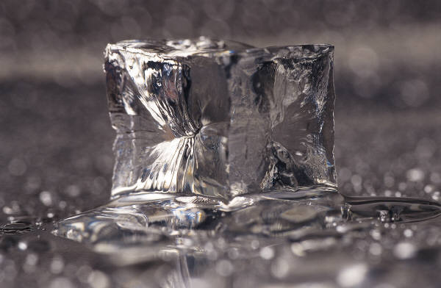
Energy is also released during freezing, which is the change of state from a liquid to a solid. The temperature at which a liquid changes into a solid is the substance’s freezing point.
Freezing and melting occur at the same temperature. So at 0° C, liquid water freezes at the same temperature that ice melts.

Slide 23
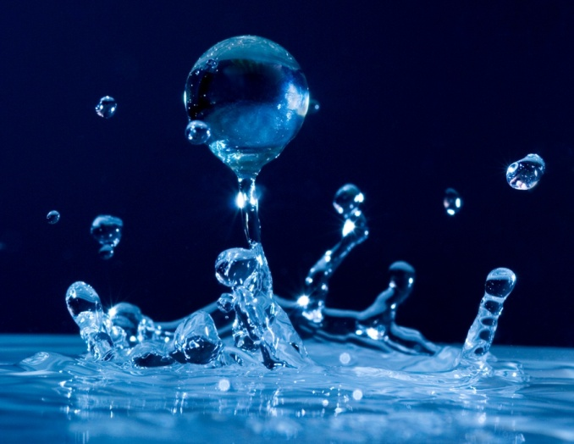
Temperature is constant during changes of state.
When a substance loses or gains energy, either its temperature changes or its state changes. But the temperature of a substance does not change during a change of state.
Example—If you add energy to ice at 0°C, the temperature will not rise until all the ice has melted.

Slide 24
Conservation of Mass and Energy
When an ice cube melts, the mass of the liquid water is the same as the ice cube.
Mass is conserved for all physical and chemical changes. Also energy can change forms during physical and chemical changes, but the total amount of energy present before and after the change is the same.
The amount of energy in a substance can change, but the added energy must come from another source.

Slide 25

Mass and energy are both conserved. Neither mass nor energy can be created or destroyed.
  These principles are fundamental laws of physical science.
The law of conservation of mass—mass can not be created or destroyed. Example: a match – the total mass of the reactants (the match and oxygen) is the same as the total mass of the products (ash, smoke, and gases)

Slide 26
Energy may be changed to another form during a physical or chemical change, but the total amount of energy present before and after the change is the same.
The law of conservation of energy states energy can not be created or destroyed. Example: lawn mower—small amount of energy is needed to start it but lots of energy results. It uses gas which is stored energy that is released when burned. When the stored energy is considered, the energy present before you start the mower is equal to the energy that is produced.

Slide 27
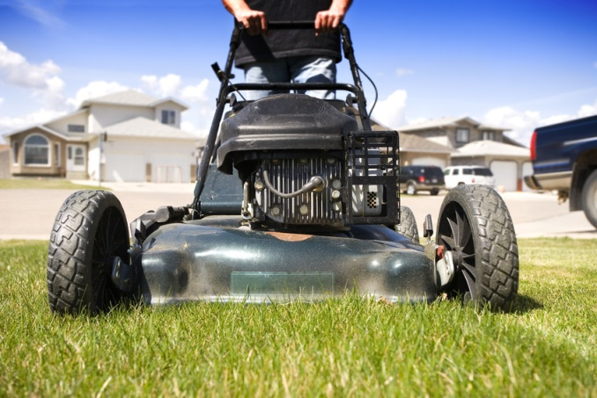
Some of the energy from the gasoline is transferred to the surrounding as heat, which is why the mower gets hot.
The total amount of energy released by the gasoline is equal to the energy used to power the lawn mower plus the energy transferred to the surroundings as heat.

Slide 28

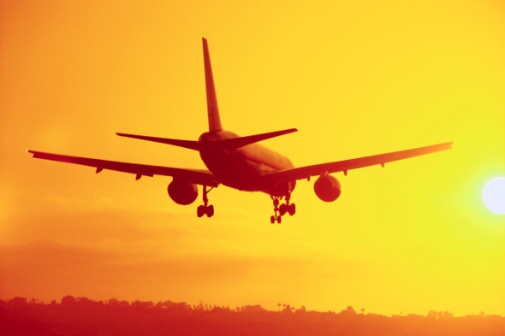

Fluids
Liquids and gases are classified as fluids. The properties of fluids allow huge ships to float, divers to explore the ocean depths, and jumbo jets to soar across the skies.

Slide 29
Pressure
Pressure is the amount of force exerted per unit area of a surface.
Fluids exert pressure evenly in all directions.
Air pressure, blood pressure, and water pressure

Slide 30
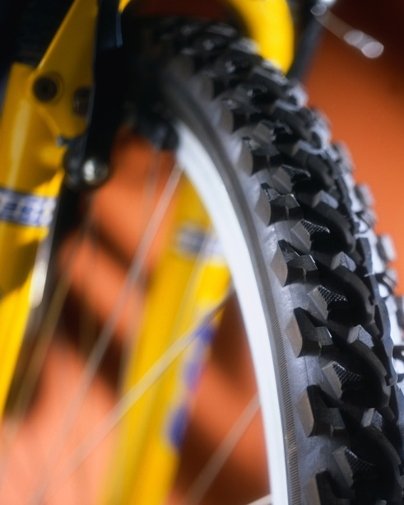
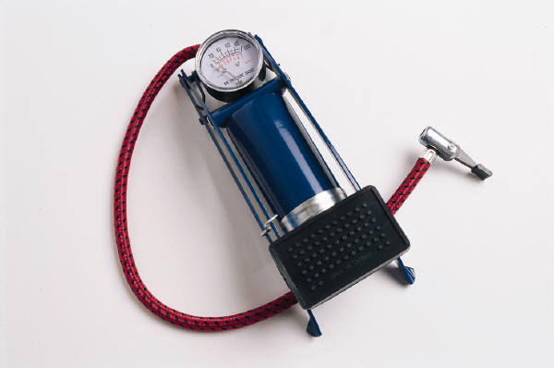
What happens when we add air to a tire?
When we push air onto a tire the inside tiny air particles push against each other and against the wall of the tire. The more air we pump in the greater the pressure.

Slide 31
Pressure is calculated by dividing force by the area over which the force is exerted.
Pressure= force/area P=F/A
The SI unit of pressure is pascal. A pascal is the SI unit of pressure, equal to the force of 1 N exerted over the area of 1 m² (symbol Pa).

Slide 32
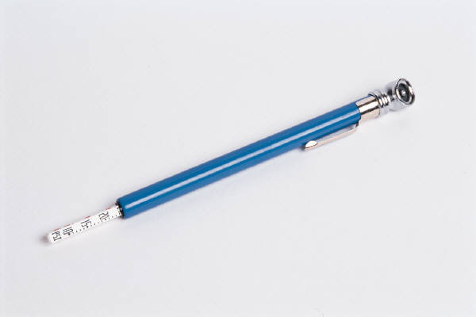
If I remove some of the air from a tire how does the pressure change?
If some of the air is removed, the pressure will decrease.

Slide 33
Buoyant Force
If you push a rubber duck to the bottom of the bathtub, the duck pops to the surface when you release it. A buoyant force pushes the duck up.
All fluids exert an upward buoyant force on matter.
Buoyant force results from the fact that pressure increases with depth. The force pushing up on an object in a fluid are greater than the forces pushing it down. So there is a net upward force: the buoyant force.

Slide 34
Archimedes’ principle is used to find a buoyant force
Archimedes was a Greek mathematician in the third century BCE discovered a method for determining buoyant force.
Archimedes’ principle –the buoyant force on an object in a fluid is an upward force equal to the weight on the fluid that the object displaces.

Slide 35
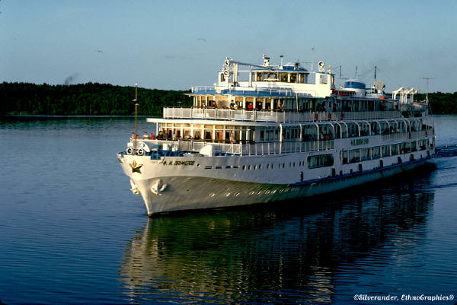
An object will float or sink based on its density
You can determine if a substance will float or sink by comparing densities.
Steel is almost eight times denser than water. So how do those ships float and carry heavy loads?
Because ships are built with a hollow shape. Water is denser than the hollow shape.

Slide 36
Pascal’s Principle
Pascal’s principle states –a change in pressure at any point in an enclosed fluid will be transmitted equally to all parts of the fluid.
In other words, if the pressure in a container is increased at any point, the pressure increases at all points by the same amount.

Slide 37
Mathematically, Pascal’s principle is stated
P₁=P₂ because P=F/A Pascal’s principle can be expressed F₁/A₁ = F₂/A₂
Hydraulic devices are based on Pascal’s principle
Hydraulic devices use liquids to transmit pressure from one point to another. This is because liquids cannot be compressed into a much smaller space, they can transmit pressure more efficiently than gases can. Hydraulic devices can multiply forces.

Slide 38
How does a hydraulic device multiply forces?
A small force is applied to a small area. This force exerts pressure on a liquid in the device. The pressure is transmitted equally to a larger area, where the pressure creates a larger force.

Slide 39
Fluids in Motion
Examples of moving fluids liquids flowing through pipes, air moving as wind, or honey dripping.

Slide 40
Fluids move faster through small areas than through larger areas, if the overall flow rate remains constant. Fluids also vary in the rate in which they flow.
Example: What happens when you make the opening to the hose smaller by placing your hand over it?
It comes out faster

Slide 41
Viscosity depends on particle attraction
Viscosity resistance of a gas or liquid to flow. Example honey drips more slowly from a spoon than lemonade being poured from a pitcher.
Why?
Because honey has a higher viscosity than lemonade
In general because the stronger the attraction between a liquid’s particles is, the more viscous the liquid is.

Slide 42
Fluid pressure decreases as speed increases
Water will move faster through the narrow part of a pipe than through the wider part. If it is carrying a leaf it will move the leaf quicker through the narrow part.
If you measure the pressure at different points, you would find the water pressure in front of the leaf is less than the pressure behind the leaf. This pressure difference caused the leaf and the water around it to accelerate as the leaf enters the narrow part of the tube.

Slide 43

This principle is known as the Bernoulli’s principle—which states that as the speed of the moving fluid increases, the pressure of the fluid decreases.

Slide 44
Behavior of Gases
Because gases are colorless and odorless, it is easy to forget they exist.
Some gases in Earth’s atmosphere are nitrogen, oxygen, argon, helium, and carbon dioxide, along with methane, neon, and krypton.
Gases are important in chemistry and in everyday life

Slide 45
Properties of Gases
Gases are fluids, and their particles move rapidly in all directions.
Gases have many unique properties.
Gases expand to fill their containers. They spread out easily and mix with one another. They have low densities and are compressible. Unlike solids and liquids, gases are mostly empty spaces. All gases share these properties.

Slide 46

Gas particles exert pressure by hitting the walls of a balloon. What happens if the pressure becomes too great.
The balloon will pop.

Slide 47
Gases exert pressure on their containers.
A balloon that is filled with helium gas is under pressure. Helium atoms in the balloon are moving rapidly.

Slide 48
If too many gas particles are in the balloon, the battering overcomes the force of the balloon that is holding the gas in, and the balloon pops.
If you let go of a pinched balloon most of the gases rushes out and causes the balloon to shoot through the air.
Why does it do this?
It does this because gas under pressure will escape its container if possible.

Slide 49
For this reason gases in pressurized containers, such as propane tanks for gas grills, can be dangerous and must be handled carefully.

Slide 50
Gas Laws
How do you measure the volume of gases?
The volume of is the same as the volume of the gas’s container.
But other factors must be considered.
Gases behave differently than solids and liquids.
The gas laws describes how the behavior of gases is affected by pressure, volume, and temperature.
Gas laws help us understand and predict the behavior of gases in specific situations.

Slide 51
Boyle’s law relates the pressure of a gas to its volume.
A diver at a depth of 10m blows a bubble of air. As the bubble rises, its volume increases. By the time it reaches the surface it will have doubled because of the decrease in pressure. This relationship between the volume and pressure of a gas is known as Boyle’s law.
Boyle’s law states: For a fixed amount of gas at a constant temperature, the volume of a gas increases as the gas’s pressure decreases. Likewise, the volume of a gas decreases as the gas’s pressure increases.

Slide 52
Gas laws is the laws, that state the mathematical relationship between the volume, temperature, pressure, and quantity of a gas.
Pressure and volume have an inverse relationship: one increases when the other decreases.
Look at the example on page 97.

Slide 53
The product of pressure and volume is constant.
Boyle’s law tells you that when pressure increases, volume decreases, and vise versa. In mathematical terms, pressure multiplied by volume is constant (if temperature is a constant).
Expressed: (pressure₁)(volume₁)=(pressure₂)(volume₂)
P₁V₁=P₂V₂ P₁ and V₁ represents the initial volume and pressure, while P₂ and V₂ represents the final volume and pressure.

Slide 54
Gay-Lussac’s law relates gas pressure to temperature.
So what would you predict about the relationship between the pressure and temperature of a gas at a constant volume?
Remember that pressure is the results of collisions of gas molecules against the walls of their containers.
As temperature increases the kinetic energy of gas particles increases. The energy and frequency of the collision of the gas particles against the container increases.

Slide 55
Gay-Lussac’s law states: The pressure of a gas increases as the temperature increases, if the volume of the gas does not change. The pressure decreases as the temperature decreases.
Example: If you measure the pressure in your bike tire you will notice that it is lower in the winter than in the summer. Why?
Because as the temperature outside decreases, so does the pressure in the tires and as the temperature rises outside so does the pressure. Notice that the volume remains constant.

Slide 56
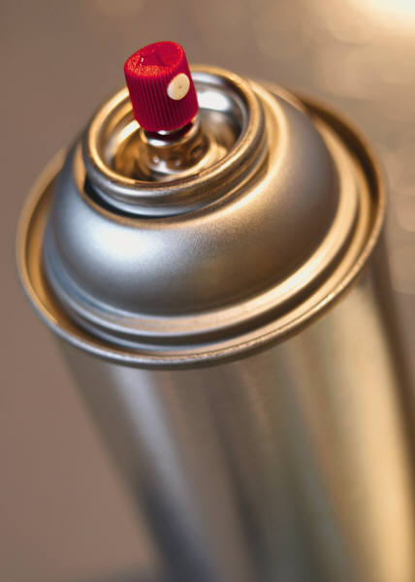

For this reason pressurized containers that hold gas should never be heated or near high heat as they will explode.

Slide 57
Charles law relate temperature to volume.
This law states: For a fixed amount of gas at a constant pressure, the volume of the gas increases as the gas’s temperature increases. Likewise the volume of the gas decreases as the gas’s temperature decreases.
Because of Charles’s law, an inflated balloon will pop if it gets to hot. Or if the gas is cooled in an inflated balloon at constant temperature it will shrink.

