Slide 1
The Structure of Matter
Chapter 6
Compounds and Molecules
Ionic and Covalent Bonding
Compound Names and Formulas
Organic and Biochemical Compounds

Slide 2
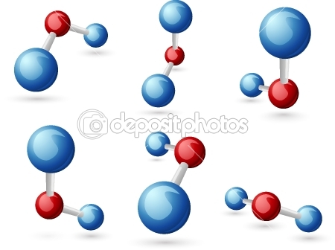
Section one
Compounds and Molecules

Slide 3

Why it Matters
Understanding the structure of compounds can help you understand changes in matters, such as molding clay.

Slide 4
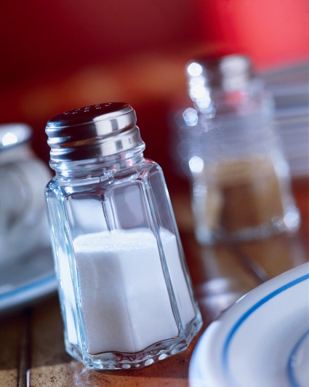
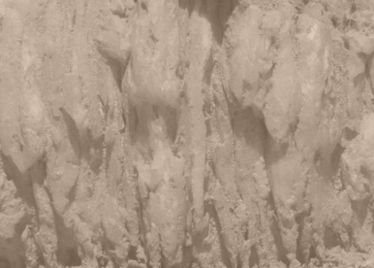
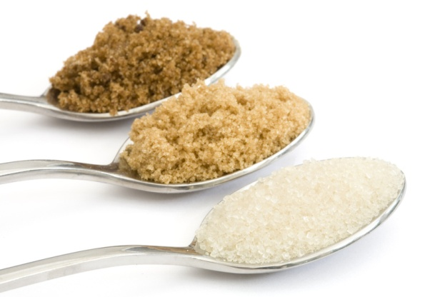
Many rocks are made of quarts. Table salt and sugar are both grainy, white solids. But they taste very different. Quartz, salt, and sugar are all compounds that are solids. There similarities and differences partly come from the way their atoms or ions are joined.

Slide 5
Chemical Bonds
A compound is made of two or more elements that are chemically combined.
The forces that hold atoms or ions together in a compound are called chemical bonds.
Chemical bond– is the attractive force that holds atoms or ions together.
Let’s look at figure 1 in your text page 177. What is happening and what is produced?

Slide 6


By lighting a candle under a balloon filled with hydrogen and oxygen gas a fiery chemical reaction takes place. Chemical bonds are broken and atoms are rearranged. New chemical bonds form water, a compound that has properties very different from the properties of the original gases.

Slide 7
Chemical Structure
Water’s chemical formula tells us what atoms make up water, but doesn’t tell us how the atoms are connected.
A compounds chemical structure is the way the compound’s atoms are bonded to make the compound.
Chemical structure—the arrangement of the atoms in a substance.

Slide 8
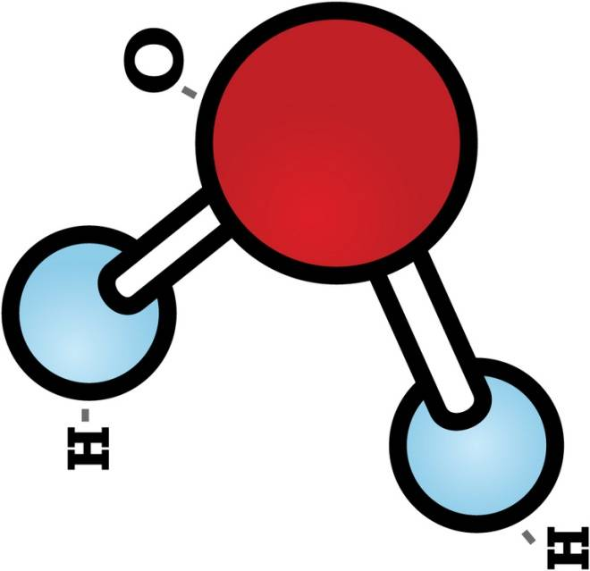
Just as the structure of buildings can be represented by blueprints, the structure of chemical compounds can be shown by various of models. Different models show different aspects of compounds.

Slide 9
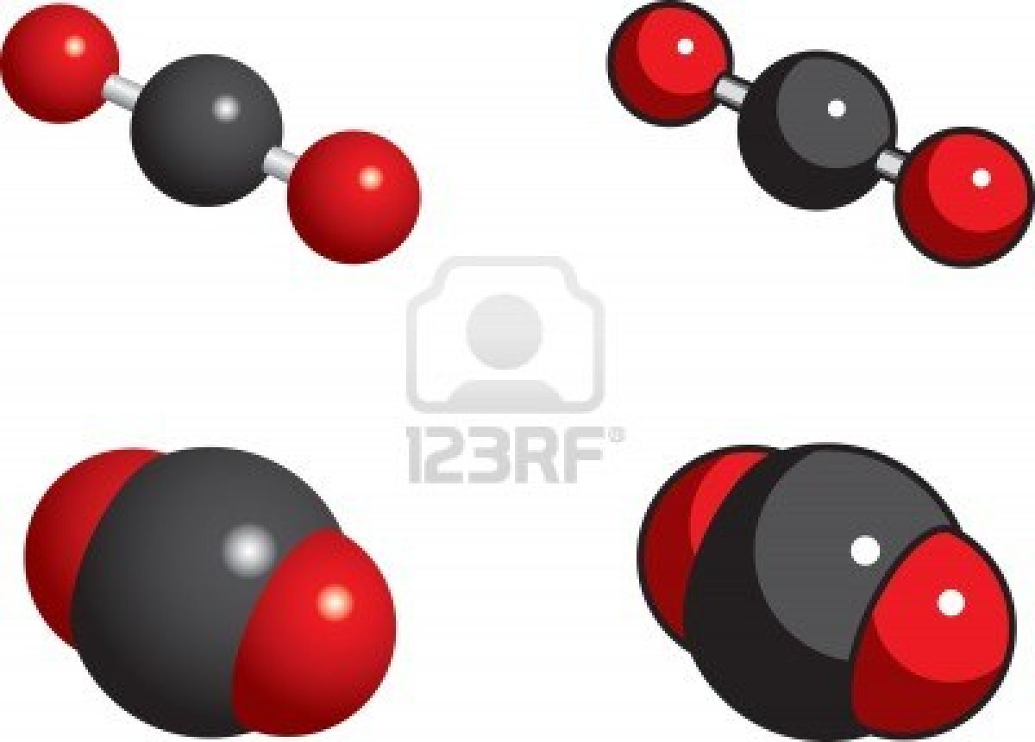

Slide 10
Some models represent bond lengths and angles
In the ball and stick models the atoms are represented by balls and the bonds are represented by the sticks.
Two terms are used to specify the positions of atoms in relation to one another in a compound.
Bond length--the average distance between the nuclei of two bonded atom.
Bond angle--angle formed by the two bonds by the same atom.

Slide 11
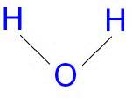
Structural formulas can also show the structures of compounds.

Slide 12
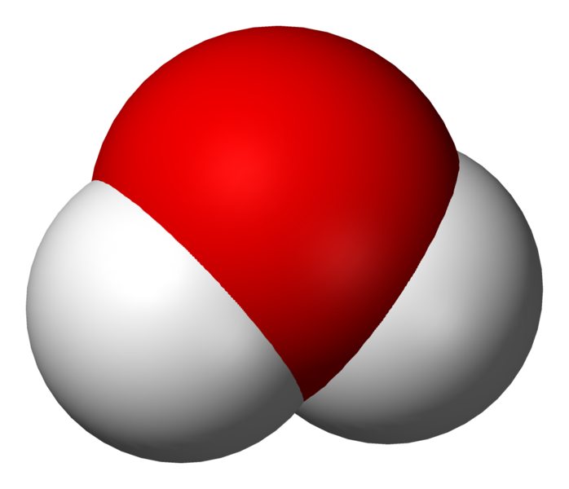
Space-filled models show the space occupied by atoms
A space-filling model shows the relative sizes of atoms in a compound, but not bond lengths.

Slide 13
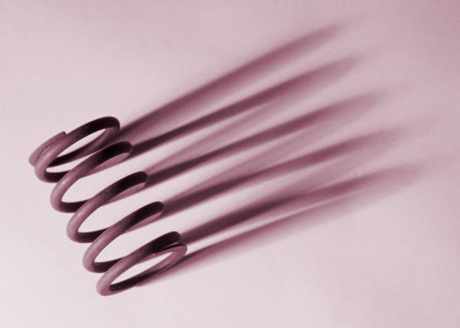
Bonds can bend, stretch, and rotate without breaking
Some chemical bonds are stronger that others. Bonds can bend, stretch, and rotate without breaking. The atoms can move back and forth a little, and their nuclei do not always stay the same distance apart. Although bonds are not rigid, they hold atoms together tightly.

Slide 14
How Does Structure Affect Properties
Quartz found in rocks form a large network of bonded atoms.
C0mpounds such as table salt, are also a large networks but made of bonded positive and negative ions.
Other compounds such as water and sugar are made of many separate molecules.
The chemical structure of a compound determines the properties of that compound.

Slide 15
Compounds with network structure are strong solids
Quartz is made of silicon dioxide, SiO₂.
The bonds that hold these atoms together are very strong. All of the Si—O—Si and O—Si—O bond angles are the same—109.5˚. This arrangement is the same everywhere in silicon dioxide and holds the silicon and oxygen atoms together in a strong rigid structure.
It takes a lot of energy to break the strong bonds between silicon and oxygen atoms in quartz. The strong bonds also make the melting point and boiling point of quartz and other minerals very high.

Slide 16
Some networks are made of bonded ions
Table salt—sodium chloride is found in the form of regularly shaped crystals. Crystals of sodium chloride are cube shaped. Sodium chloride is made of a repeating network connected by strong bonds. The network is made of tightly packed positively charged sodium ions and negatively charged chloride ions. The strong attractions between the oppositely charged ions give table salt and other similar compounds high melting points and high boiling points.
Na⁺ Clˉ

Slide 17
Some compounds are made of molecules
Both salt and sugar are solids that can be eaten, but their structures are very different. Unlike salt, sugar is made of molecules. A molecule of sugar is made of carbon, hydrogen, and oxygen atoms that are joined by bonds. Molecules of sugar attract each other to form crystals. But these attractions are much weaker than attractions that bond carbon, hydrogen, and oxygen atoms to make a sugar molecule.

Slide 18
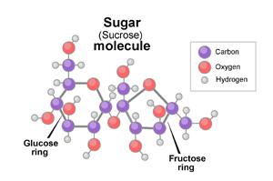
We breath N₂, O₂, and CO₂ everyday. These are all gases that are made of molecules. Within each molecule, the atoms are so strongly attracted to one another that they are bonded. But the molecules of each gas have very little attraction to one another. Because the molecules of these gases have weak attractions to one another, they are spread out.

Slide 19
The strength of attractions between molecules varies
Compare sugar, water, and dihydrogen sulfide, H₂S.
All three compounds are made of molecules, their properties are very different. Sugar is a solid, water is a liquid, and dihydrogen sulfide is a gas. Sugar molecules have a stronger attraction than water molecules do. The dihydrogen sulfide has an even weaker attraction to each other than the sugar and water molecules do.
Water and dihydrogen sulfide have similar chemical structures. H₂O and H₂S.

Slide 20
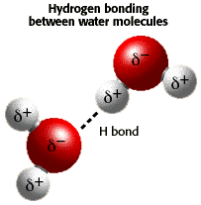
Because water has a higher melting point and boiling points than dihydrogen sulfide, and water molecules have a stronger attraction.
Water molecules are held together by hydrogen bonding . Water molecules attract each other, but these attractions are not as strong as the bonds holding oxygen and hydrogen together within the a molecule.

Slide 21
Questions
Name the advantage to each model: the ball-and-stick model and the space-filling model.
A ball-and-stick model shows bond lengths, and a space –filling model shows relative atom sizes.
How is the hardness of minerals explained by minerals’ chemical structure?
The hardness of minerals is explained by the fact that their chemical structure consist of rigid networks of bonded atoms.

Slide 22
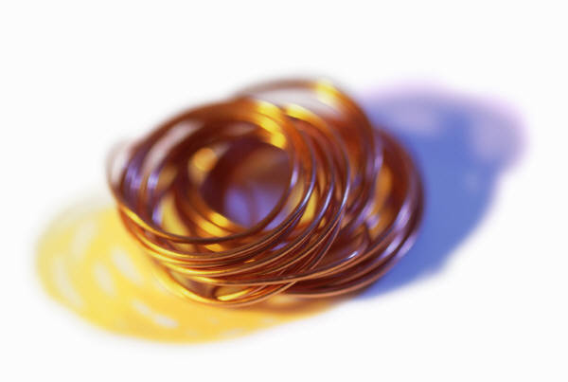
Ionic and Covalent Bonding
Section 2
Why it Matters
Chemical structure explains matter’s properties, such as why metals like copper conduct electricity.

Slide 23
Why Do Chemical Bonds Form?
Generally, atoms join to form bonds so that each atom has a stable electron configuration.
When this happens, each atom has an electronic structure similar to that of a noble gas.
There are two basic kinds of chemical bonding ionic and covalent bonding.
See the chart on page 183

Slide 24
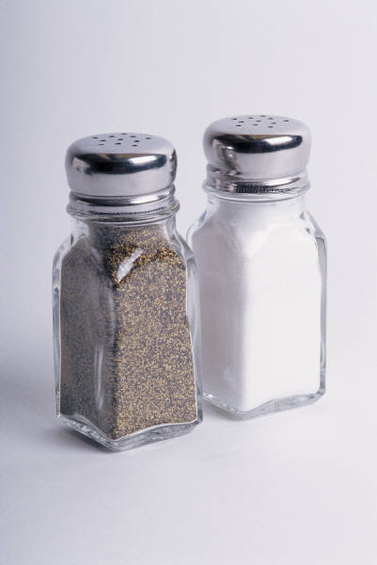
Ionic Bonds
Atoms of metals, such as sodium and calcium form positively charged ions. Atoms of nonmetals, such as chlorine and oxygen form negatively charged ions.
Ionic bonds form from attractions between oppositely charged ions.
Na⁺Clˉ

Slide 25
Ionic bonds are formed by the transfer of electrons.
Some atoms form bonds because they transfer electrons . One of the atoms gains electron and the other one loses electrons.
Ionic bonds—the attractive force between oppositely charged ions, which form when electrons are transferred from one atom to another.
What holds two ionically bonded atoms together?
Ions are held together by the attraction between their opposite charges.

Slide 26
Ionic compounds are in the form of networks, not molecules.
Sodium chloride is a network of ions, there is no such thing as “a molecule of NaCl”. Sodium chloride is a network because every sodium ion is next to six chloride ions.
Chemist talk about the smallest ratio of ions in ionic compounds.
Sodium chloride’s chemical formula, NaCl, it says there is one Na⁺ ion for every Clˉ ion, or a 1:1 ratio of ions. This has a total charge of zero.

Slide 27
Not every ionic compound has the same ratio of ions as sodium chloride. Calcium fluoride– the ratio of Ca⁺² ions to Fˉ ions is 1:2 to make a neutral compound. The chemical formula is CaF₂.
When melted or dissolved in water, ionic compounds conduct electricity.
Electric current is moving charges. Solid ionic compounds do not conduct electric current because the charged ions are locked into place. But if dissolved in water or melted they can conduct electricity.

Slide 28
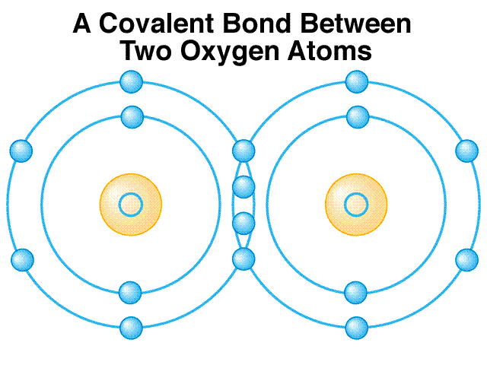
Covalent Bonds
Compounds that are made of molecules, such as water and sugar, have covalent bonds.
Covalent bond--a bond formed when atoms share one or more pairs of electrons.
Atoms joined by covalent bonds are shared.

Slide 29
Covalent compounds can be solids, liquids, or gases.
Most covalent compounds that are made of molecules have a low melting points—usually below 300˚C.
Molecules are free to move when the compound is dissolved or melted.
Most of these molecules do not conduct electricity.
Lets look at figure 5 on page 186.
What holds two covalently bonded atoms together?
By sharing electrons between the atoms.

Slide 30
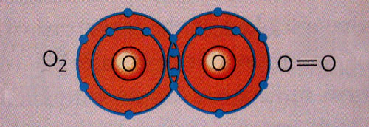
Atoms may share more than one pair of electrons.
These will form double bonds and triple bonds in an atom. A double bond shares two pairs of electrons and a triple bond shares three pairs of electrons.
Lets look at figure 6 on page 187 of your text book.

Slide 31
Atoms do not always share electrons equally.
Any two chlorine atoms are identical. When the atoms bond, electrons are equally attracted to the positive nucleus of each atom. Bonds like this which electrons are shared equally are called nonpolar covalent bonds.
When two atoms of different elements share electrons, the electrons are not shared equally. The shared electrons are attracted to the nucleus of one atom more than to the nucleus of the other. An unequal sharing of electrons forms a polar covalent bond.
Usually electrons are attracted to atoms of elements that are located farther to the right and closer to the top of the periodic table.

Slide 32
Metallic Bonds
Metals such as copper can conduct electricity when they are solid. Metals are also flexible, so they can bend and stretch without breaking. Copper can be pounded into thin sheets or drawn into very thin wire.
Metals are flexible and conduct electric current well because their atoms and electrons can move freely throughout a metal’s packed structure.

Slide 33
Electrons move freely between metal atoms.
The atoms in metals such as copper form metallic bonds.
Metallic bonds--a bond formed by the attraction between positively charged metal ions and the electrons around them.
The attraction between an atom’s nucleus and a neighboring atom’s electrons packs the atoms together. This packing causes the outermost energy levels of the atoms to overlap, the electrons are free to move from atom to atom.

Slide 34
Polyatomic Ions
Some compounds have both ionic and covalent bonds.
These are made of polyatomic ions, which are groups of covalently bonded atoms that have a positive or negative charge as a group.
Polyatomic ion—an ion made of two or more atoms.
A polyatomic ion acts as a single unit in a compound, just as ions that consist of a single atom do.

Slide 35
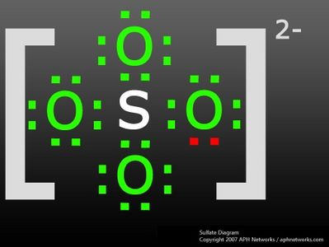
There are many common polyatomic ions.
Many compounds that you use either contain or are made from polyatomic ions.
Some examples: hydroxide ion OHˉ, carbonate ion CO₃ˉ², ammonium ion NH₄⁺.
Oppositely charged polyatomic ions, like other ions, can bond to form compounds.

Slide 36
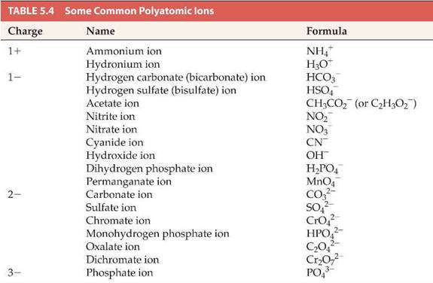

Slide 37
Parentheses group the atoms of a polyatomic ion.
The chemical formula for ammonium sulfate is written as (NH₄)₂SO₄ instead of N₂H₈SO₄. The parentheses remind us that ammonium, NH₄, acts like a single ion.
Lets look in our text on page 189
Why are parentheses used in a chemical formula for a compound that contains more that one of a particular polyatomic ion?
They are used to represent the fact that a polyatomic ion acts as a single unit.

Slide 38
Some names of polyatomic anions relate to the oxygen content of the anion.
Many polyatomic anions are made of oxygen. Most of there names end with –ite or –ate.
The –ate ending is usually to name an ion that has more oxygen atoms while ions that have fewer oxygen atoms associated with the same positive group usually end in –ite.
Lets look at figure 10 on page 190.

Slide 39
Compound Names and Formulas
Section 3
Why it Matters
Knowing how compounds are named can help you recognize them in food ingredients.

Slide 40
Naming Ionic Compounds
Ionic compounds are formed by the strong attractions between oppositely charged particles, cations (positive ions) and anions (negative ions). Both ions are important to the compound’s structure, so both ions are included in the name.
The names of ionic compounds consist of the names of the ions that make up the compounds.

Slide 41
Names of cations include the elements of which they are composed.
In many cases, the name of the cation is just like the name of the element. See the chart on page 191 for common cations.
The periodic table can be used as a tool for figuring out what ions are formed by different elements.
Group 1 ions have a 1+ charge and group 2 elements have a 2+ charge. I have given you the charges for you to write across your periodic tables.

Slide 42
Names of anions are altered names of elements.
An anion of element has a name similar to that elements name. The difference is the name’s ending. Figure 2 on page 192 shows a list of some common anions.
An ionic compound must have a total charge of zero.
If an ionic compound is made up of ions that have different charges, the ratio of ions will not be 1:1. Calcium fluoride is made of calcium ions, Ca²⁺ and fluoride ions, Fˉ. For calcium fluoride to have a zero charge, there must be 2 fluoride ions for every calcium ion.

Slide 43
Some cation names must show their charge.
Iron is a transition metal. Transition metals may form several cations—each with a different charge. See the list on page 192 of some of the transition metal cations.
Look at the compounds FeO and Fe₂O₃ according to the rules we learned both should be called iron oxide, even though they are not the same compound.
The charge of the iron cation in Fe₂O₃ is different from the charge of the iron cation FeO. In cases like this the cation name must be followed by a Roman numeral in parentheses. The Roman numeral shows the cation’s charge.

Slide 44
Fe₂O₃ is made of Fe³⁺ ions, so it is named iron (III) oxide. FeO is made of Fe²⁺ ions, so it is named iron (II) oxide.
Determine the charge of a transition metal cation.
How can we tell that the iron ion in Fe₂O₃ has a charge of 3+? Three oxide ions O²ˉ, have a total charge of 6- so the total positive charge in the formula must be 6+, so that the total charge can be zero. So each of the two iron ions must have a charge of 3+.
Writing ionic formulas page 193.

Slide 45
Naming Covalent Compounds
Covalent compounds are named using rules that are different from rules used to name ionic compounds. The main difference from ionic compound is the use of prefixes.
For covalent compounds of two elements, numerical prefixes tell how atoms of each element are in the molecule.

Slide 46
Numerical prefixes are used to name covalent compounds of two elements.
Look at figure 5 at the prefixes used to name covalent compounds.
If there is only one atom of the first element the name does not get the prefix. The element farther to the right in the periodic table is named second and in –ide.
One boron atom and three fluorine atoms make up boron trifluoride, BF₃. Dinitrogen tetroxide, N₂O₄, is made of 2 nitrogen atoms and 4 oxygen atoms.

Slide 47
Empirical Formulas
Chemical formula for beryl is Be₃Al₂Si₆O₁₈. Chemical formulas that are unknown are determined by figuring out the mass of each element in the compound.
Once that is known, scientists can calculate the compound’s empirical formula, or simplest formula.
An empirical formula tells us the smallest whole-number ratio of atoms that are in a compound.
Empirical Formula--the composition of a compound in terms of the relative numbers and kinds of atoms in the simplest ratio.

Slide 48
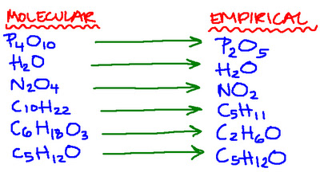
For most ionic compounds, the empirical formula is the same as the chemical formula. Covalent compounds have empirical formula too. The empirical formula for water is H₂O. The formula tells you that the ratio of hydrogen atoms to oxygen is 2:1.

Slide 49
Different compounds can have the same empirical formulas.
Formaldehyde, acetic acid, and glucose are all covalent compounds that are made of molecules. They all have the same empirical formula, but each compound has its own molecule formula.
A compound’s molecular formula tells you how many atoms are in one molecule of the compound.
Molecular formula—a chemical formula that shows the number and kinds of atoms in a molecule, but not the arrangement of atoms.
Lets look at figure 8 on page 195.

Slide 50
Masses can be used to determine empirical formulas.
You can find the empirical formula of a compound if you know the mass of each element present in a sample if the compound. Convert the masses to moles. Then find the molar ratio, which will give you empirical formula.

Slide 51
Organic and Biochemical Compounds
Section 4
Why it Matters
Your body is made of organic compounds, which play important roles in keeping you alive.

Slide 52
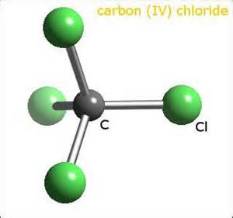
The word organic has many different meanings.
Most associate it with living organisms.
In chemistry the word organic is used to describe a type of compound.

Slide 53
Organic Compounds
An organic compound is a covalently bonded compound that contains carbon.
Most organic compounds also contain hydrogen.
You can also find oxygen, nitrogen, sulfur, and phosphorus in organic compounds.
Organic compounds--a covalently bonded compound that contains carbon, excluding carbonates and oxides.
See book samples of organic compounds on page 197 of your text book.

Slide 54

Carbon atoms form four covalent bonds in organic compounds.
When a compound is made of only hydrogen and carbon it’s called a hydrocarbon. Methane, CH₄, is the simplest hydrocarbon.
Methane gas is formed when living matter decay, and it is often found in swamps and marshes.

Slide 55
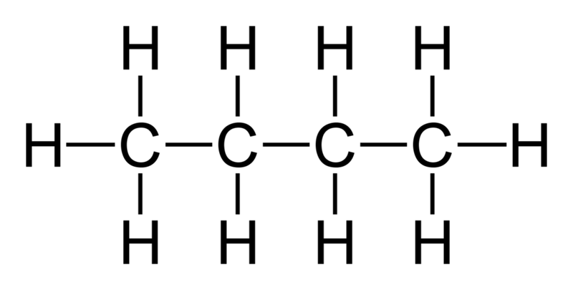
Carbon atoms have four valence electrons. In methane, each of these electrons participates in a C-H single bond.
A carbon atom may also share two of its electrons with two from another atom to form a double bond. Or a carbon atom may share three electrons to form a triple bond.
It can never form more that four bonds at a time.

Slide 56
Alkanes are hydrocarbons that have only single covalent bonds.
Methane is the simplest form alkane. It has only C-H bonds. But alkanes can also have C-C bonds.
Look at figure 2 on page 198: see the two carbon atoms in ethane bond to each other C₂H₆. Note how each carbon atom in both the sample compound bonds to four other atoms.

Slide 57
Arrangement of carbon atoms in alkanes may vary.
The carbon atoms in methane, ethane, and propane are all bonded in a single line because that is their only possible arrangement.
When there are more than three bonded carbon atoms in a molecule, the carbon atoms do not have to be in a single line. When they are the alkane is called normal alkane, or n-alkane.
Look at figure 3 for the n-alkanes that have up to 10 carbon atoms. The condensed structural formulas shows how the atoms bond.

Slide 58
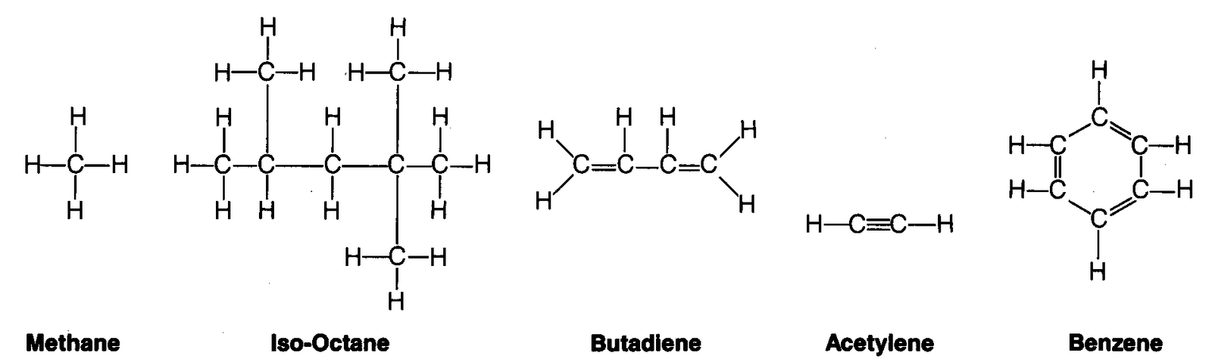
The carbon atoms in any alkane that has more than three carbon atoms have more than one possible arrangement.
They may have branches or form rings.
See figure 4 in text on page 199.

Slide 59
Alkane chemical formulas usually follow a pattern.
Except for cyclic alkanes the chemical formulas follow a special pattern alkanes. The number of hydrogen atoms is always two more that twice the number of carbon atoms. This is represented by a general formula CnH₂n₊₂.

Slide 60
Alkenes have double carbon-carbon bonds.
Alkenes are also hydrocarbons. They are different from alkanes because alkenes have at least one double covalent bond between carbon atoms. This bond is shown by C=C.
Alkenes are named by replacing the –ane ending with –ene. The simplest alkene is ethene (or ethylene), C₂H₄.
See figure 5 in your text on page 200.

Slide 61
Alcohols have a hydroxyl group.
Alcohols are organic compounds that are made of oxygen as well as carbon and hydrogen.
Alcohols have hydroxyl, or –OH, groups.
Alcohol methanol, CH₃OH, is sometimes mixed with another alcohol ethanol, CH₃CH₂OH, to make denatured alcohol. These can be found in many familiar products.
Isopropanol is found in rubbing alcohol, has a chemical formula of C₃H₈O, or (CH₃)₂CHOH.
The names of these three alcohols end in –ol common for most alcohols.

Slide 62
Alcohol and water molecules behave similarly.
A methanol molecule is like a methane molecule except that one of the hydrogen atoms is replaced by a hydroxyl group. Like water molecules neighboring alcohol molecules are attracted to one another.
Because of this attraction they are liquid at room temperature.
Alcohols have much higher boiling points than alkanes of similar size.

Slide 63
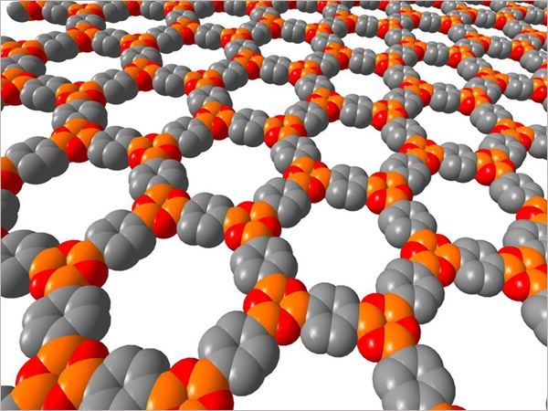
Polymers
A polymer is a molecule that is a long chain made of smaller molecules.
Polymer--a large molecule that is formed by more than five monomers, or small units.

Slide 64
Polymers have repeating subunits.
Polyethene which is known as polyethylene or polythene, is the polymer that makes up plastic milk jugs.
Poly means “many”. Ethene is an alkene that has a formula C₂H₄.
Polyethene means “many ethenes”.
The smaller molecule that makes up the polymer, in this case C₂H₄ is called a monomer.

Slide 65
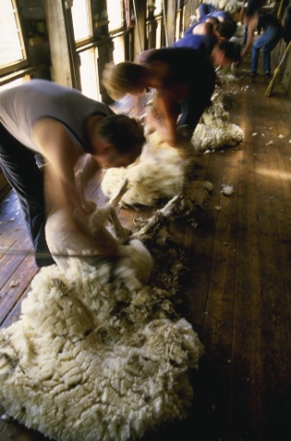


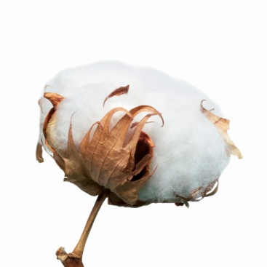
Some polymers are natural, and others are artificial.
Rubber, wood, cotton, wool, starch, protein, and DNA are all natural polymers.
Human made polymers are usually either plastics or fibers.
Most plastics are flexible and easily molded, whereas fibers form long thin strands.

Slide 66
A polymer’s structure determines its elasticity.
Properties of a polymer are determined by its structure.
Polymer molecules are like long thin chains.
When chains are connected to each other, the polymer’s properties are different.
Some polymers are elastic. Rubber bands are elastic and return to its original shape, milk jugs can be crushed or dented but will not go back to original shape.

Slide 67
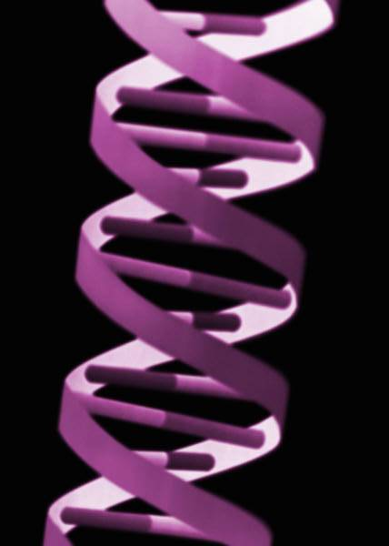
Biochemical Compounds
Biochemical compounds are organic compounds that can be made by living things.
Biochemicals, which are essential to life, include carbohydrates, proteins, and DNA.
The DNA inside your cells gives your body information about what proteins you need. Each of these biochemical compounds is a polymer.

Slide 68
Many carbohydrates are made of glucose.
Biochemicals called carbohydrates which include sugars and starches, provided energy to living things.
Carbohydrates--a class of molecules that includes sugars, starches, and fiber; contains carbon, hydrogen, and oxygen.
Proteins--an organic compound that is made of one or more chains of amino acids and that is a principal component of all cells.

Slide 69

Sucrose, table sugar, is made of two simple carbohydrates, glucose and fructose, bonded together.
Starch is made of a series of bonded glucose molecules, and is therefore a polymer.
You get energy from the chains of starch stored in certain plants.
Glucose that is not needed right away is stored in the body as glycogen, a polymer of glucose.

Slide 70
Proteins are complex polymers of amino acids.
Starch is made of only glucose. Proteins which provide structure and function to parts of the cells, are much more complex.
Proteins are made of many different molecules that are called amino acids.
Amino acids—a compound of a class of simple organic compounds that contain a carboxyl group and an amino group and that combine to form proteins.

Slide 71
Every amino acid contains an amino group (-NH₂), a carboxyl group (-COOH), and a side group that gives the amino acid its unique properties.
There are 20 amino acids found in naturally occurring proteins.
Each protein is made of specific combination of a certain number of amino acids.
The amino acids that make up a protein determine the proteins structure and function.

Slide 72
DNA is a polymer that stores genetic information.
All of your genes are made of DNA molecules, DNA is a very long molecule made of carbon, hydrogen, oxygen,, nitrogen, and phosphorus.
DNA is in the form of paired chains, or strands. It has the shape of a twisted ladder known as the double helix.
Sugar molecules that are bonded to phosphate units correspond to the ladder’s sides. Attached to each sugar molecule is one of four DNA monomers—adenine, thymine, cytosine, or guanine.

Slide 73
These make the rungs of the ladder.
Most cells in your body have a copy of your genetic material in the form of chromosomes made of DNA.
When a cell in your body divides, copies of your chromosomes are made.

Slide 74
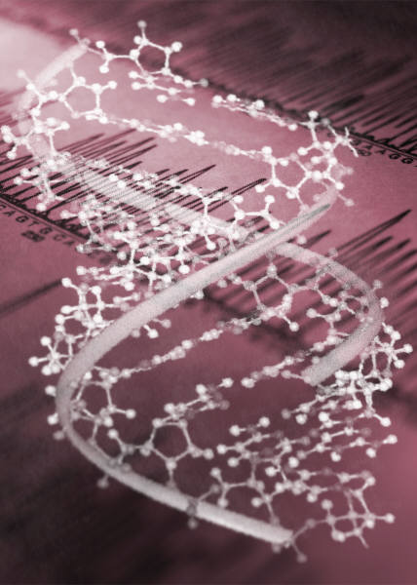
DNA is the information that the cell uses to make proteins.
The sequence of the monomers in DNA determines the proteins that are made in a cell. Each group of three monomers represents a specific amino acid in a protein. The resulting proteins that are made determine all of the activities and characteristics of the cell.

Slide 75
Questions
What is the shortest chain of carbon atoms that can have more than one arrangement? Explain.
The shortest carbon chain with more than one possible arrangement is one with four carbon atoms; carbon chains with three or fewer carbon atoms cannot form branched chains.
What is the relationship between a monomer and a polymer?
A polymer is a molecule that is a long chain of smaller molecules called monomers.

Slide 76
Why do people need carbohydrates in their diets?
You need to eat carbohydrates so your body can get the energy that it needs.

