Slide 1
Chapter 9 Photosynthesis and Cellular Respiration
Energy in Living Systems
Photosynthesis
Cellular Respiration

Slide 2
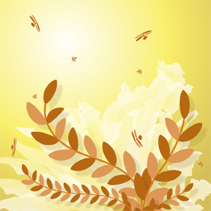
Energy in Living Systems
Why it Matter
Plants convert sunlight into chemical energy. This chemical energy can be used for biological purposes in nearly all living things.

Slide 3
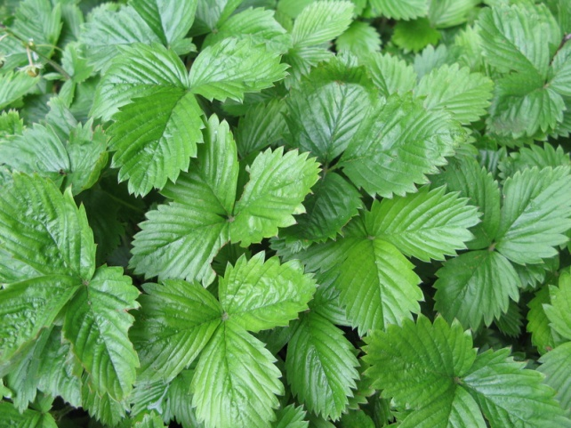
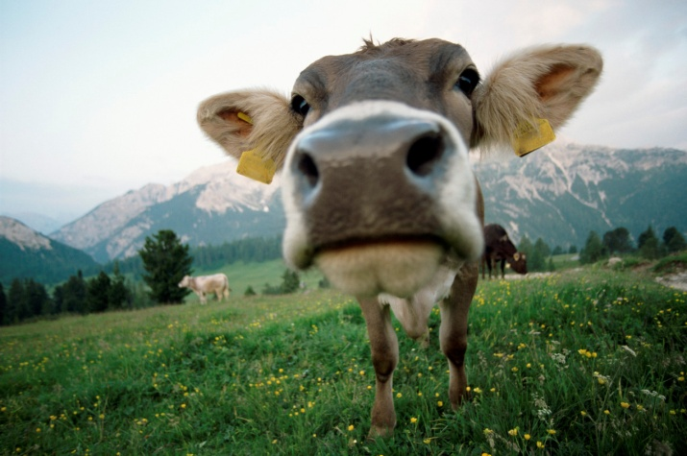
Every organism must maintain homeostasis as long as it lives. Therefore organisms require a constant source of energy.

Slide 4
Chemical Energy
Organisms use and store energy in the chemical bonds of organic compounds. Almost all of the energy in organic compounds comes from the sun.
Solar energy enters living systems when plant, algae, and certain prokaryotes use sunlight to make organic compounds from carbon dioxide and water through a process called photosynthesis.

Slide 5
Photosynthesis—is the process by which plants, algae, and some bacteria use sunlight, carbon dioxide, and water to produce carbohydrates and oxygen.
Organisms that are able to perform photosynthesis are autotrophs.
Most autotrophs have a supply of food as long as sunlight is available. So how do other organisms get food molecules?
Organism that cannot make their own food must eat autotrophs or consume organisms that eat autotrophs.

Slide 6
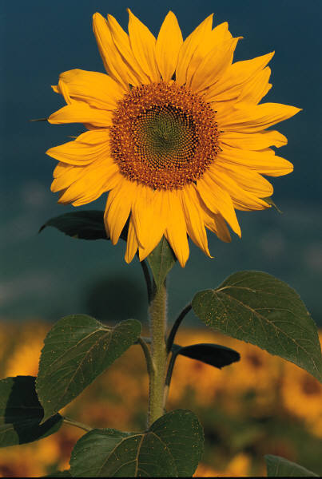
Food molecules that are made or consumed by an organism are the fuel for cells. Cells use these molecules to release the energy stored in the molecules’ bonds. The energy is used to carry out life processes.

Slide 7
Metabolism and the Carbon Cycle
Metabolism involves either using energy to build organic molecules or breaking down organic molecules in which energy is stored. Organic molecules contain carbon. Therefore, an organism’s metabolism is part of Earth’s carbon cycle.
The carbon cycle not only makes carbon compounds a continuously available in an ecosystem but also delivers chemical energy to organisms living within the ecosystem.

Slide 8
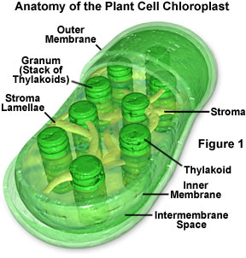
Photosynthesis—energy enters the ecosystem when organisms use sunlight during photosynthesis to convert stable carbon dioxide molecules with glucose, a less stable compound.
In plant cells and algae, photosynthesis takes place in the chlorplasts.

Slide 9
Cellular respiration--the process in which cells produce energy from carbohydrates.
Organisms extract energy stored in glucose molecules. Throughout the process of cellular respiration, cells make the carbon in glucose into stable carbon dioxide molecules and produce energy. So stable and less stable compounds alternate during the carbon cycle and provide a continuous supply of energy for life processes in an ecosystem.

Slide 10
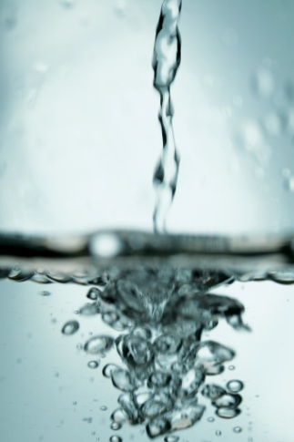
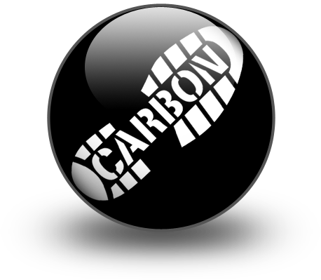
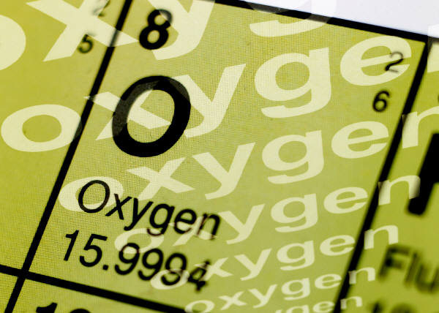
The breakdown of glucose during cellular respiration is the inputs are a glucose molecule and six oxygen molecules. The final product is six carbon dioxide molecules and six water molecules.

Slide 13
Transferring Energy
In cells, chemical energy is gradually released in a series of chemical reactions that are assisted by enzymes.
ATP--when cells break down food molecules, some of the energy on the molecules is released as heat. Cells use much of the remaining energy to make ATP. When glucose is broken down during cellular respiration energy is stored temporarily in molecules of ATP. ATP can be used to power chemical reactions, such as those that build molecules.

Slide 14
ATP can be made in one place and used in another place.
It is a nucleotide made up of a chain of three phosphate groups. This chain is unstable because the phosphate groups are negatively charged and repel each other. When the bond of the third phosphate group is broken energy is released. This produces adenosine diphosphate or ADP.
ATP→ADP + P + energy
the reaction in which ATP is converted to ADP requires a small input of energy. More energy is released than used during the reaction.

Slide 15
ATP Synthesis--the enzyme that catalyzes the synthesis of ATP, recycles ADP by bonding a third phosphate group to a molecule.
ATP synthesis acts as both an enzyme and a carrier protein for hydrogen ions H+. The flow of H+ ions through ATP synthesis powers the production of ATP.
As H+ ions flow, ATP synthesis catalyzes a reaction in which a phosphate group is added to a molecule of ADP to make ATP.

Slide 17
Hydrogen Ion Pump
The inner mitochondrial membrane allows H+ ions to diffuse through only ATP synthase. When glucose is broken down during cellular respiration NAD+ (nicotinamide adenine dinucleotide) accepts electrons and hydrogen ions, which change NAD+ to NADH.
NADH enters the electron transport chain, it allows electrons to drop in energy as they are passed along and uses the energy released to pump H+ ions out of a mitochondrion’s inner compartment. This action increases the concentration of H+ ions in the outer compartment. The ions then diffuse back into the inner compartment through ATP synthase.

Slide 18
Electron transport chain--a series of molecules, found in the inner membrane of mitochondria and chlorplasts, through which electrons pass in a process that causes protons to build up on one side of the membrane.

Slide 20
Questions
Why do organisms need a constant supply of energy?
In order to maintain homeostasis.
How is solar energy related to the carbon cycle?
Solar energy powers part of the carbon cycle by providing the energy needed for autotrophs to convert carbon dioxide into glucose.

Slide 21
How is ATP used inside a cell?
ATP is used as an energy source for cellular processes. When the cell needs to perform an activity, ATP can be broken down in order to release energy.

Slide 22
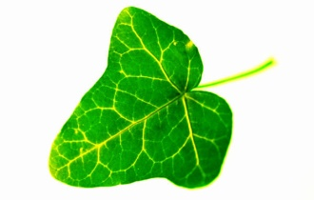
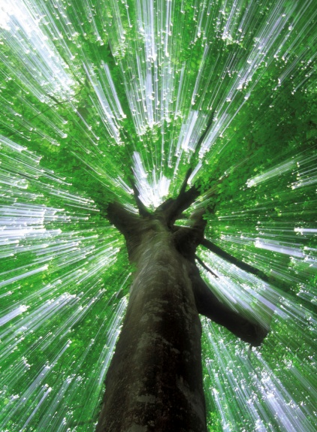
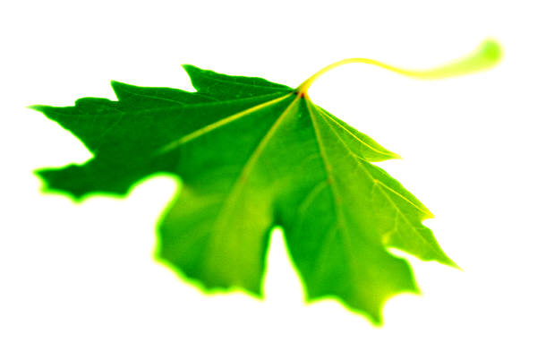
Photosynthesis
Section 2 Why it Matters:
Nearly all of the energy for life processes comes from the sun and is stored in organic molecules during the process of photosynthesis.

Slide 23
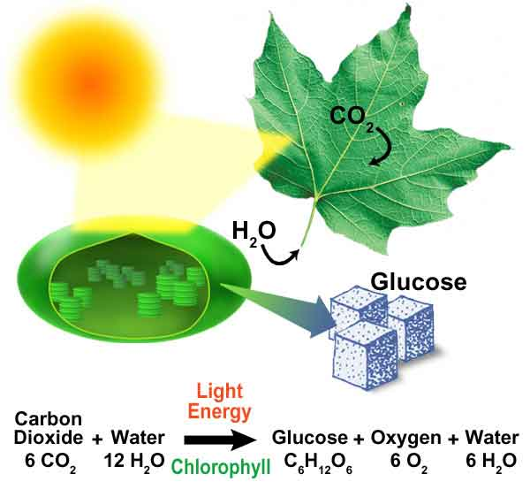
Plants, algae, and certain prokaryotes capture about 1% of the energy through photosynthesis. Photosynthesis is the process that provides energy for almost all life.

Slide 24
Harvesting Light Energy
The cells of many photosynthetic organisms have chloroplasts, organelles that convert light energy into chemical energy.
A chloroplast has an outer membrane and an inner membrane. The inner membrane is much more selective about what substances enter and leaves. Both membranes allow light to pass through.

Slide 25
The space inside the inner membrane is in the stoma. Within the stoma is a membrane called the thylakoid membrane.
The membrane is folded in a way that produces flat, disc-like sacs called thylakoids.
These sacs contain molecules that absorb light energy for photosynthesis, are arranged in stacks. The first stage of photosynthesis begins when light waves hit these stacks.
Thylakoid—a membrane system found within chlorplasts that contain the components to photosynthesis.

Slide 26
Electromagnetic Radiation:
Light is a form of electromagnetic radiation, energy that can travel through empty space in the form of waves.
Radio waves, X-rays, and microwaves are also forms of electromagnetic radiation.
These forms of radiation have different wavelengths and each wavelength corresponds to a certain amount of energy.
The wavelength is the distance between consecutive wave peaks.

Slide 27
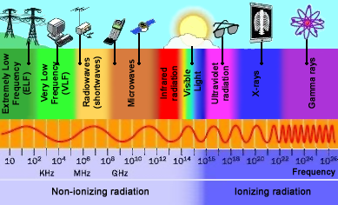
Sunlight contains all of the wavelengths of visible light. We see these wavelengths as different colors.

Slide 28
Pigments:
What makes the human eye sensitive to light? Cells in the back of the eye contain pigments.
Pigments--a substance that gives another substance or a mixture its color.
A pigment is a substance that absorbs certain wavelengths (colors) of light and commonly reflects all of the others.
In plants, light energy is harvested by pigments that are located in the thylakoid membrane of the chlorplasts.

Slide 30
Chlor0phyll—a green pigment that is present in most plant and algae cells and some bacteria, that gives plants that characteristic color, and that absorbs light to provide energy for photosynthesis.
Chlorophyll a green pigment absorbs mostly blue and red light and reflects green and yellow light. Which is why plants appear green.
Plants have two types of chlorophyll: chlorophyll a and chlorophyll b.
They also have pigments called carotenoids.

Slide 31
Carotenoids absorb blue and green light, and they reflect yellow, orange, and red light.
When chlorophyll fades away in the fall, the color of carotenoids are exposed.
Carotenoids aid in photosynthesis by allowing plants to absorb additional light energy.

Slide 32
Electron Carriers:
When light hits a thylakoid, energy is absorbed by many pigment molecules. They all funnel the energy to a special chlorophyll molecule in a region called the reaction center, where the energy causes the electrons to become “excited” and to move to a higher energy level. These electrons are transferred quickly to other nearby molecules and then to an electron carrier.

Slide 33
Two Electron Transport Chains
Electrons from the electron carrier are used to produce new molecules, including ATP, that temporarily store chemical energy. The carrier transfers the electrons to the first of two electron transport chains in the thylakoid membrane.
During photosynthesis, one electron transport chain provides energy to make ATP, while the other provides energy to make NADPH.

Slide 34
Producing ATP--In mitochondria, electron transport chains pump H⁺ ions through a membrane, which produces a concentration gradient. This process also happens in the chloroplasts.
There are 3 steps:
Step 1 –Water Splitting-- the excited electrons leave chlorophyll molecules must be replaced by other electrons. They get these replacements from water molecules H₂O. During photosynthesis water molecules are split the chlorophyll molecules take the electrons from the hydrogen atom leavening the H⁺ ions.

Slide 35
The remaining O atoms from the split water molecule combine to form oxygen gas O₂. The oxygen gas is not used for any later steps in photosynthesis, so it is released into the atmosphere.
Step 2 -Hydrogen Ion Pump--a protein acts as a membrane pump. Excited electrons transfer some of their energy to pump H⁺ ions into the thylakoid. This process creates a concentration gradient across the thylakoid membrane.

Slide 36
Step 3 – ATP Synthase—the energy from the diffusion of H⁺ ions through the carrier protein is used to make ATP. These carriers are unusual because they function as both as an ion channel and as the enzyme ATP synthase. As hydrogen ions pass through the channel portion of the protein, ATP synthase catalyzes a reaction in which a phosphate group is added to a molecule of ADP. The result of the reaction is ATP, which is used to power the final stage of photosynthesis.

Slide 37
Producing NADPH:
While one electron transport chain provides energy used to make ATP, a second electron transport chain receives excited electrons from a chlorophyll molecule and uses them to make NADPH.
Step 4 -Reenergizing—in this second chain, light excites electrons in the chlorophyll molecule. The excited electrons are passed on to the second electron chain. They are replaces by the de-energized electrons from the first transport chain.

Slide 38
Step 5 –Making NADPH—excited electrons combine with H⁺ ions and an electron acceptor called NADP⁺ to form NADPH. NADPH is an electron carrier that provides the high-energy electrons needed to store energy in organic molecules. Both NADPH and the ATP made during the first stage of photosynthesis will be used to provide the energy to carry out the final stage of photosynthesis.

Slide 39
Producing Sugar
The first two stages of photosynthesis depend directly on light because light energy is used to make ATP and NADPH.
In the final stage of photosynthesis, ATP and NADPH are used to produce energy-storing sugar molecules from the carbon in carbon dioxide.
The use of carbon dioxide to make organic compounds is called carbon dioxide fixation or carbon fixation.

Slide 40
The reactions that fix carbon are light independent reactions, sometimes called dark reactions. There are several ways in photosynthesis that carbon dioxide is fixed. The most common method is the Calvin cycle.
Calvin cycle-- is a biochemical pathway of photosynthesis in which carbon dioxide is converted into glucose using ATP and NADPH.

Slide 42
Step 1 – Carbon Fixation—an enzyme adds a molecule of carbon dioxide, CO₂, to a five-carbon compound. This process occurs three times to yield three six-carbon molecules.
Step 2 –Transferring Energy—each six-carbon compound splits into two three-carbon compounds. Phosphate groups from ATP and electrons from NADPH are added to the three-carbon compound to form higher energy three-carbon sugars.

Slide 43
Step 3 –Making Sugar—one of the resulting three-carbon sugars leaves the cycle and is used to make organic compounds—including glucose, sucrose, and starch—in which energy is stored for later use by the organism.
Step 4 –Recycling—the remaining five three-carbon sugars are rearranged. Using energy from ATP, enzymes reform three molecules of the initial five-carbon compound. This process completes the cycle. The reformed compounds are used to begin the cycle again.

Slide 44
Factors that Affect Photosynthesis
Light intensity, carbon dioxide concentration, and temperature are three environmental factors that affect photosynthesis.
The most obvious of these factors is light.
The rate of photosynthesis increases as light intensity increases until all the pigments in the chloroplast are being used.
At this saturation point the rate of photosynthesis levels off because the pigments cannot absorb more light.

Slide 45
The concentration of carbon dioxide affects the rate of photosynthesis in a way similar to light.
Once a certain concentration of carbon dioxide is present, photosynthesis cannot proceed any faster.
Photosynthesis is most efficient in a certain temperature range.
Like all metabolic processes, photosynthesis involves many enzyme-assisted chemical reactions.
Unfavorable temperatures may inactivate certain enzymes so that reactions cannot take place.

Slide 47
Questions
Describe the structure of chloroplast.
The chloroplast has an outer membrane and an inner membrane . The space inside the inner membrane is the stroma. Within the stroma lies the thylakoid membrane, which contains stacks of thylakoids.

Slide 48
How does temperature affect photosynthesis?
Temperatures that are too high or too low could inactivate enzymes that are used to perform photosynthesis, which could slow down or stop the process.

Slide 49
Summarize how ATP and NADPH are formed during photosynthesis.
Pigment molecules in the thylakoids of chloroplasts absorb light energy. Electrons in the pigments are excited by light and move through electron transport chains in thylakoid membranes. These chains generate both ATP and NADPH for the final stage of photosynthesis. Enzymes remove electrons from water to form O₂. These electrons replace the excited electrons that passed through the electron transport chains.

Slide 50
Cellular Respiration
Section 3
Why it Matters
Cellular respiration is the process used by humans and most other organisms to release the energy stored in the food they consume.

Slide 51
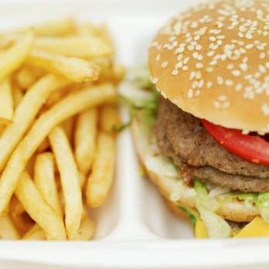
Most of the foods we eat contain energy.
Must of the energy in a hamburger, for example, is stored in proteins, carbohydrates, and fats.
But before you can use that energy, it must be released and transferred to ATP.
Cells of most organisms, your cells transfer the energy in organic compounds, especially the glucose made during photosynthesis, to ATP through cellular respiration, which begins with glycolysis.

Slide 53
Glycolysis
The primary fuel for cellular respiration is glucose, which is formed when carbohydrates, such as starch and sucrose, are broken down.
If too few carbohydrates are available to meet an organism’s energy needs, other molecules, such as fats, can be broken down to make ATP.
In fact one gram of fat releases more energy than two grams of carbohydrates do. Protein and nucleic acids can be used to make ATP, but they are usually used for building important cell parts.

Slide 54
Steps of glycolysis
In the first stage of cellular respiration, glucose is broken down in the cytoplasm by glycolysis. In glycolysis, enzymes break one six-carbon molecules of glucose into two three-carbon pyruvate molecules. Most of the energy that was stored in a glucose molecule is stored in the pyruvate.
Glycolysis—the anaerobic breakdown of glucose to pyruvate, which makes a small amount of energy available to cells in the form of ATP.

Slide 55
Step 1—Breaking Down Glucose
Two ATP molecules are used to break glucose into two smaller units. This stage has 4 steps with 4 different enzymes. A phosphate group from ATP is added to the six-carbon compound. This makes the molecule reactive so that an enzyme can break it into two three-carbon sugars, each with a phosphate group. ATP is produced in the next two stages.

Slide 56
Step 2—NADH Production
Three-carbon compounds reacts with another phosphate group (not from ATP). As the two three-carbon sugars reacts further, hydrogen atoms, including their electrons, are transferred to two molecules of NAD⁺, which produces two molecules of the electron carrier NADH. NADH is used later in other cell processes, where it is recycled to NAD⁺.

Slide 57
Step 3—Pyruvate Production
In a series of four reactions, each three-carbon sugar is converted into a three-carbon molecule of pyruvate. This process produces four ATP molecules. Thus, the breaking of a sugar molecule by glycolysis results in a net gain of two ATP molecules.
Glycolysis is the only source of energy for some prokaryotes.
This process is anaerobic, so it takes place without oxygen.
Other organisms use oxygen to release even more energy from a glucose molecule.

Slide 58
Metabolic processes that require oxygen are aerobic. In aerobic respiration, the pyruvate produce of glycolysis undergoes another series of reactions to produce more ATP molecules.
What are the three products of glycolysis?
Pyruvate, ATP, & NADH

Slide 59
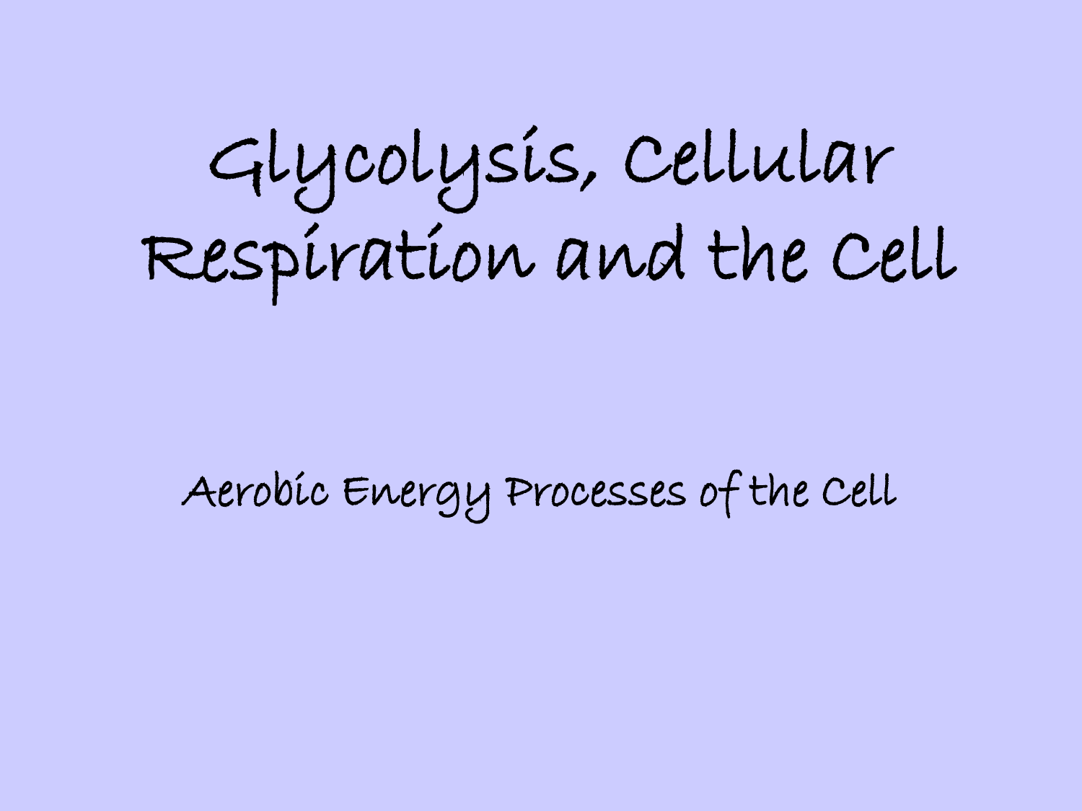
Anaerobic--describes a process that does not require oxygen.
Aerobic—describes a process that requires oxygen.

Slide 60
Aerobic Respiration
Organisms such as humans can use oxygen to produce ATP efficiently through aerobic respiration. Pyruvate is broken down in the Krebs cycle, series of reactions that produce electron carries. The electron carriers enter an electron transport chain, which powers ATP synthase. Up to 34 ATP molecules can be produced from one glucose molecule in aerobic respiration.
Krebs cycle--a series of biochemical reactions that convert pyruvate into carbon dioxide and water.

Slide 62
Krebs Cycle
The Krebs cycle begins with pyruvate, which is produced during glycolysis. Pyruvate releases a carbon dioxide molecule to form a two-carbon compound. An enzyme attaches this two-carbon compound to a four carbon compound and forms a six-carbon compound.
The six-carbon compound releases one carbon dioxide molecule and then another. Energy is released each time, which forms an electron carrier, NADH. The remaining four-carbon compound is converted to the four-carbon compound that begin the cycle.

Slide 63
This conversion takes place in a series of steps that produce ATP, then FADH₂ and another NADH. The four-carbon compound combines with a new two-carbon unit from pyruvate to continue the cycle.
Products of the Krebs Cycle
The total yield of energy-storing products from one time through the Krebs cycle is one ATP, and three NADH, and one FADH₂. Electron carriers transfer energy through the electron transport chain, which ultimately powers ATP synthase.

Slide 64
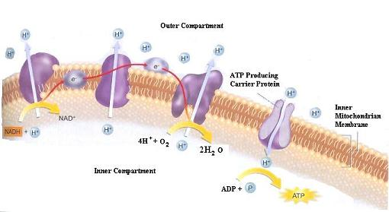
Electron Transport Chain
The second stage of aerobic respiration takes place in the inner membranes of the mitochondria. Recall the electrons pass through a series of molecules called an electron transport chain.

Slide 65
Look at Figure 13 on page 211
1—electrons that are carried by NADH and FADH₂ pass through this chain. Energy is transferred into each molecule through which the electrons pass. Some of the molecules are hydrogen ions.
2—energy from the electrons is used to actively transport hydrogen ions H⁺, out of the inner mitochondrial compartment. As H⁺ accumulate in the outer compartment, a concentration gradient across the inner membrane is created.

Slide 66
ATP Production
The enzyme ATP synthase is also present on the inner membranes of mitochondria.
3—hydrogen ions diffuse through a channel in this enzyme. This movement provides energy, which is used to produce several ATP molecules from ADP.

Slide 67
The Role of Oxygen
At the end of the electron transport chain, the electrons have given up most of their energy.
4—oxygen atom combines with these electrons and 2 H⁺ ions to form two water molecules, H₂O. If oxygen is not present, the electron transport chain stops. The electron carriers cannot be recycled, so the Krebs cycle stops. The electron carriers cannot be recycled, so the Krebs cycle also stops. Without oxygen, a cell can produce ATP only by glycolysis.

Slide 68
Fermentation
Many prokaryotes live entirely on the energy released in glycolysis.
Under anaerobic conditions the electron transport chain, if present does not work. Organism must have another way to recycle NAD⁺. So, electrons carried by NADH are transferred to pyruvate, which is produced during glycolysis. This process in which carbohydrates are broken down during the absence of oxygen, called fermentation, recycles the NAD⁺ that is needed to continue making ATP through glycolysis.

Slide 69
In Fermentation enables glycolysis to continue supplying a cell with ATP in anaerobic conditions.
Two types of fermentation are lactic acid fermentation and alcohol fermentation.
Fermentation--the breakdown of carbohydrates by enzyme, bacteria, yeast, or mold in the absences of oxygen.

Slide 70
Lactic Acid Fermentation
Recall that the end products of glycolysis are three-carbon pyruvate molecules. In some organisms pyruvate accepts electrons and hydrogen from NADH. Pyruvate is converted to lactic acid in a process called lactic acid fermentation.
This also occurs in muscles of animals, including humans.
During vigorous exercise, muscle cells must operate without oxygen. So glycolysis becomes the only source of ATP as long as the glucose supply lasts. For glycolysis to continue, NAD⁺ is recycled by lactic acid fermentation.

Slide 72
Alcohol Fermentation
In other organisms, an enzyme removes carbon dioxide from the three-carbon pyruvate to form a two-carbon molecule. Then a second enzyme adds electrons and hydrogen from NADH to the molecule to form ethanol (ethyl alcohol) in a process called alcohol fermentation.
In this process, NAD⁺ is recycled and glycolysis can continue to produce ATP.

Slide 74
Efficiency of Cellular Respiration
The total amount of ATP that a cell harvests from each glucose molecule depends on the presence or absence of oxygen.
First stage of cellular respiration, glucose is broken down to pyruvate during glycolysis. Glycolysis is an anaerobic process, and it results in a net gain of 2 ATP molecules.
Second stage of cellular respiration, pyruvate either passes through the Krebs cycle or undergoes fermentation. When oxygen is not present, fermentation occurs.

Slide 75
The NAD⁺ that is recycled during fermentation allows glycolysis to continue producing ATP.
Cells release energy more efficiently when oxygen is present because they make most of their ATP during aerobic respiration. For each molecule of glucose that is broken down, as many as two ATP molecules are made during the Krebs cycle. The Krebs cycle feeds NADH and FADH₂ to the electron transport chain. The electron transport chain can produce to 34 ATP molecules.

Slide 76
Questions
What are the three produces of glycolysis?
Pyruvate, ATP, and NADH.
Why is glycolysis important to the Krebs cycle?
Glycolysis breaks down glucose into pyruvate, which is small enough to diffuse across mitochondrial membranes into the mitochondria, where the Krebs cycle takes place.

Slide 77
Explain how fermentation recycles NAD⁺.
Electrons carried by NADH are transferred to pyruvate produced during glycolysis.

